Slide 1
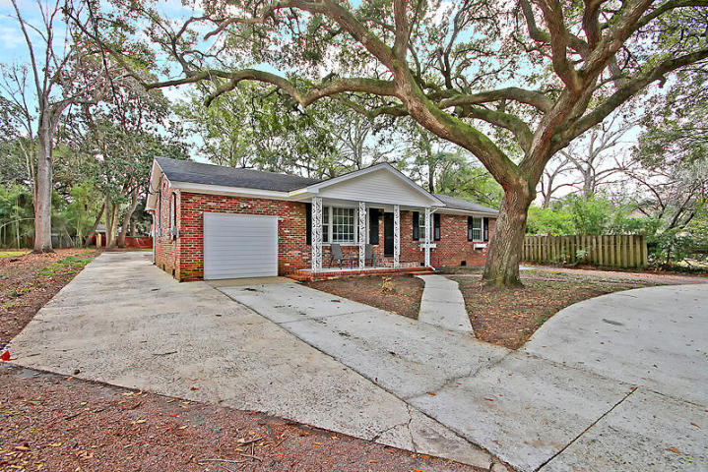
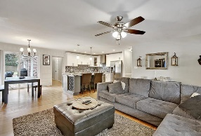
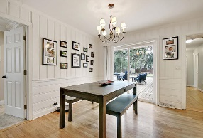
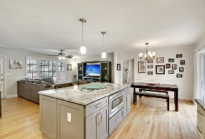
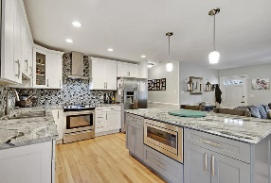
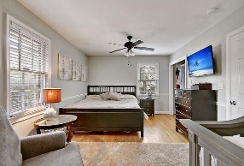
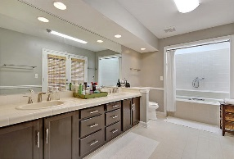
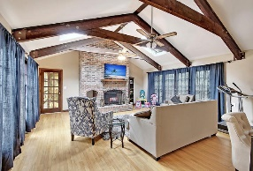
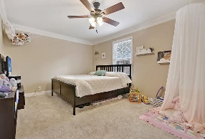
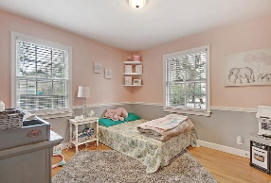
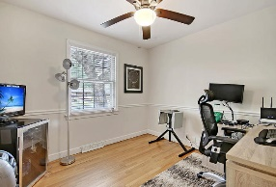
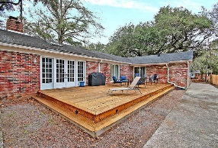
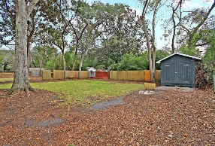


Updated One-story just 15 mins to Downtown
1451 River Front Drive
Orange Grove Estates
Charleston, SC 29407
MLS# 19001909
$379,000
4 Bedrooms | 3 Baths | 2,262 sf
Welcome to 1451 River Front Dr! Gorgeous, renovated, one story home close to it all! Just a fifteen minute drive to downtown Charleston and to the airport! This home has great curb appeal which you will notice as soon as you pull up to the house! A lovely grand oak, circular driveway and front porch greet you! Upon entering the home, you'll immediately be drawn to the welcoming feel of the stunning kitchen open to the living room . The kitchen has been newly renovated and offers a large island that can seat two and has both a built in microwave and wine rack. The granite countertops, beautifully tiled backsplash and stainless steel appliances give this kitchen an elegant look. The eat in kitchen area is large and has access to the back deck. Off the living room is one of the two master bedrooms. This is a very large room and can be used as a master bedroom, mother in law suite, teen suite or perfect as a guest room. On the other side of the home, there are two more bedrooms, both with wood flooring, as well as the second master bedroom. This master suite has three closets, wood floors, a large master bath with dual vanities as well as outside access to the big backyard. In the rear of the home is another full updated bath, large laundry room, which offers storage space, as well as a gorgeous family room. The family room is stunning! Beautiful beamed, vaulted ceilings, brick wood burning fireplace, tons of natural light, wood floors and access to the back deck. Beyond the family room is the two car garage which offers built in shelving. The backyard is very large and has a shed for extra storage. This home has it all and is close to it all! No need to look any further!
Larry & Kathy Mazalatis
Larry Cell 843-693-0529
Kathy Cell 843-693-0159
Office 843-871-9133
AGENTOWNED PREMIERE GROUP | 1800 TROLLEY RD | SUMMERVILLE, SC 29485

