Slide 1
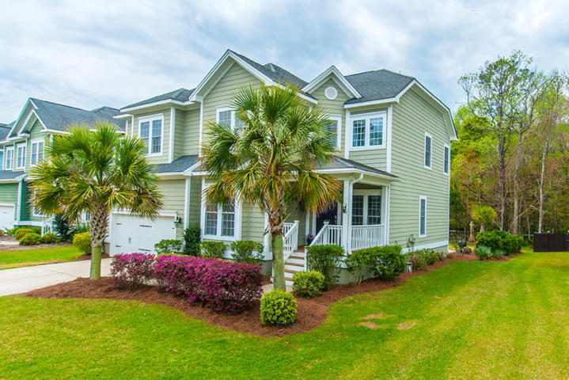
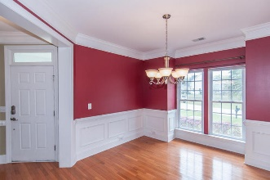
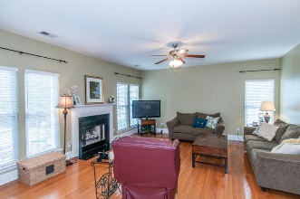
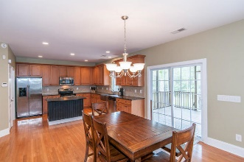
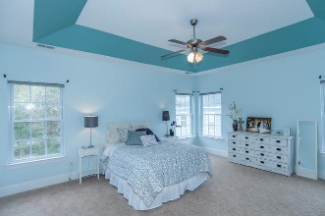
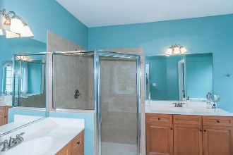
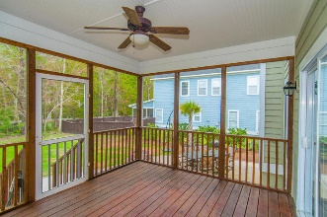

New Adjusted Price!
Open House Saturday 12-3 Refreshments Provided
1452 Saint Hubert Way
Hunt Club :: Charleston, SC 29414 :: MLS# 16008036 :: $399,900
Beautiful, FOUR BEDROOMS plus BONUS ROOM (could be 5th bedroom), 3.5 BATHROOMS, large LowCountry style open floor plan, updated and well maintained home in the desirable Hunt Club. The home has great curb appeal, nice front porch that brings you into the entry foyer with an office, Dining Room with room for a large table, open kitchen and den with high ceilings and lots of space for entertaining. The large backyard has a screen porch and patio with fire pit. Upstairs you will find 4 bedrooms plus the Bonus Room. Hardwood floors downstairs, on the stairs, and through the hallway and in the bonus room. Updated new Trane 16 SEER HVAC unit is very efficient. The bedrooms are all great size. The floorplan is very inviting and accommodating for any buyer. Nice quiet street. Come see it today!
Scott Baskin
843-324-4139 M | 843-972-2400 O scott.r.baskin@gmail.com | www.scottbaskin.com
RE/MAX Advanced Realty
311 Johnnie Dodds Blvd
Mt Pleasant, SC 29464

