Slide 1
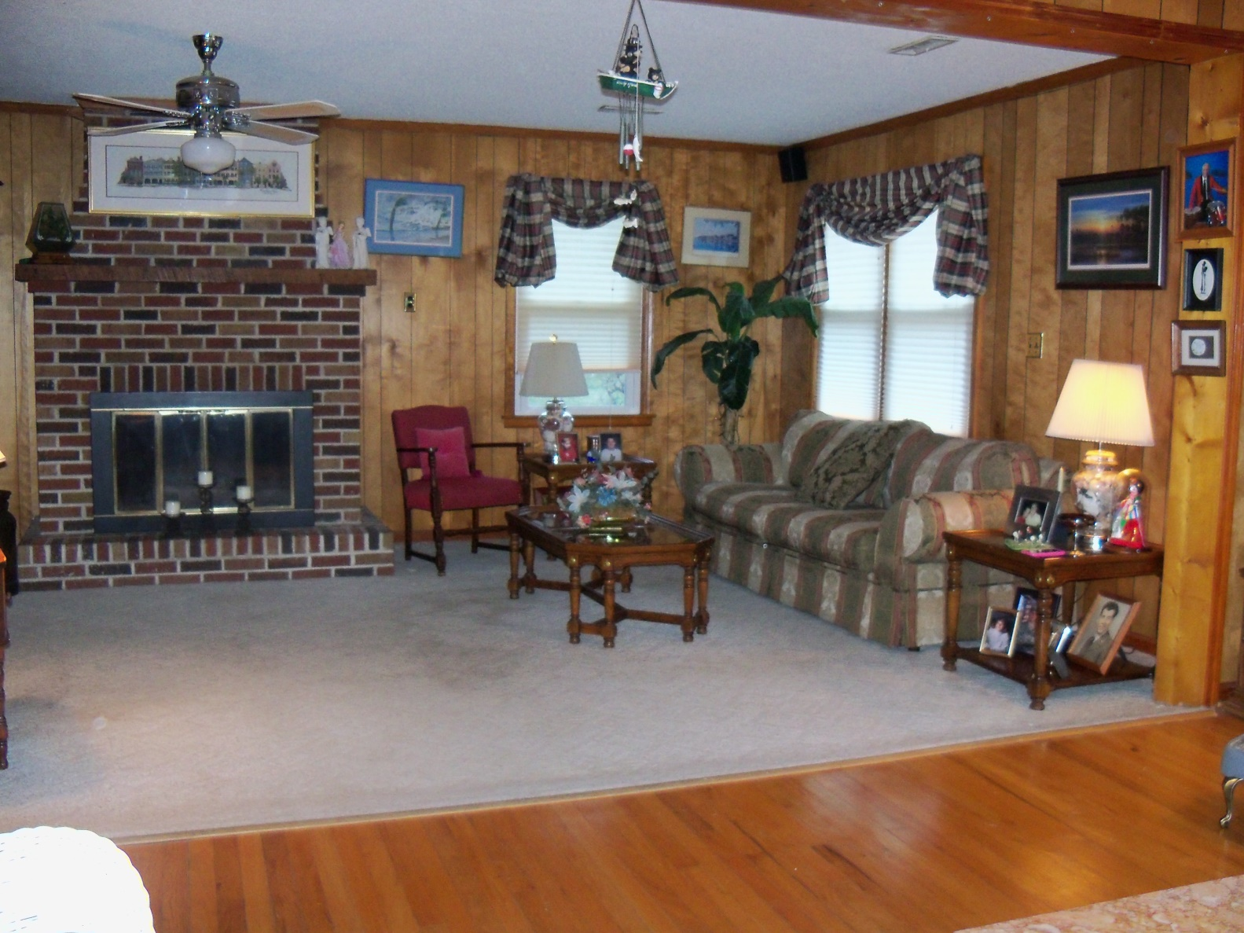
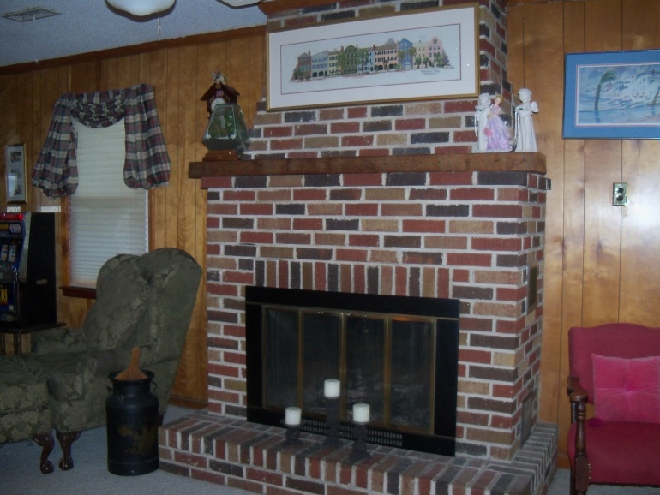
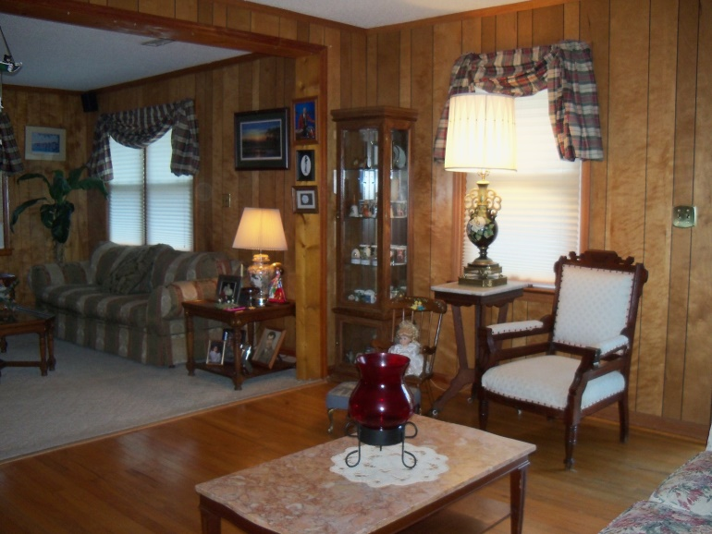
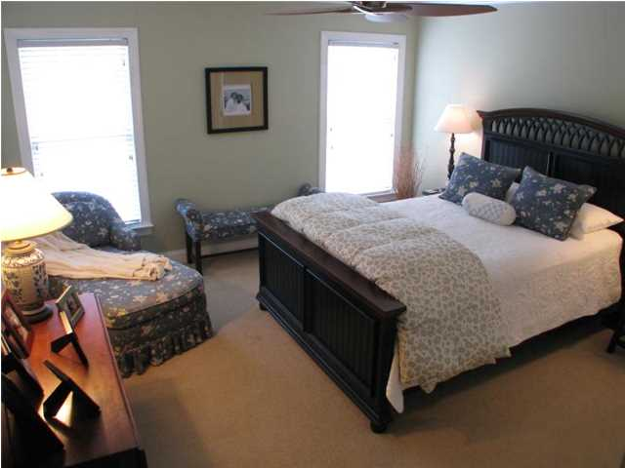
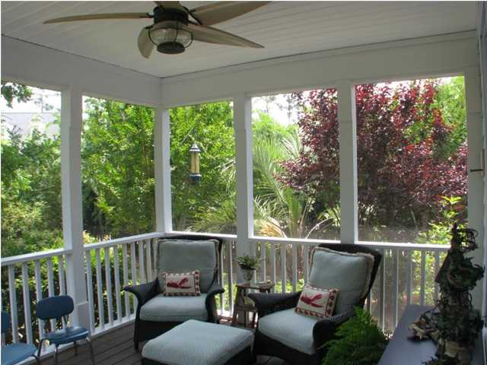
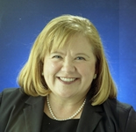

1453 Seminole Street Old Mount Pleasant
Wine and Cheese Agent Preview ~ Friday, Feb 6th, 2:30-5
Contact Cheryll for details.
Cheryll Woods-Flowers
ABR, e-Certified, SHS
(843) 442-2219
www.woodsflowers.com

