Slide 1
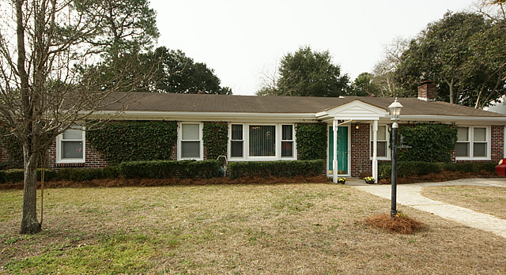
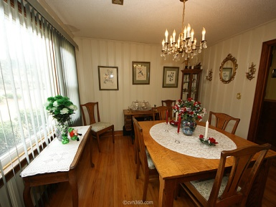
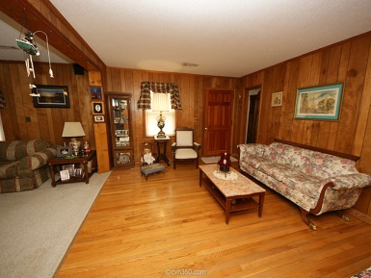
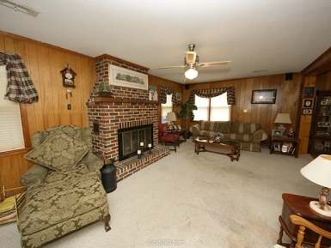
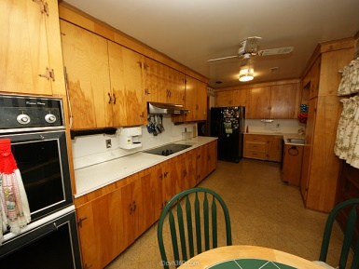
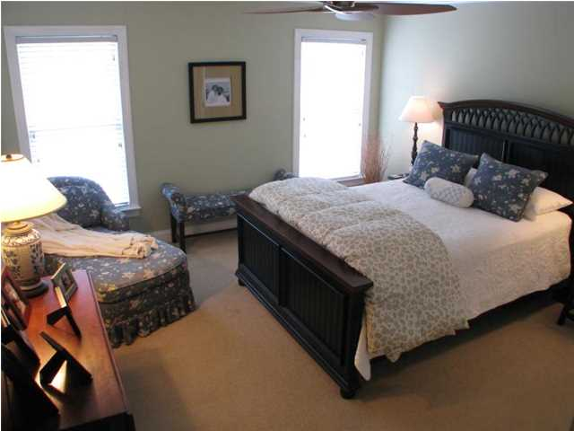
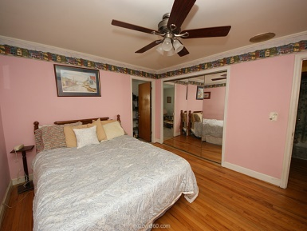
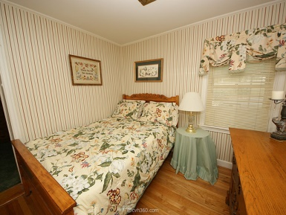
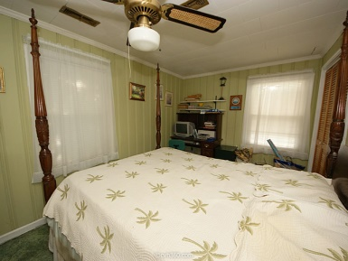
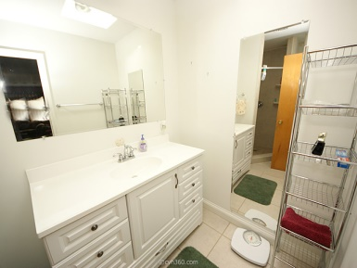
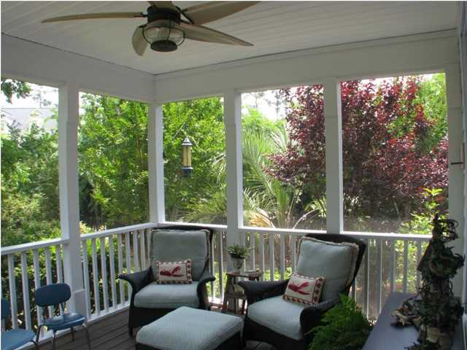


1453 Seminole Street Old Mount Pleasant ~ MLS# 15003188 ~ $395,000
4BR/2BA in one of the most sought out areas of Mount Pleasant, SC (no flood insurance required), within walking distance of Mount Pleasant Academy and Moultrie and within a 10 minute drive or biking distance to beach at Sullivans Island, shopping, parks, Farmers Market, and restaurants...Home is all Brick with vinyl trim and vinyl windows, custom cabinets, original hardwood floors that are in good shape in all rooms except kitchen (vinyl), two baths (tile, and two of the bedrooms (carpet), open family room, Formal Dining room that could be used for office, or playroom, LOTS of windows, Money for floor replacement will be escrowed at closing and pool could also potentially be filled by seller, Seller will consider making other repairs/changes dependent on price.
No Flood Insurance in Old Mount Pleasant, Seller to Replace Roof
Cheryll Woods-Flowers
ABR, e-Certified, SHS
(843) 442-2219
www.woodsflowers.com

