Slide 1
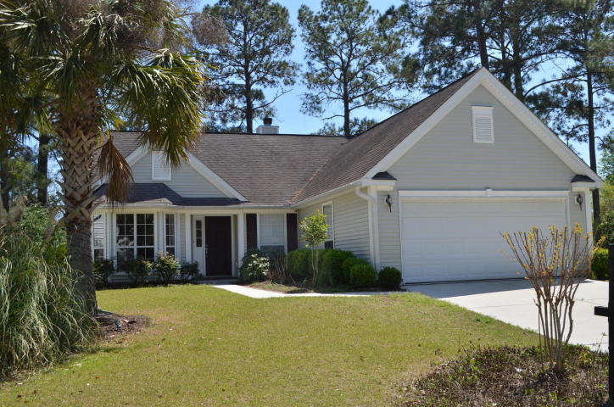
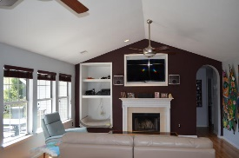
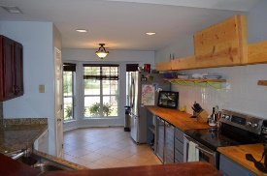
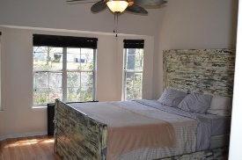
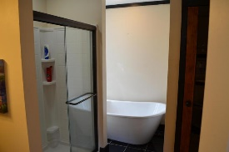
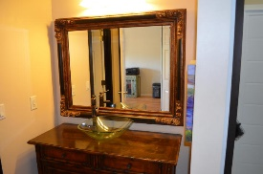
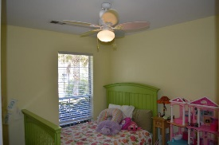
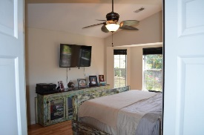
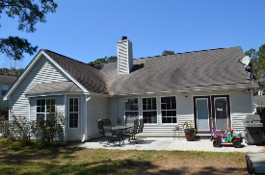
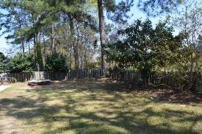
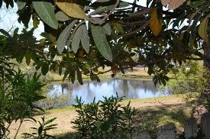

Amazing Value In Dunes West!!
1453 Water Oak Cut
Mount Pleasant ~ MLS# 17008791 ~ $320,000
This lovely ONE STORY home is located in the heart of Mt. Pleasant in the premier subdivision of award-winning Dunes West. This 3 BR/2 Bath home features abundant natural light throughout the open space living area. You will find upgrades throughout the home including built-in cabinet beside the wood burning fireplace, custom lighting, custom kitchen countertop, and custom beverage coolers. The large living room is great for entertaining as it is open to the dining and kitchen area. There is a large master bedroom and upgraded master bath complete with separate water closet, large soaking tub, custom cabinet sink as well as a full walk-in closet. Two additional bedrooms are down the hall and share a full bath. You will find a separate mudroom/laundry area that is accessible to the 2 stall garage. All of this and a large, fully fenced yard with mature trees overlooking a beautiful pond can be yours!
Dunes West offers a membership to an award winning golf course, club house, three pools, tennis club, boat ramp and boat storage plus tons of walking paths. Dunes West is conveniently located close to shopping, dining, the beaches and minutes from the new Roper St. Francis hospital and a short drive to historic, downtown Charleston.
Wendy Deitsch
O - (843) 491-1445
M - (843) 270-0433
wendy@lifetreeliving.com
LifeTree Real Estate, LLC
3094 Hwy 17 North
Mt. Pleasant, SC 29466
www.lifetreerealestate.com

