Slide 1
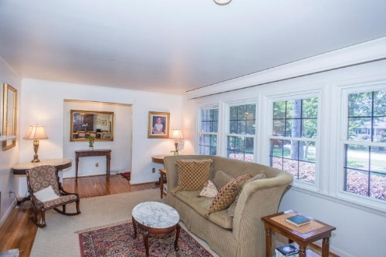
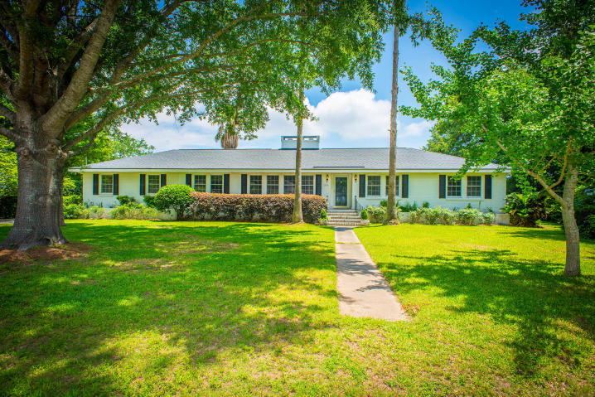
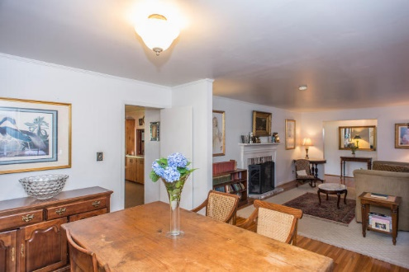
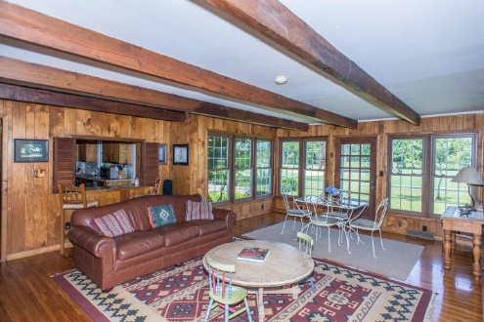
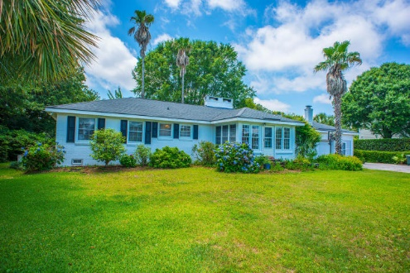
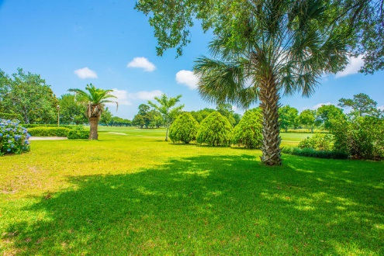
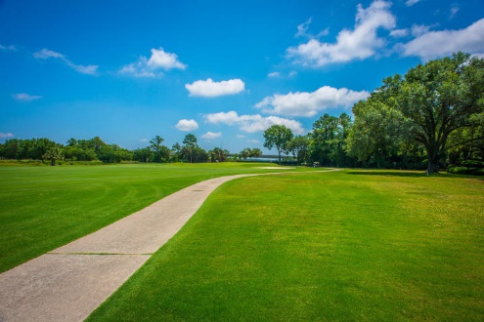

Country Club of Charleston
Reduced to Sell ~ Motivated Seller
$695,000
3 Bedroom
2 Bath
2,264 Sq Ft
1455 Burningtree Road
Country Club II
Charleston, SC
MLS# 15015101
This beautiful home is located only minutes from downtown Charleston in the very desired neighborhood of Country Club II. Located on the 5th fairway of the Country Club of Charleston's award winning golf course this house features views of holes #5,6,7 and the harbor beyond.
The home itself sits on .4 acre of a beautifully landscaped lot with over 40 hydrangea bushes in full bloom and a very rare Canary palm tree. The classic 3 bedroom, 2 bath ranch layout boast 2 fireplaces, hardwood floors and spacious living areas throughout.
In addition there is a bonus room off the garage that could be used as a home office, guest quarters or renovated into a large master suite. This home with its amazing location and incredible views is a must see.
Melanie Thornhill, Realtor®
(843) 270-8997
melaniethornhill1@gmail.com
www.hanlangroup.com
Hanlan Consulting and Development
241-243 East Bay St · Charleston, SC 29401

