Slide 1
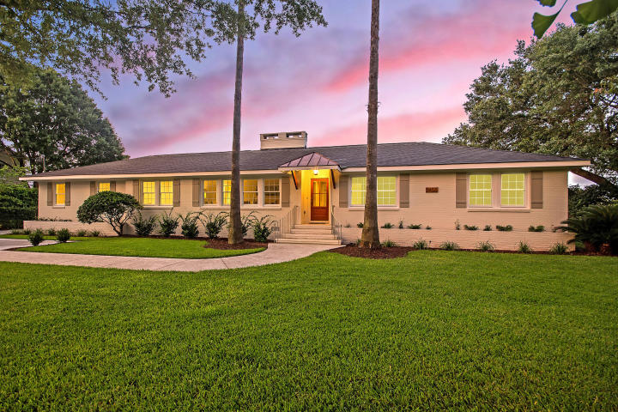
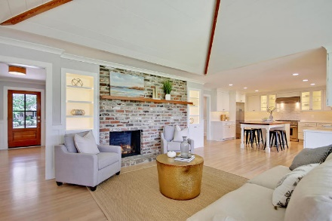
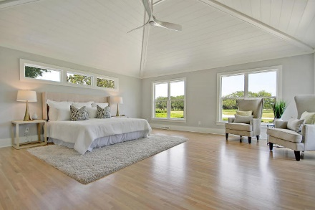
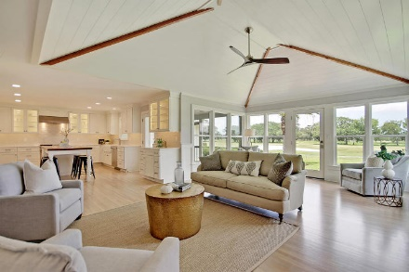
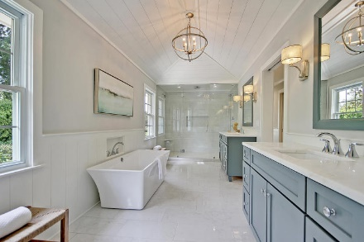
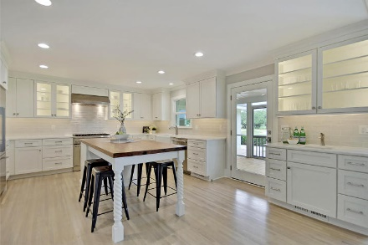
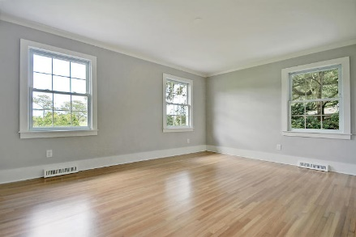
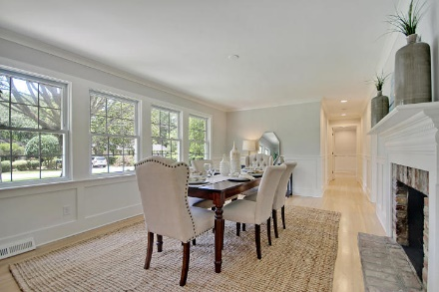
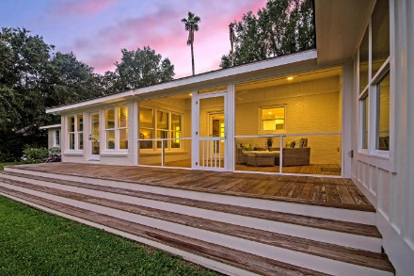
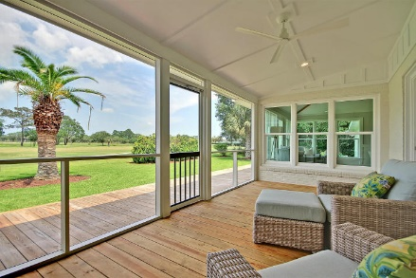
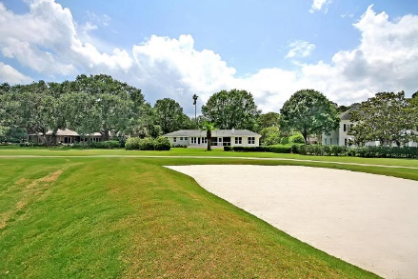
Price Reduced in Dunes West!
New A/C Units With Nest Controllers PLUS a 10 Year Warranty
Price Reduced!
1455 Burningtree Road
Country Club II ~ Charleston, SC 29412 ~ MLS# 18017182 ~ $1,495,000
1959 Brick Ranch charm meets 2018 Luxury Home comfort! Backing up to the scenic County Club of Charleston Golf Course, this "down to the studs" renovation is astounding! From the lush landscaping that greets you, to the design details found throughout, this home is set to impress.The kitchen is magnificent with custom medallion cabinetry, African marble counters, a heart-of-pine island & gorgeous Thermador appliances. The open floor plan with its vaulted shiplap ceiling, fireplace with reclaimed brick surround, & 2nd fireplace in the formal dining, are all sun drenched & inviting spaces.The 1,000+ square foot master retreat will not be forgotten with dual walk-in closets, shiplap ceilings & luxurious master bath. Come see for yourself, & you won't ever want to leave James Island!
Additional features include:
A short drive to downtown Charleston and Folly Beach
Reclaimed heart pine beams preserved from original home thoughtfully repurposed throughout home
Sweeping views of the golf course
Large rear deck
Extensive interior trim work with wainscoting throughout
Shiplap ceilings in family room, master bedroom, and master bath
1,000+ ft2 of space dedicated to master suite with dual walk-in closets and expansive master bedroom
Master bath with grand shower (featured on p.170 of Charleston Home + Design Magazine, Spring 2018)
Strategically placed wet bar easily accessed from all living spaces
Book your viewing today!
Madalyn Hull | 864-483-2991
madalyn@mattoneillteam.com
Nate Gainey | 843-513-2038
nate@mattoneillteam.com

