Slide 1
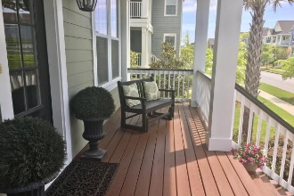
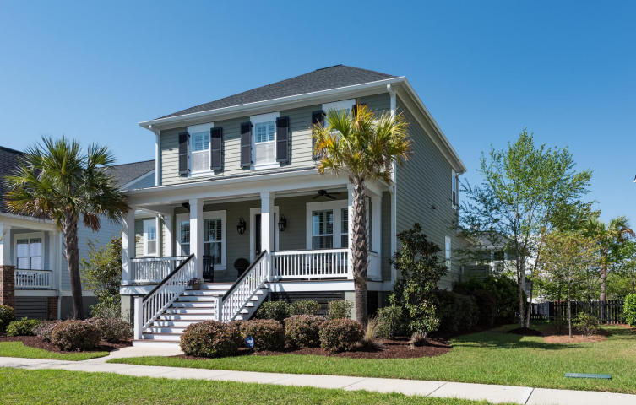
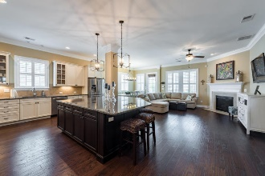
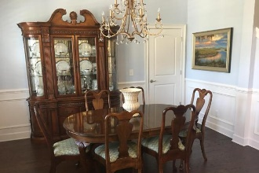
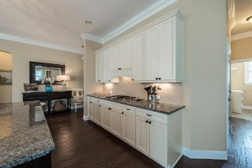
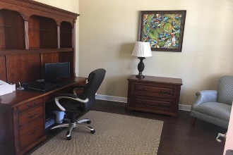

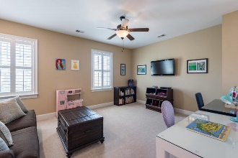

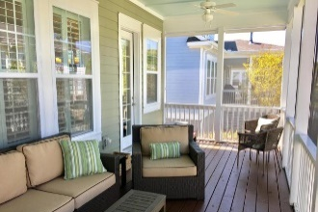
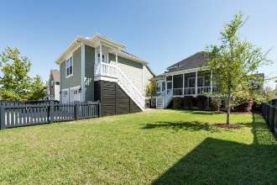

1458 Wando Landing Street Daniel Island ~ Charleston MLS# 17009802 ~ $859,900
Open Floor Plan on Daniel Island
Great location near park, school, library
5 bedrooms includes a frog with kitchenette and a first floor master
Open floor plan
Screened porch
Large backyard
Meticulous home!
Don't miss out on this wonderful opportunity!!
Donna Landry
Mobile - (225) 921-2111
donna.landry@cbunited.com
Coldwell Banker Residential Brokerage
1127 Queensborough Blvd. 103
Mt Pleasant, SC 29464
Betsy Sarsfield
(724) 816-9445
betsysarsfield23@gmail.com

