Slide 1
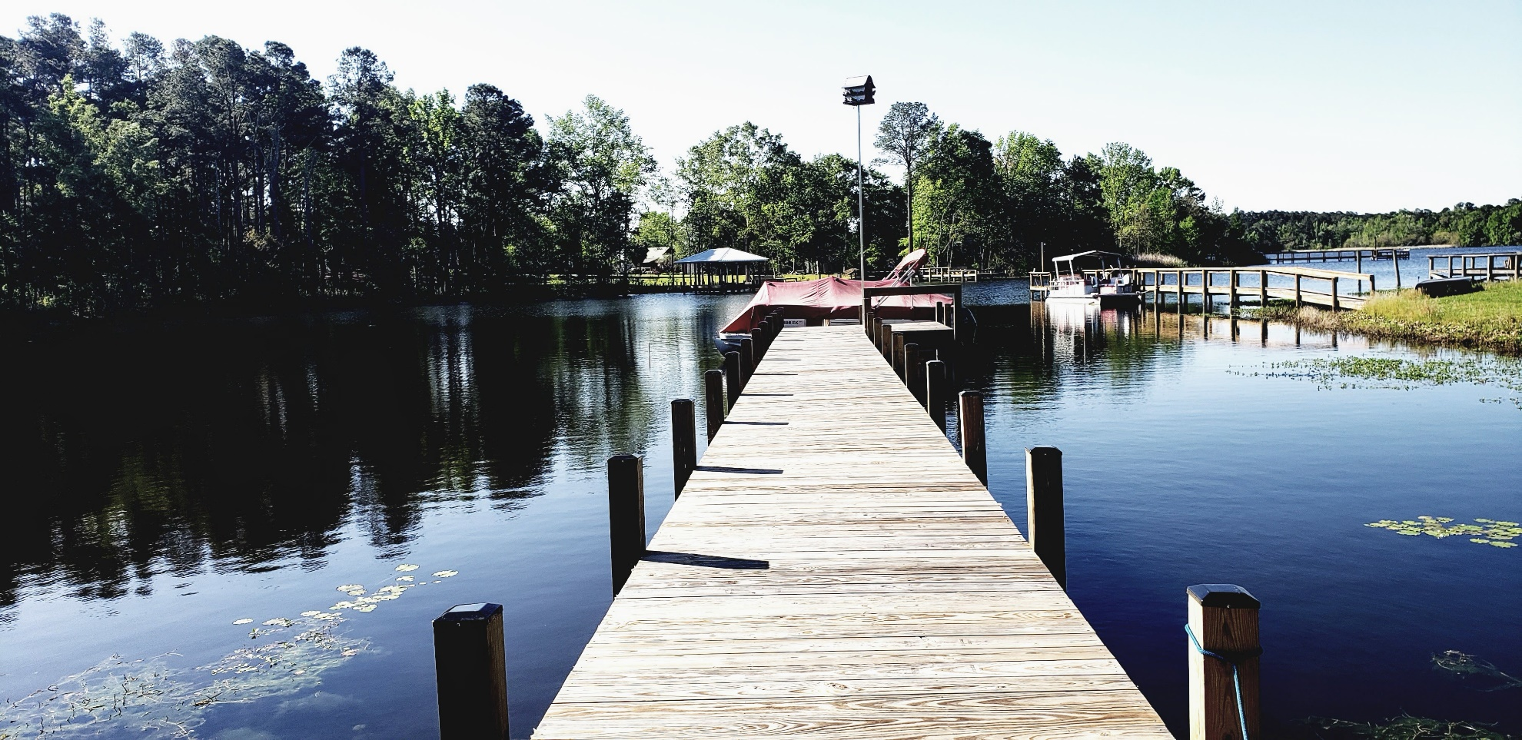
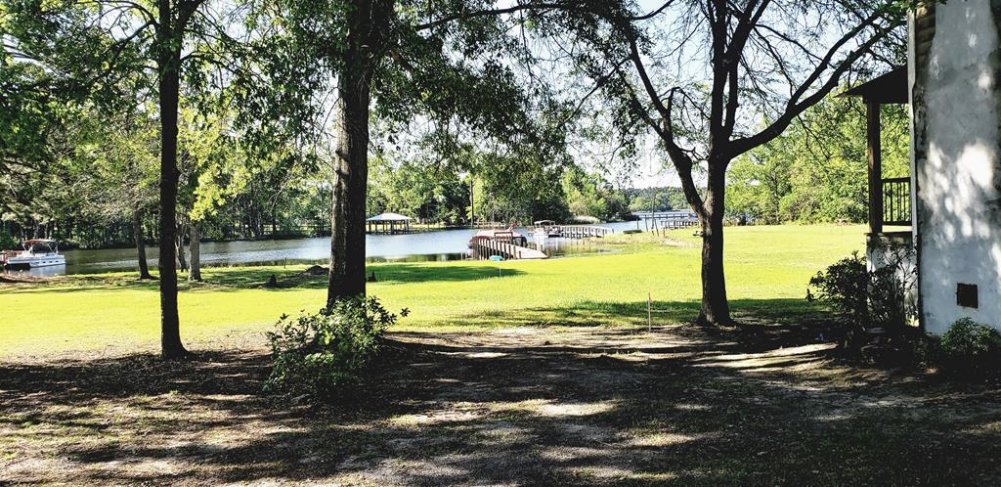
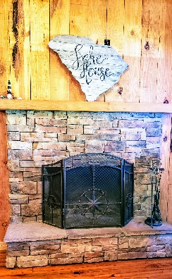
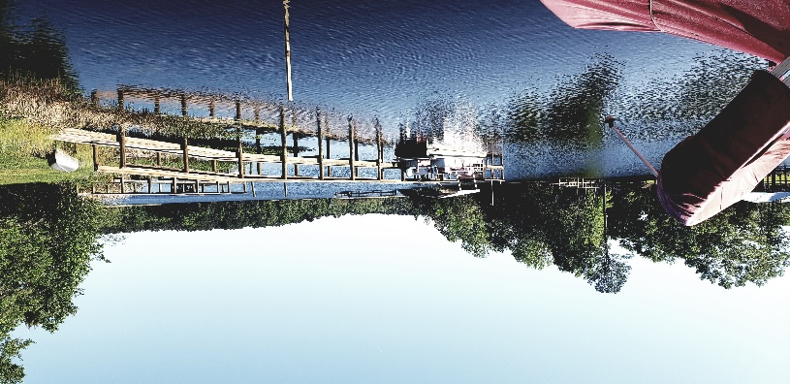
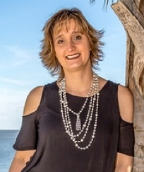
Looking For That Cabin On The Lake?
1459 Greenall Rd
Summerton, SC ~ MLS# 151038 ~ $365,000
This is the one for you! Rustic cabin get a way with a Sandy Beach and new Dock just off potato creek. Make this your full time home or just the weekend getaway from the urban life. Enjoy the sights and sounds of the Largest Lake in SC with boatable access to the ATLANTIC OCEAN. Set sail and travel through Lake Marion and Lake Moutire and experiance the Pinopplous Locks to enter the Cooper River system ending at the Charleston Harbor. Hardwoods through out the home. Home comes furnished. Just bring the suitcase and the lake toys. Storage shed would hold all the rafts and floats. Parking for the boats and trailers. Ramp is shared in the neighborhood privately. Under 400k this one will not last long. Fiber Internet - work from the dock!
Lake Homes Realty, LLC
Elloree, SC 29047
www.SCLakeLife.com
Kristie Anderson
(803) 387-9459
kristie@sclakelife.com

