Slide 1

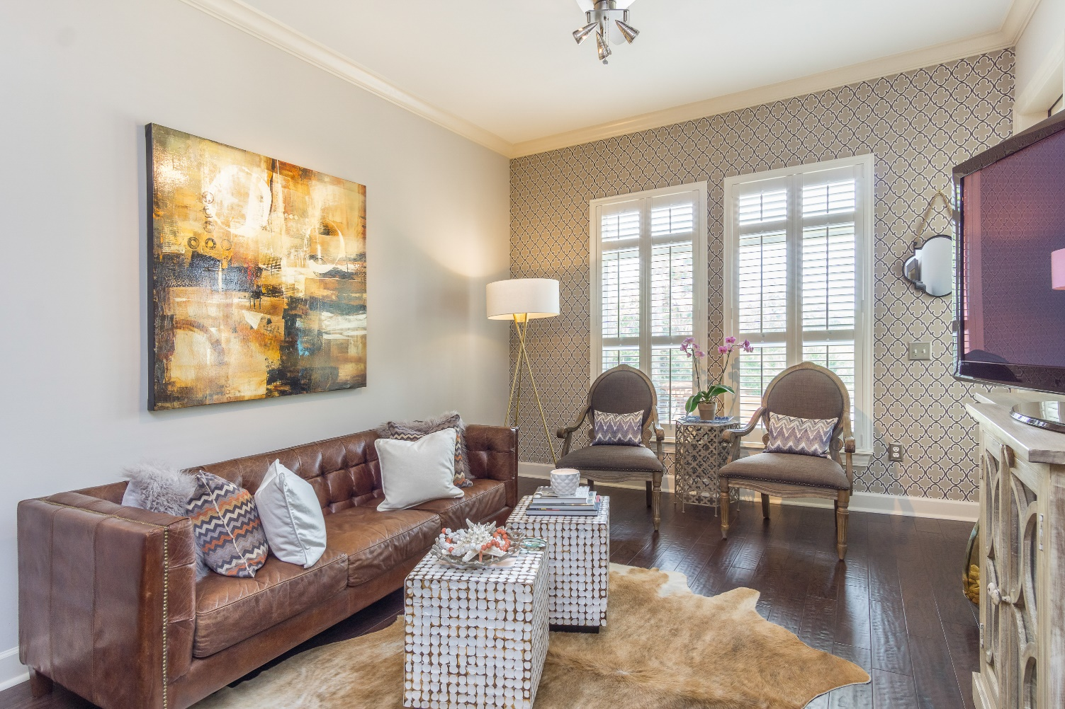
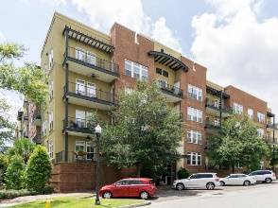
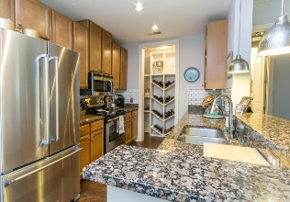
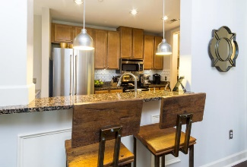
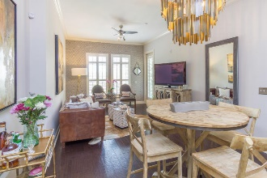
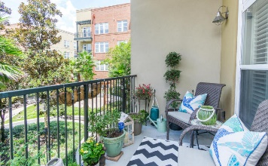
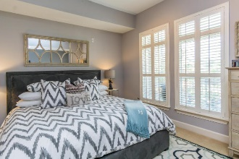
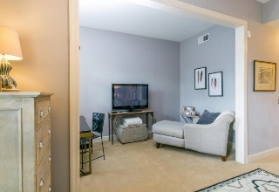
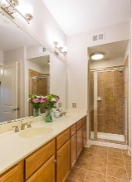
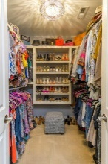
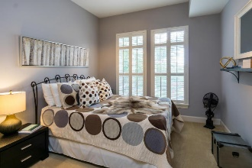
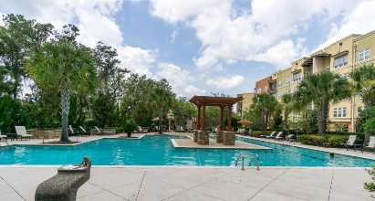

You'll LOVE This Luxury Condo … And Its New Price!
145 Pier View Street #210
Daniel Island ~ Charleston, SC 29492 ~ MLS# 17022812 ~ $359,500
GET READY TO LOVE THIS HOME!
Tons of upgrades! This is a 2nd floor unit with 2 bedrooms, 2 baths and easy access to the elevator, lovely views of the courtyard/pool and gorgeous sunsets. New hardwood floors in main living area, upgraded trim package, high ceilings and new Kitchen-aid appliances in the kitchen. New plantation shutters throughout and fresh paint. Custom built-ins in the master closet, guest bedroom closet and coat closet in the entry. The pantry is a wine lovers dream with custom built-in shelving! Be sure to check out the custom barn doors on the laundry room and built-in cabinetry within. Further recent additions include; a Nest Thermostat, new kitchen faucet, and keyless entry. The resort style swimming pool is just 150 ft from your door & comes with a brand new community grille.
Andrew Tackitt
(843) 437-8726
andrew@radekopf.com
1205 Two Island Court, Suite 201 Mount Pleasant, SC 29466 Phone: (843) 579.2217 Fax: (843) 971-0281
Erin Quinn Hanhauser
(843) 743-8204
erin@radekopf.com

