Slide 1

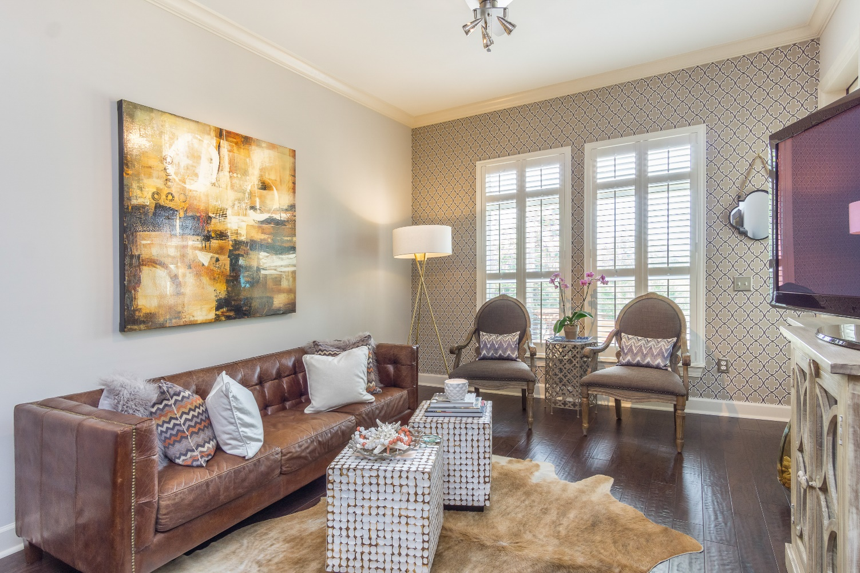
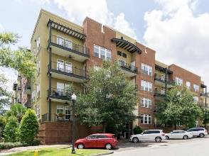
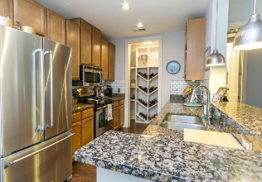
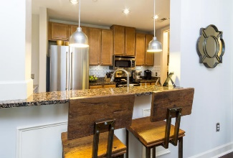
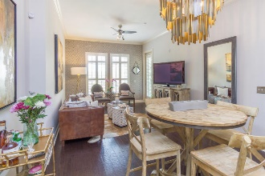
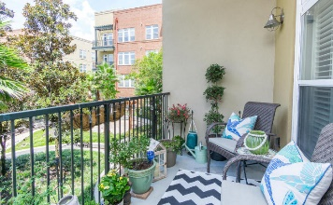

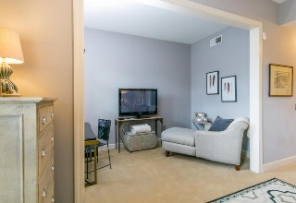
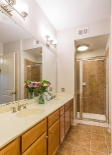


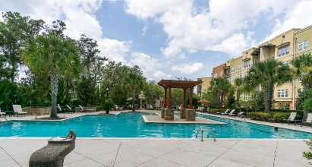

You'll LOVE This Luxury Condo … And Its New Price!
145 Pier View Street #210
Daniel Island ~ Charleston, SC 29492 ~ MLS# 17022812 ~ $358,880
GET READY TO LOVE THIS CONDO!
Tons of upgrades! This is a 2nd floor unit with easy access to the elevator, lovely views of the courtyard/pool and gorgeous sunsets. New hardwood floors in main living area, upgraded trim package, high ceilings and new Kitchenaid appliances in the kitchen. New plantation shutters throughout and fresh paint. Custom built-ins in the master closet, guest bedroom closet and coat closet in the entry. The pantry is a wine lovers dream with custom built-in shelving! Be sure to check out the custom barn doors on the laundry room and built-in cabinetry within. Further recent additions include; a Nest Thermostat, new kitchen faucet, and keyless entry. The resort style swimming pool is just 150 ft from your door & comes with a brand new community grille. Subway tile back-splash in the kitchen was added in the spring of 2017. This condo is located just a short walk to several miles of walking /jogging/ biking trails, several area downtown restaurants/shops and the Volvo Car Stadium.
Andrew Tackitt
(843) 437-8726
andrew@radekopf.com
1205 Two Island Court, Suite 201
Mount Pleasant, SC 29466
Phone: (843) 579.2217
Fax: (843) 971-0281
Erin Quinn Hanhauser
(843) 743-8204
erin@radekopf.com

