Slide 1

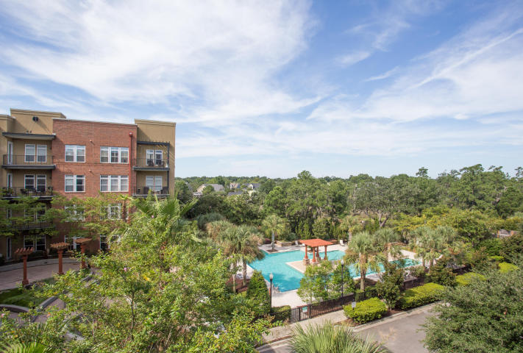
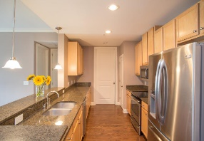
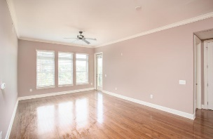
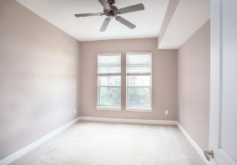
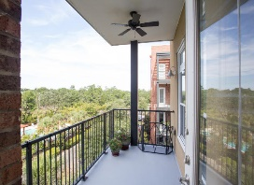
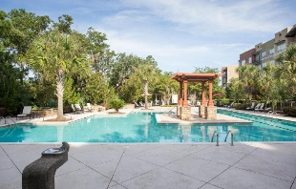


PRICE REDUCED to $368,800 MOVE-IN READY!
145 Pier View Street #302
Daniel Island, SC 29492 ~ MLS# 18021489 ~ $368,800 ~ 2BR/2BA
VIEWS VIEWS VIEWS!
This 3rd floor, corner/end unit has scenic views of the marsh, pool/courtyard and gorgeous sunsets. Enjoy a glass of wine in the evening or watch the sun rise with a cup of coffee on your private balcony. Hardwood floors throughout the main living area, high ceilings and a NEW, eco-friendly Pardee HVAC system. NEW interior paint Aug 2018.The resort-style swimming pool is less than 125 ft from your door & comes with a new community grille. This condo is located just a short walk to walking /jogging/ biking trails, community fishing pier/dock, several area downtown restaurants/shops and the Volvo Car Stadium.
Andrew Tackitt
(843) 437-8726
andrew@radekopf.com
1205 Two Island Court, Suite 201 Mount Pleasant, SC 29466 Phone: (843) 579.2217 Fax: (843) 971-0281
Erin Quinn Hanhauser
(843) 743-8204
erin@radekopf.com

