Slide 1
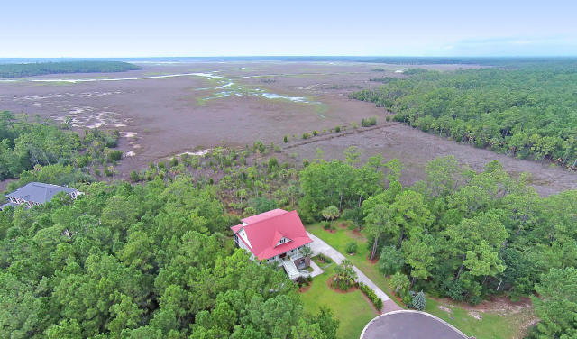

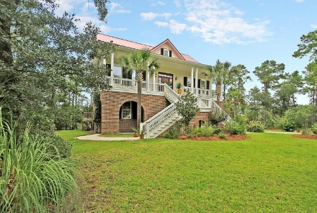
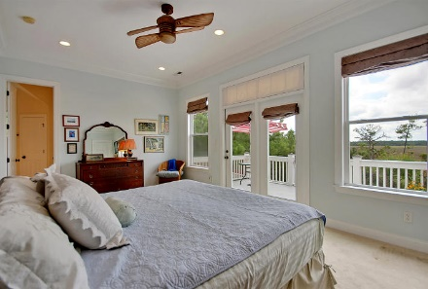
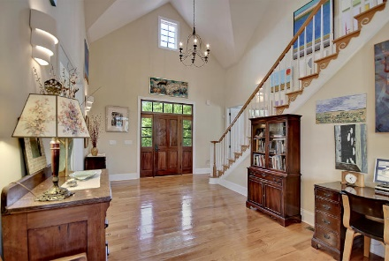
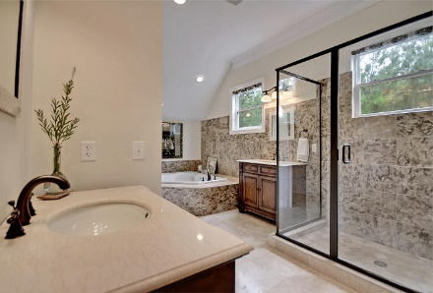
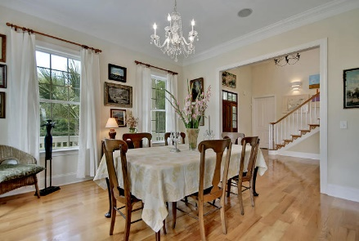
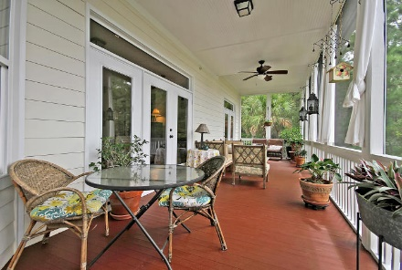
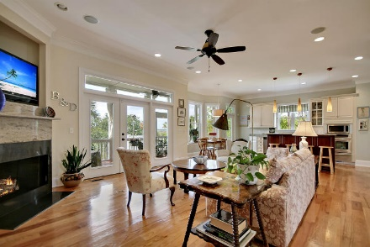
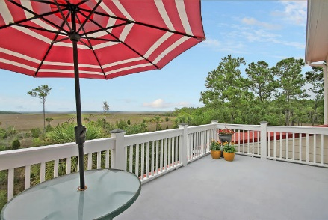
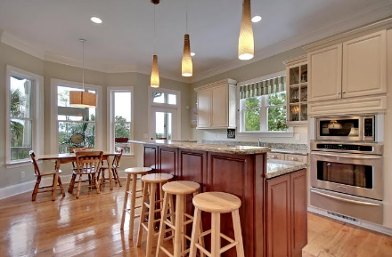
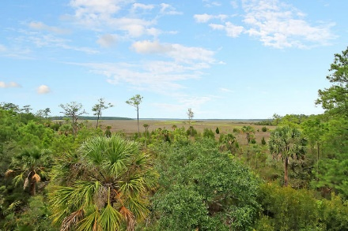

Parkshore Marshfront
Serenity Found on Paradise Island
1461 Alligator Creek Ct ~ Awendaw ~ MLS# 15022741 ~ $750,000
Experience the serenity of Paradise Island at this private 4BR, 4.5BA, 2CG home situated on a quiet cul-de-sac. With three levels of living, the ground floor can serve as a great in-law suite with a full bath, screened-in porch, washer/dryer hook-up and an area that is plumbed for a kitchen. Enter the main living area into the giant two story foyer where you’ll find gorgeous, five inch red oak hardwood floors, high ceilings and an open floor plan. The living room boasts a gas fireplace, allows access to the back screened-in porch and opens to the gourmet kitchen. A formal dining room, two bedrooms, full bath and powder room complete this floor. On the top level is the master suite and fourth bedroom. There’s a luxurious master bath and balcony with incredible views.
Additional features include:
Paradise Island has a boat storage area, dock and water access
Views of Francis Marion National Forest as well as Deep Creek
Dual staircase leading to full front porch
Hot water shower in the rear patio
All levels have 10 foot or higher ceilings
Kitchen features granite counters, recessed lighting, center island with breakfast bar, stainless steel appliances, gas burner, custom cabinets, built-in desk area
Surround sound inside and out
Master bath boasts Jacuzzi tub, walk-in shower, dual vanities, dual master closets
Metal roof
Tons of closets for storage
Book your showing today!
Call or email for details: (843) 654-7777 or Ben@MattOneillTeam.com

