Slide 1

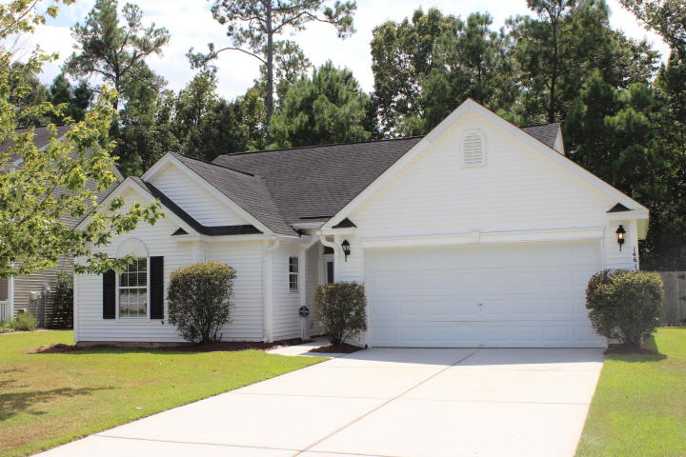
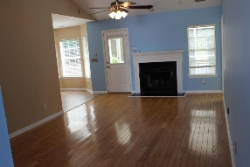
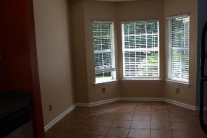
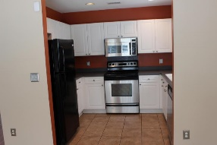
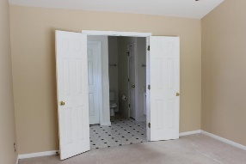
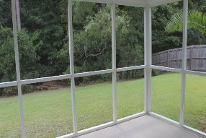
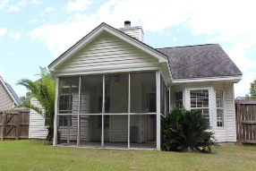

Great Home with Private Backyard in Tanner Plantation
Debbie Himebaugh
(843) 324-6959
dhimebaugh@century21properties.com
www.DebbieHimebaugh.com
1461 Coopers Hawk Dr | Hanahan | MLS# 16022538 | $220,000
Brand New Flooring!
Welcome to 1461 Coopers Hawk! This charming 3 bedroom, 2 full bath ranch is located on an interior lot backing up to wooded reserve. You enter into a wooded foyer and walk straight into a spacious Great room with fireplace and wired for surround sound and Alarm System! Open to the ceramic tiled Eating Area leading to a Kitchen featuring stainless appliances, natural lighting and ceramic tiled flooring. The Split bedroom design offers the Grand Master on one side of the house with walk in closet and double doored large bath suite. On the opposite side of the home you will find 2 additional bedrooms, a full bath and a laundry room. Fresh paint and new carpet make this home move in ready!
Make your appointment today, it is a must see.
Century 21 Properties Plus | 3301 Salterbeck Ct Suite 100 | Mt. Pleasant, SC 29466

