Slide 1
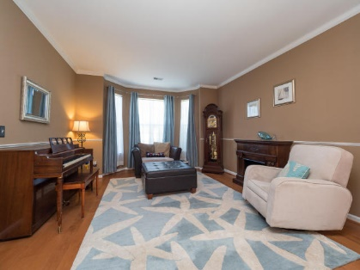
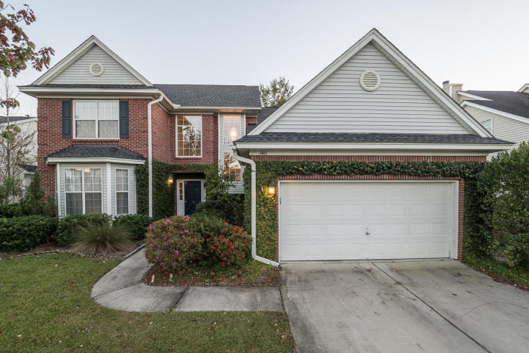
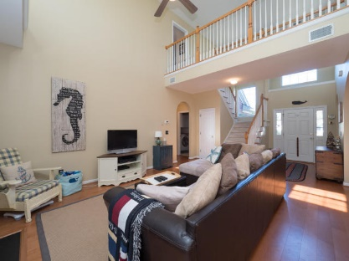
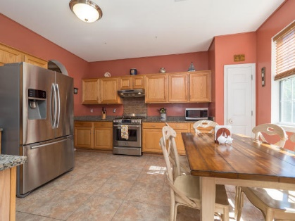
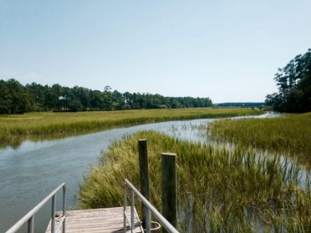
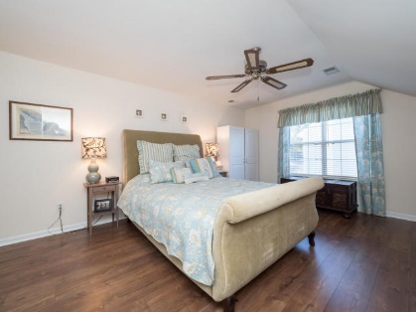
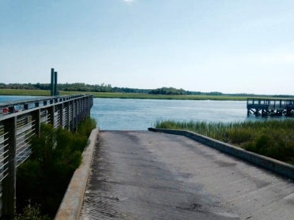
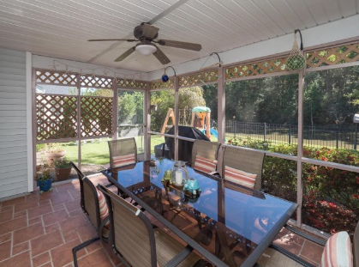
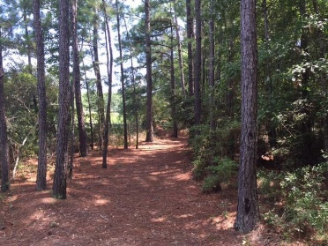
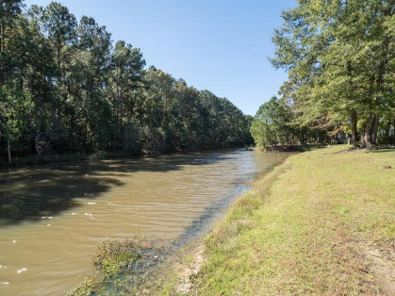
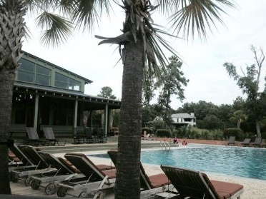


1461 Endicot Way Park West | Mount Pleasant, SC 29466 | MLS# 17029602 | $420,000
Established Park West Neighborhood Home
Tired of all the new construction?
Come see this well-maintained home in Park West! It backs to protected woodlands of Laurel Hill Park property...no new construction behind this backyard! And no flood insurance required! Notice the nicely landscaped yard and walkway as you approach this 2-story brick-front home. Complete with a new roof in 2015, it has 4 bedrooms, 2.5 baths, large living room and dining room areas as well as a family room and kitchen filled with tons of natural light from the cathedral ceiling windows! One of many great features is that the master bedroom and walk-in closet (along with an oversized master bathroom and linen closet) are located downstairs - no more climbing the steps to your retreat at night! The kitchen has solid oak cabinetry, tasteful granite countertops, and a full suite of stainless steel appliances, as well as a good-sized breakfast nook that overlooks the private backyard. The main living spaces downstairs (and the upstairs 3rd bedroom) have beautiful hardwood floors as well. If it's the outdoors you prefer, this is the house for you! Besides a large tile-floor screened porch, there is a small exterior wood deck, ideal for grilling. The yard is fully fenced, so perfect for the kids, pets, or a family gathering. Between pond and wooded acreage of Laurel Hill Park immediately behind the yard, it makes for the perfect R&R location after a long work day.
Park West is home to award winning schools just a short bike ride away, miles of paved walking/biking trails, and an amenity center including 2 large swimming pools with a summer kitchen/cabana, multiple tennis courts, and a club house. In addition, Park West property also houses a 59-acre town recreation center with variety of sports fields, a public indoor pool, and play parks for the kids! Downtown Charleston, beaches, dining, shopping and restaurants all nearby.
Kris Higman
(843) 810-8824
kris.higman@cbcarolinas.com
www.CharlestonHomesByKris.com
Coldwell Banker Residential Brokerage | 1127 Queensborough Blvd. 103 | Mt Pleasant, SC 29464

