Slide 1

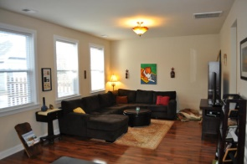
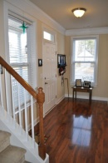
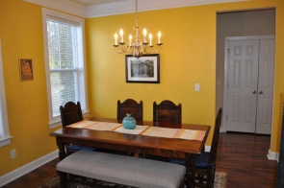
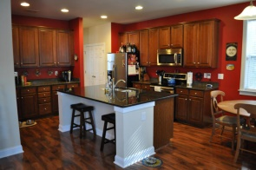
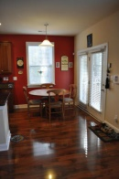
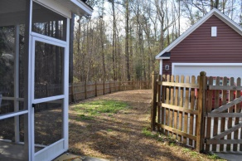
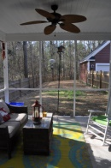
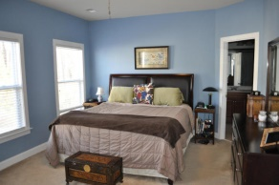
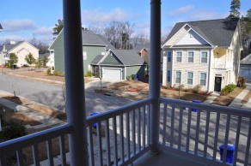
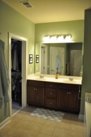


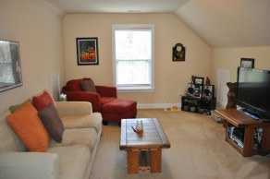
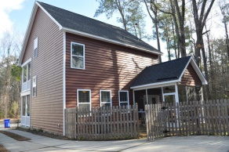


Better than new in Bolton's Landing
1463 Seabago Dr – Charleston - MLS# 15004497 - $277,500
Why wait for new construction in Bolton's Landing when you can buy this gorgeous, nearly-new home on a premium lot today?! Downstairs you'll find beautiful, dark wood flooring, a HUGE open kitchen/living room, laundry room, 1/2 bath, and separate dining room. Up the first flight of stairs there's a huge master suite complete with it's own porch, walk-in closet, dual vanity, and separate tub and shower. Two other guest rooms and a guest bathroom round out this floor. Up one more flight of stairs you'll find a fantastic bonus room/4th bedroom. The back of the house features a great screened-porch, fenced-in backyard, and detached 2 car garage. You'll love all the upgrades in this home so grab your agent and come see it today!
The Boulevard Company, LLC
Mark Macpherson
mark@beachbreak-properties.com
843.367.5640 Mobile

