Slide 1
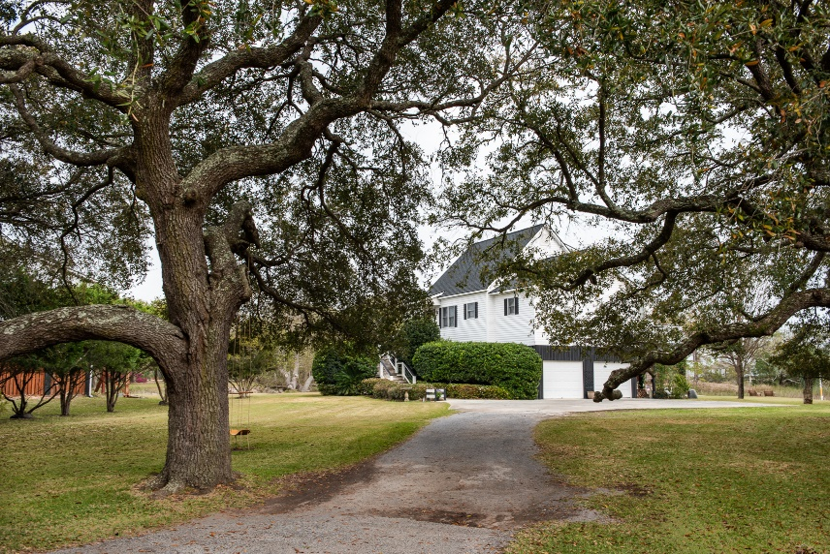
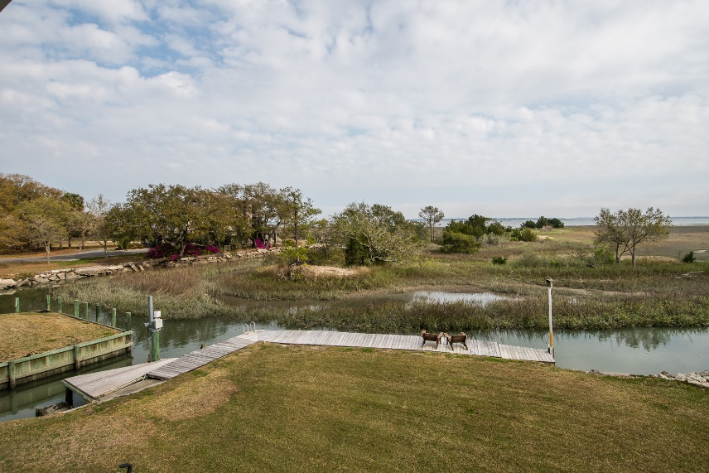
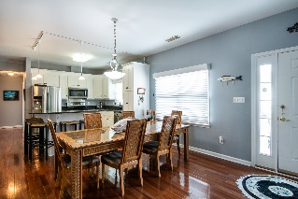
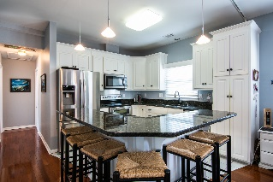
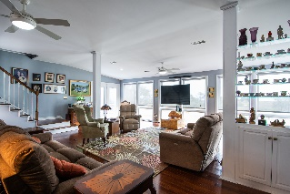
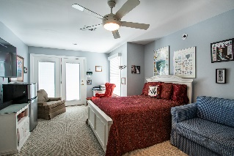
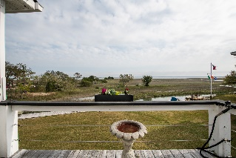
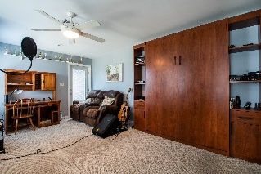
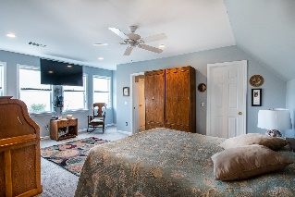
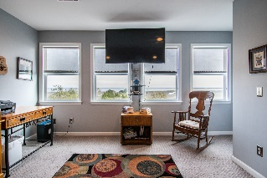
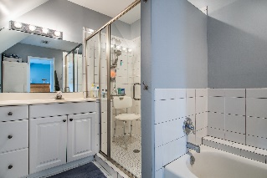
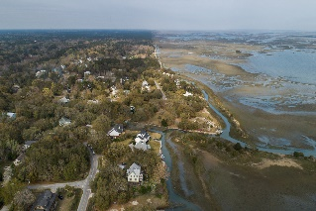


1464 Lieben Road Copahee View | Mount Pleasant, SC 29466 | MLS# 20008047 | $900,000
Truly A Slice Of Low Country Paradise!
Enjoy Neighborhood Lakes
What a wonderful opportunity to own waterfront property in Copahee View! This property not only includes a great home, but features a private boat ramp (rare to find these anymore!), seawall and dock. This tidal creek has access to Copahee Sound and just a 2-3 minute boat ride to Intracoastal waters, and 5-6 miles to Capers and Dewees Island. The home is elevated with open floor plan and great views from every room! The main living area has an updated kitchen with granite countertops and island. A large great room/family room with expansive views of the marsh and sound. Two small decks are accessible from the den and from each downstairs bedroom. Each bedroom has full bathroom for great privacy. The master suite is located on the second floor with walk in closet. The home is also equipped with an elevator from the garage to the main level. The downstairs has a two car garage and enclosed workshop. Home is equipped for generator. Well water 5 point irrigation system on automatic timer. Fabulous outdoor Tiki bar and entertainment areas to enjoy! Also, there is an outdoor shower and bathroom downstairs to utilize after a great boat adventures!
Gorgeous GRAND oak trees. This lot is approximately half acre. It's truly a slice of low-country paradise!
Charla McDonald
Cell - (843) 343-1456
cmcdonald@carolinaone.com
charlamcdonaldproperties.com
Karen Tawes
Cell - 843-568-2402
karen.tawes@carolinaone.com
Carolina One Real Estate
628 Long Point Rd.
Mt Pleasant, SC 29464-3032

