Slide 1
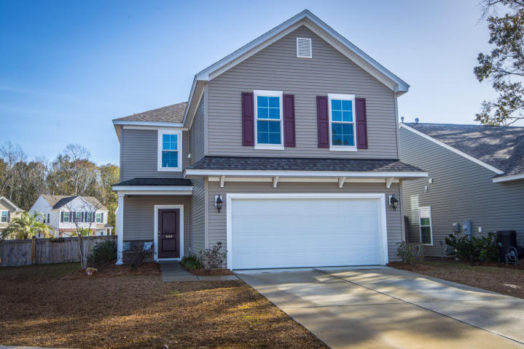
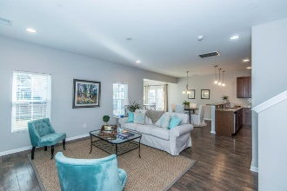
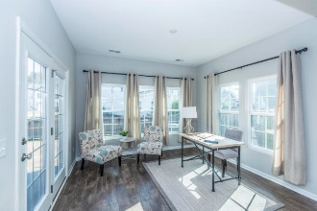
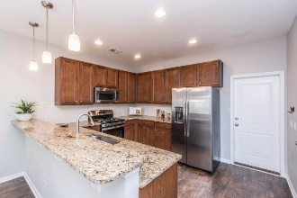
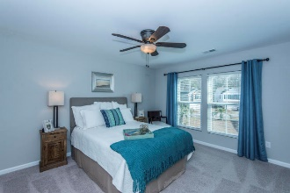
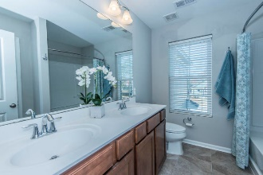
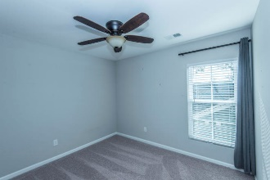
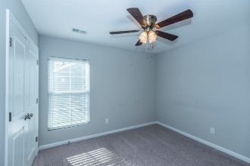
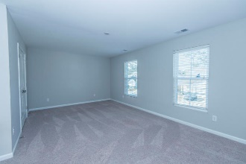
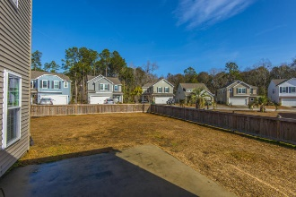
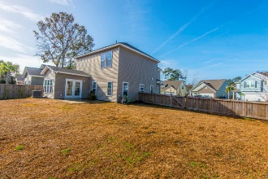


1464 Oldenburg Drive Tupelo :: Mount Pleasant, SC 29466 :: MLS# 18000682 :: $369,000
The Only Deep Water Home On Daniel Island
Open House
Sunday, January 21st
1:30-4pm
Welcome home to 1464 Oldenburg Drive! This immaculate home is turnkey ready. You’ll appreciate the fully fenced large back yard, blinds on all windows, plus the refrigerator, washer & dryer all convey. The floor plan is open and perfect for entertaining. Upgrades include a 10 x 12 sunroom, wide plan flooring throughout the downstairs, ceramic tile in the bathrooms, 42" kitchen cabinets, granite countertops and stainless appliances. The kitchen has a large pantry with lots of extra storage space. The back yard is one of the largest in the neighborhood so there’s plenty of room for play equipment or a pool. The master suite features a walk-in closet, ceiling fan, dual vanity, linen closet and a garden tub & shower. The upstairs also features 2 additional bedrooms plus a large bonus.
Helen Hudson
843-991-9875
helen.hudson@carolinaone.com
Carolina One Real Estate
2713 Highway 17 North
Mt. Pleasant, SC 29466

