Slide 1
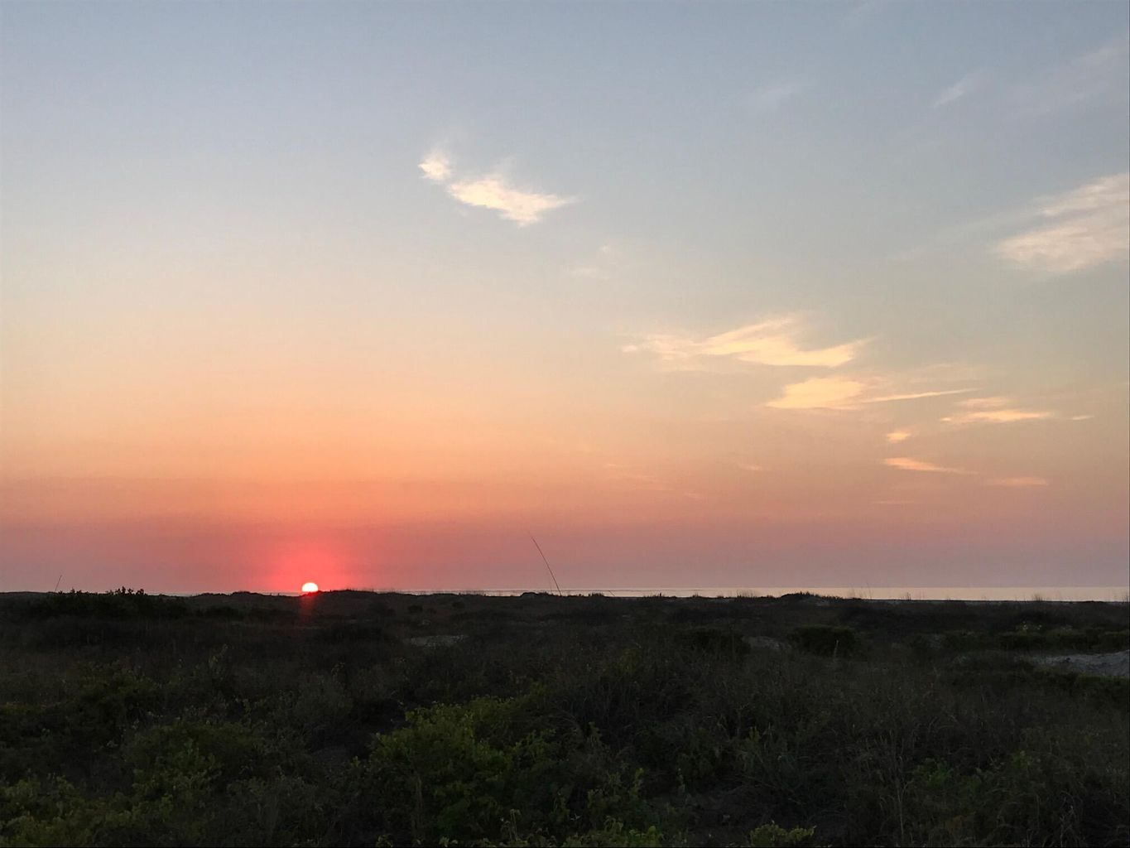
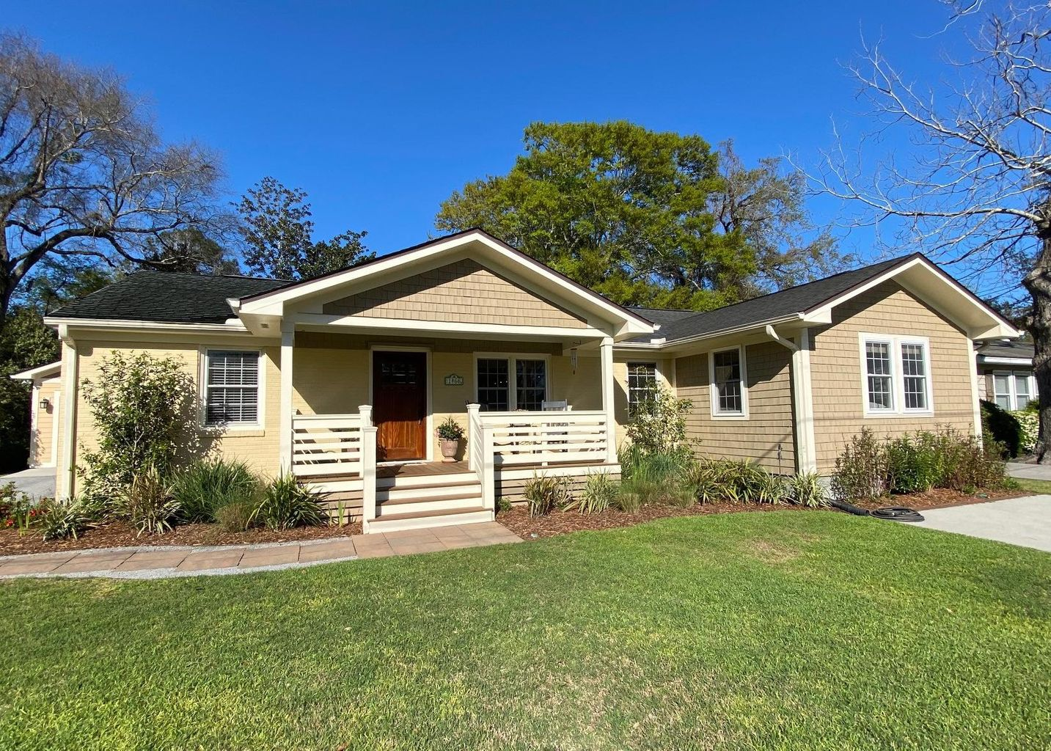
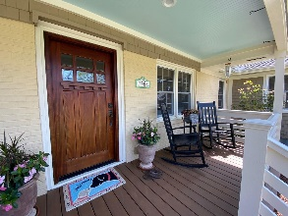
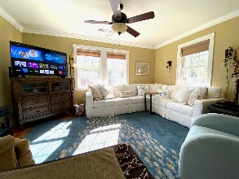
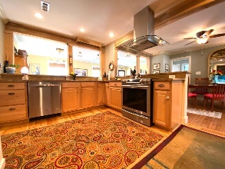
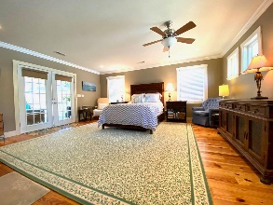
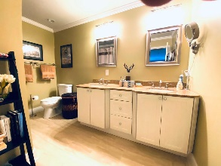
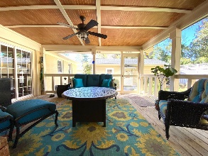
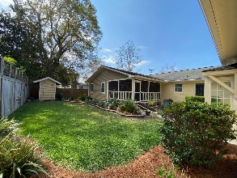
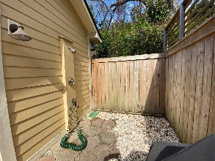
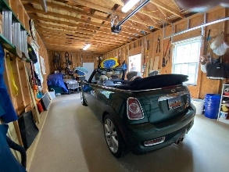
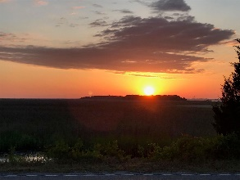


1466 Barbara Street Old Mt Pleasant | Mount Pleasant | MLS# 21008730 | $895,000
Brokers Compensation Increasing to 2.5%
Don't miss this beautiful home in Old Mt Pleasant! Wonderful remodeled house close to everything and MOVE IN READY! Sullivan's Island, Pitt street pharmacy, Pitt street bridge and Town Center shopping are very close and your new home is only 10 minutes to downtown Charleston. Home is only 2 blocks from Publix Grocery store. Mt Pleasant Academy is one of the best public primary schools in the state! No Flood insurance on this high and dry lot. Crawl space encapsulated with dehumidifier. Two car Garage added in 2014. New HVAC in 2018. Stainless steel kitchen fixtures. Interior & front porch painted in 2020. Exterior soffits and trim and Cedar shake all painted in June 2020. Custom Hunter Douglas window treatments.
DuBose Blakeney
843-442-4096
duboseblakeney@gmail.com
http://www.duboseproperties.com
Southern Visions Realty Inc.
332 East Bay St
Charleston, SC 29401

