Slide 1
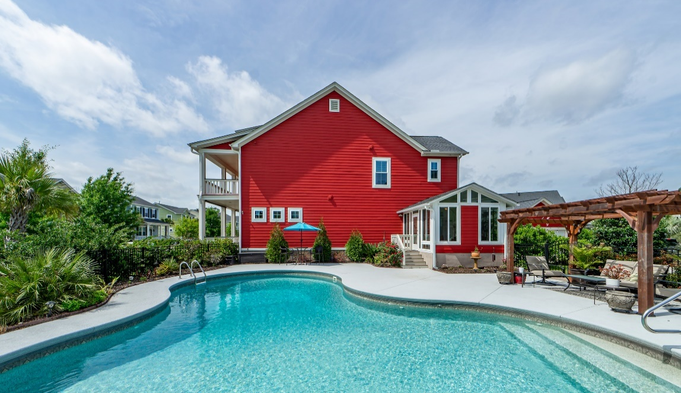
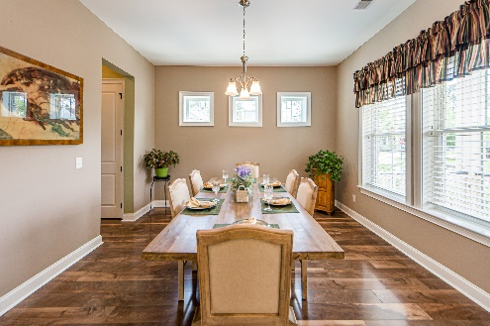
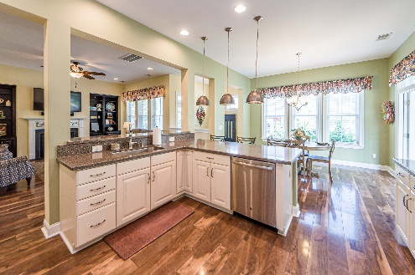
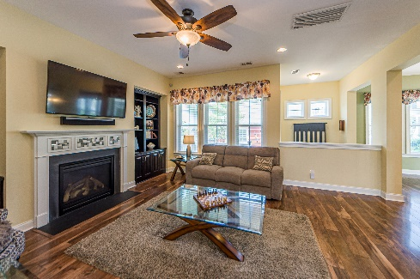
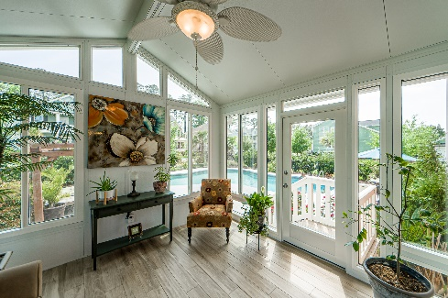
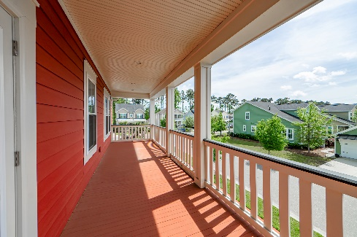


Price Reduced
1466 Hollenberg Lane
Carolina Park | Mt Pleasant | MLS# 23007801 | $1,085,000
Welcome home to this picturesque Southern Charmer, that sits on one of the nicest and largest lots in the sought-after community of Carolina Park in Mt. Pleasant. One of this homes many features is it's Freeform Saltwater Pool...Featuring an expansive deck, surrounded by matured plantings, creating privacy and an Oasis type feel. Complemented by a 12' x 14' Cedar Veranda that offers a shaded seating area to enjoy the view. This 3BR, 2 1/2BA home with 3,085 sq ft. lives large. Immediately as you enter the Open Foyer you have a well located Office (Flex Room) with French Doors. Then adjacent is a spacious separate Dining Room . Continuing is a half bath, then living area offering a Large Open Floor Plan, with good flow thru the Great Room, with Gas Fireplace then through the Gourmet Eat In Kitchen, with Butlers Pantry, Stainless Steel Appliances, Quartz Countertops and loads of Cabinets...Complemented by a generous amount of Counter Space with the adjoining Peninsula, providing additional seating. Adjacent is a nicely finished, separately heated and cooled, tiled Sunroom, that provides space to relax, tons of natural light, and offers easy access to the Pool area. Off the back of the home is a large inlaid Paver Patio, with raised pavers flanking the steps. Additionally there's a 4 ft. Stone Fountain feature providing another outdoor space. Complemented by an outdoor kitchen area for barbecuing and entertaining. The Master Bedroom is upstairs, and has a spacious en-suite, featuring two walk in closets, dual vanity sinks, large separate shower, and separate water closet. Also upstairs are the two remaining bedrooms, with a hall bath. Also here is the Loft lounging area, with access to the second level Porch. The exterior of the home has been recently hand painted for lasting durability and a Fresh Look!! "Storage" is always important, and there is lots of floored storage, that runs the width of the attic...In addition to that offered in the detached garage.
Frank Rutigliano
843-813-4961
frutigliano@kwchs.com

