Slide 1
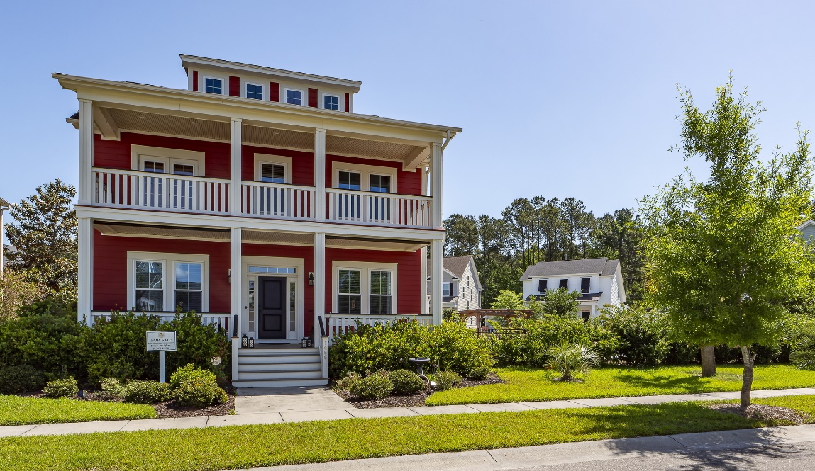
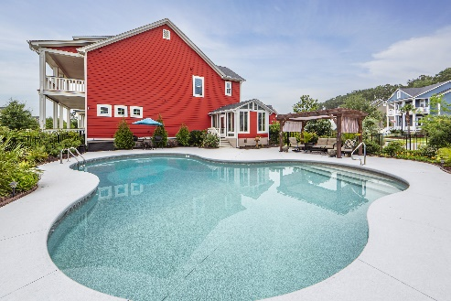
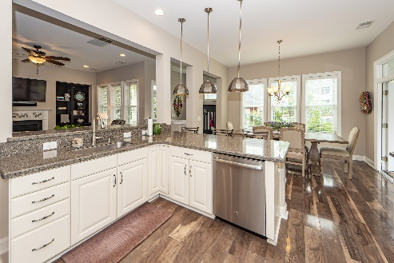
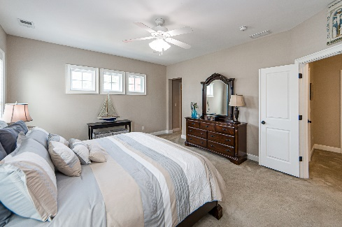
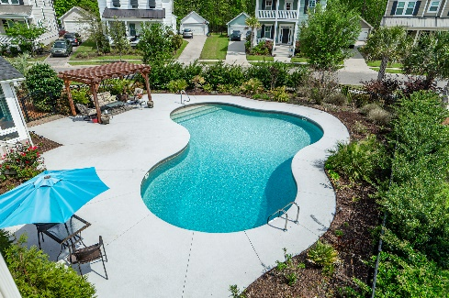
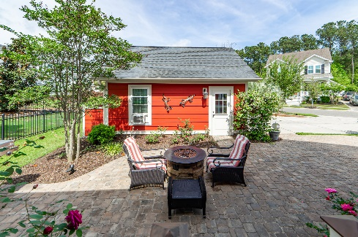
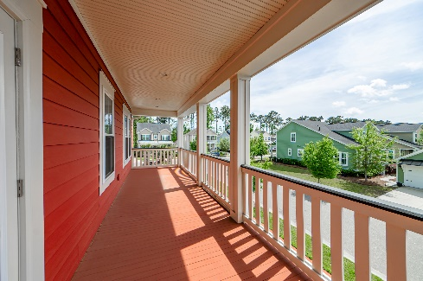
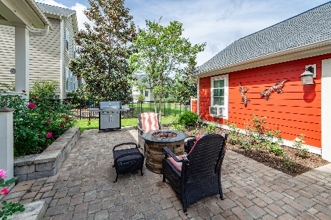
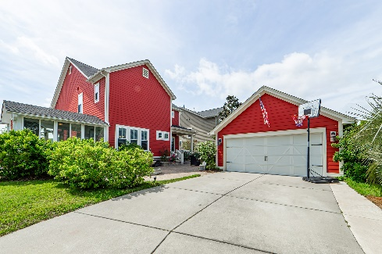


Back on the Market ~ Loaded with Upgrades
Join us for an Open House on Sunday 1-4
Public/Agent Open House Saturday 5/27 from 1-4
1466 Hollenberg Lane
Carolina Park | Mt Pleasant | MLS# 23007801 | $1,085,000
Welcome to 1466 Hollenberg Lane, a Southern Charmer that sits on one of the largest lots in the sought-after Carolina Park Community. With many recent updates...This 4 Bedroom home with 3,085 sq. ft. is move in ready! This home features an Open Floor Plan with large rooms throughout the home. As you enter the large Foyer you have access to an Office (Flex Room) with French Doors... Then adjacent is a relaxing Living Room and/or Library. Continuing through the entryway is the living area, offering a Large Great Room, with Gas Fireplace. There is good, flow through, to the Gourmet Kitchen which includes Stainless Steel Appliances, Quartz Counter Tops, and loads of tall Cabinets and storage space. The Kitchen has a generous amount of Counter Space with an L-shaped island for entertaining, and is complemented by the Butlers Pantry/Bar Area. Adjacent to the dining area is a nicely finished, tiled Sunroom, that provides tons of natural light and easy access to the Pool area. The flooring on second floor has recently been updated with tasteful Luxury Vinyl Plank. Master Bedroom is upstairs, and has a spacious en-suite, featuring two walk in closets, dual vanity sinks, large separate shower, and separate water closet. All additional bedrooms are upstairs and serviced by a large hall bath. For outdoor living, the Sunroom leads to the Low Maintenance, Oversized Freeform Saltwater Pool, featuring an expansive deck with a large Cedar Veranda, that offers shaded seating, so you can enjoy the view. As you are surrounded by mature plantings that provide natural privacy, you experience your own private Oasis feel. Off the back of the home is a large inlaid Paver Patio, with a 4 foot fountain, an outdoor kitchen area for barbecuing, and entertaining, with raised flower beds flanking the steps of the porch. The exterior of the home has been recently, hand painted, for lasting durability and a Fresh Look!! "Storage" is always important, and there is lots of floored storage, that runs the width of the attic...In addition to that offered over the detached 2 car garage. Carolina Park offers community amenities as well to enjoy, beautiful walking paths throughout, tennis, pickle ball courts, community pool, (not shown here) and covered pavilion areas for parties and planned events. Amenities photos will be available soon.
Frank Rutigliano
843-813-4961
frutigliano@kwchs.com

