Slide 1
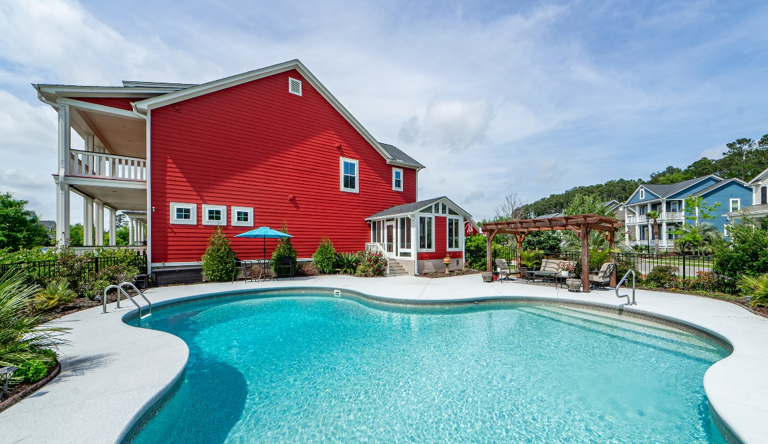
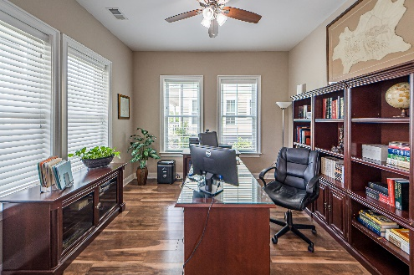
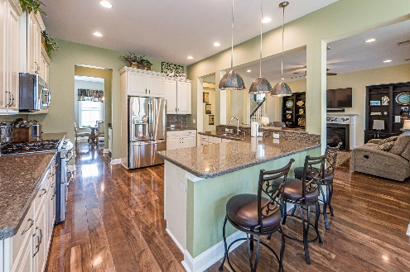
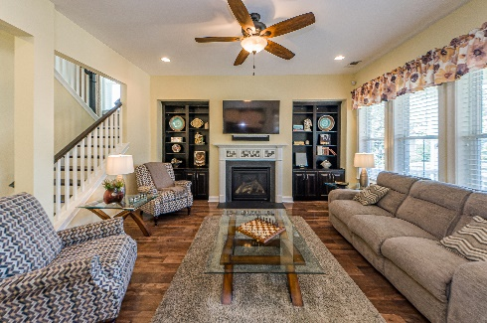
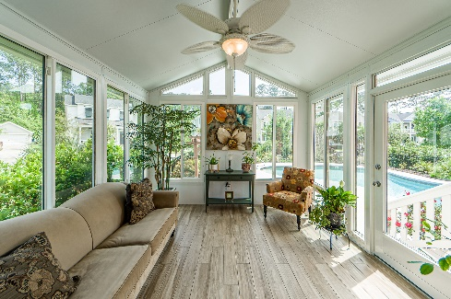
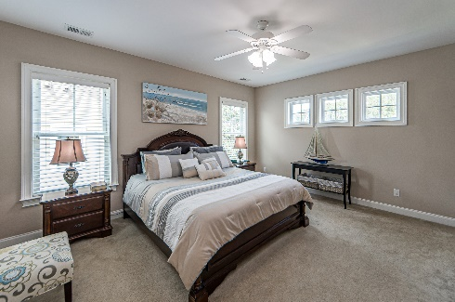
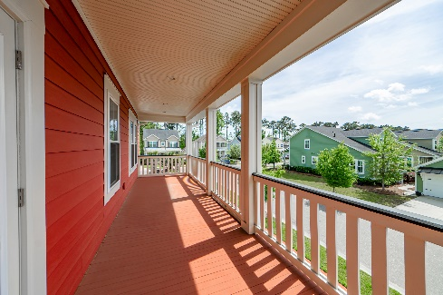
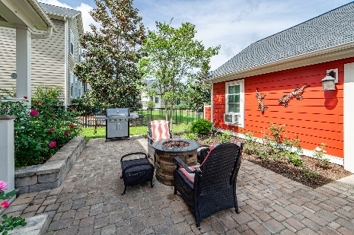
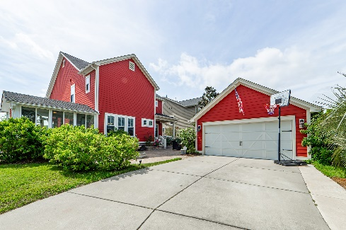


Open House
Stop by or send your buyers ~ Saturday, April 22nd from 10-1
1466 Hollenberg Lane
Carolina Park | Mt Pleasant | MLS# 23007801 | $1,127,500
Welcome home to this picturesque Southern Charmer, that sits on one of the nicest and largest lots in the sought-after community of Carolina Park. One of this homes primary features is it's beautiful oversized Saltwater Freeform Pool...Featuring an expansive deck, surrounded by matured plantings, creating privacy and an Oasis type feel. Complemented by a 12' x 14' Cedar Veranda that offers a shaded seating area to enjoy the view. This 3BR, 2 1/2BA home with 3,085 sq ft. lives large. Immediately as you enter the Open Foyer you have a comfortably located Office (Flex Room) with French Doors. Then adjacent is the spacious separate Dining Room area, convenient to the Butlers Pantry. Continuing...The living area offers a Large Open Floor Plan, with good flow through the Great Room with Gas Fireplace... Then through the Gourmet Eat In Kitchen, with beautiful Stainless Steel Appliances, Quartz Countertops and loads of Cabinets, complemented by a generous amount of Counter Space with the adjoining Peninsula, providing additional seating. Adjacent is a large beautifully finished, separately heated and cooled, tiled Sunroom, that provides space to relax, and offers easy access to the Pool area. Off the back of the home is a large inlaid Paver Patio, with raised pavers flanking the steps. Additionally there's a 4 ft. Stone Fountain providing another outdoor space. Complemented by an outdoor kitchen area for barbecuing and entertaining. Upstairs are three bedrooms with two full baths and a comfortable Loft area, with access to the second level Porch. The Master Bedroom is large, and has a very spacious En-suite, offering two walk-in closets, separate Water Closet, Dual Vanity Sinks, and large separate shower. The exterior of the home has been recently hand painted for lasting durability and a Fresh Look!! "Storage" is always important, and there is lots of floored storage, that runs the width of the attic...In addition to that offered in the detached garage... This is a must see!!
Frank Rutigliano
843-813-4961
frutigliano@kwchs.com

