Slide 1
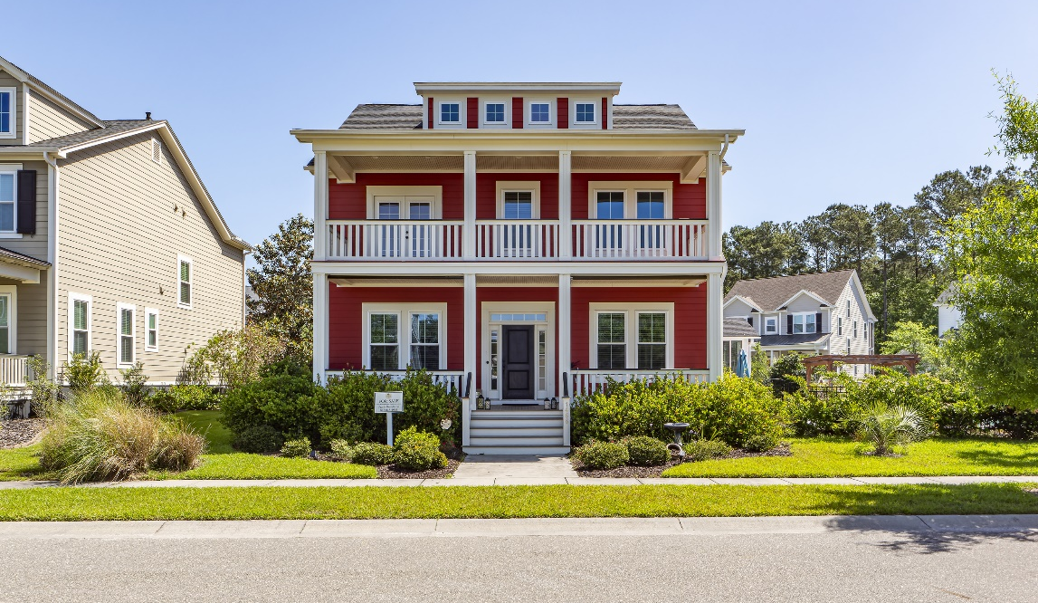
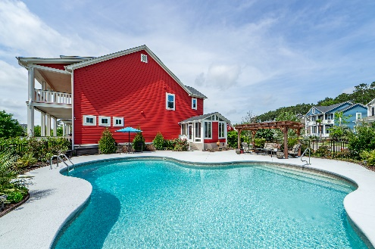
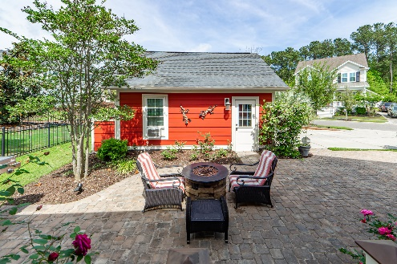
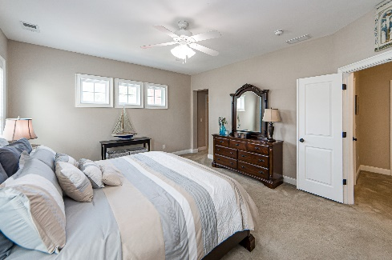
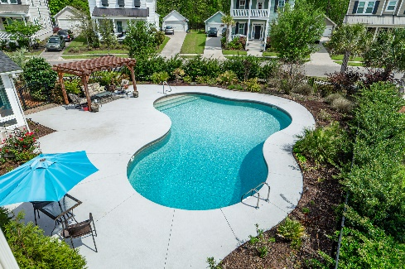
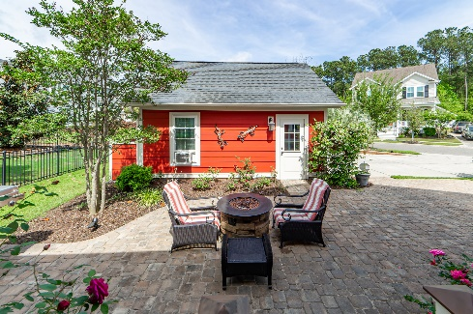
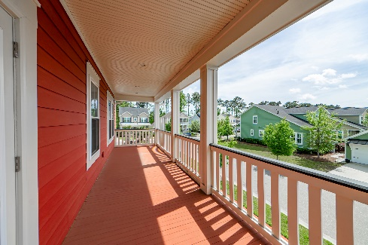
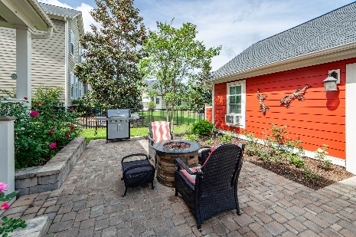
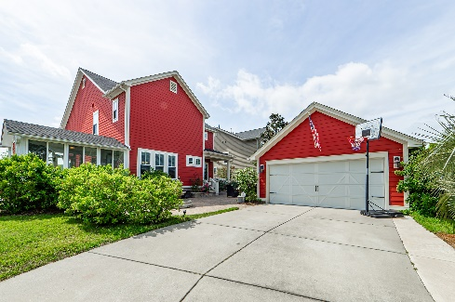


Back on the Market at a Reduced Price
Public/Agent Open House Sunday from 1-4
Join us for an Open House on Sunday 1-4
1466 Hollenberg Lane
Carolina Park | Mt Pleasant | MLS# 23007801 | $1,040,000
Welcome to 1466 Hollenberg Lane, a Southern Charmer that sits on one of the largest lots in the sought after Carolina Park Community. With many recent updates...This 4 BR, 3 BA home with 3,085 sq. ft. is in move in ready! Featuring an Open Floor Plan...Immediately as you enter the large Foyer you have access to an Office (Flex Room) with French Doors... Then adjacent is a cozy Living Room or Library. Continuing thru the entry is a half bath. Followed by the living area, offering a Large Great Room, with Gas Fireplace, surrounded by shelving. There is a good, flow through, to the Gourmet Kitchen including Stainless Steel Appliances, Quartz Countertops and loads of Cabinets...Complemented by the Butlers Pantry, and generous amount of Counter Space with adjoining Peninsula Adjacent is a nicely finished, tiled Sunroom, that provides tons of natural light and an space to relax...Then here is easy access to the Pool area. The low maintenance, oversize Freeform Saltwater Pool features an expansive deck, with a large Cedar Veranda, that offers shaded seating, so you can enjoy the view...As you're surrounded by mature plantings, creating your own private Oasis feel. Off the back of the home is a large inlaid Paver Patio, with raised pavers flanking the steps. Additionally there's a 4 ft. Stone Fountain feature, providing another outdoor space...Along with an outdoor kitchen area for barbecuing and entertaining. The flooring on second floor has recently been updated with tasteful Luxury Vinyl Plank Master Bedroom is upstairs, and has a spacious en-suite, featuring two walk in closets, dual vanity sinks, large separate shower, and separate water closet. Also upstairs are the remaining bedrooms, serviced by a large hall bath. The exterior of the home has been recently, hand painted, for lasting durability and a Fresh Look!! "Storage" is always important, and there is lots of floored storage, that runs the width of the attic...In addition to that offered in the detached garage.
Frank Rutigliano
843-813-4961
frutigliano@kwchs.com

