Slide 1
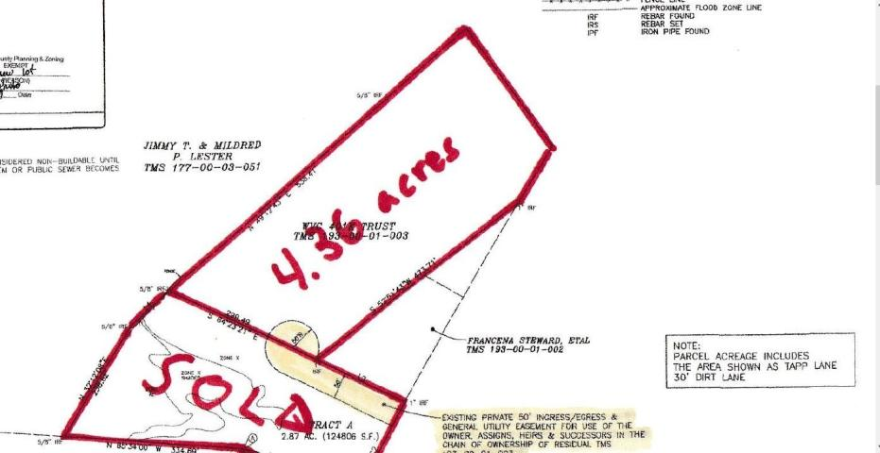
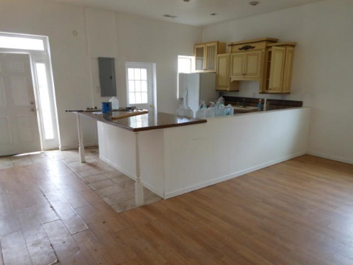
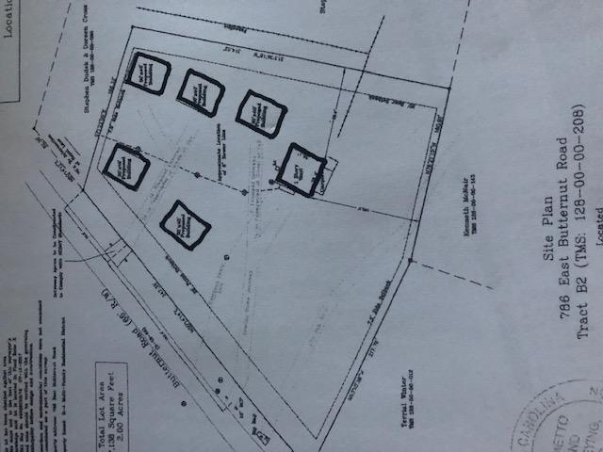
Owner Financing
4+ Acres $99,900
Jedburg Rd
$40,000
Price Reduction!
100 W Butternut Road ~ MLS# 20004023 ~ $379,000 (0.85Acres)
1467 Jedburg Road | MLS# 19029717
Conveniently located just 3 miles from I-26, 5 minutes from Cane Bay, 30 minutes from Lake Moultrie and 30 minutes from Historic Charleston. Wastewater system already on site. With over 100 feet of Jedburg Rd frontage at one end and a 50 foot wide ingress/egress easement at the other, it could be subdivided into smaller lots. Flex1 zoning allows residential, agricultural, and other uses. Seller will consider seller financing.
Rick Willis
843-327-3017 Rick@RickWillis.com The Group, LLC

