Slide 1
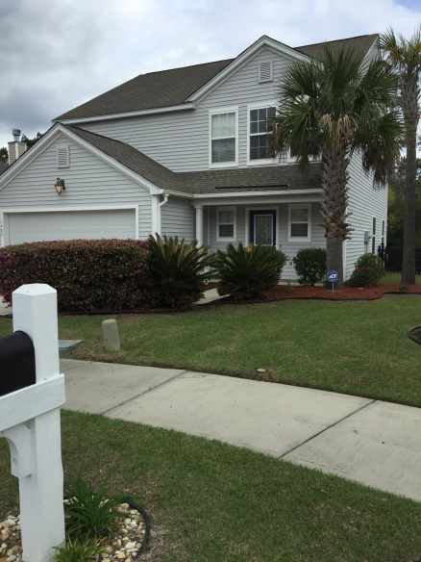
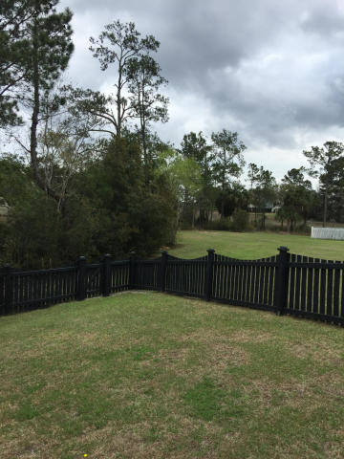
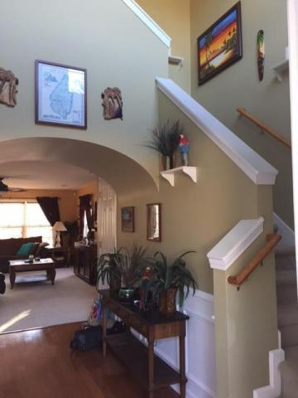
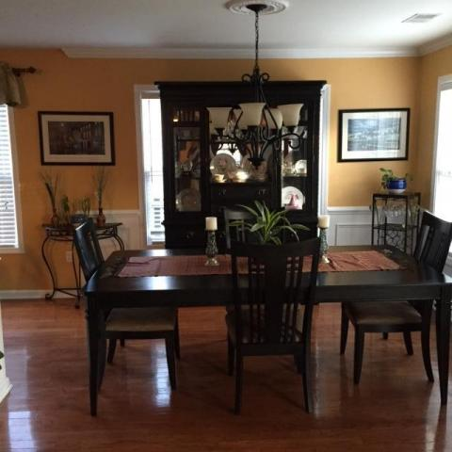
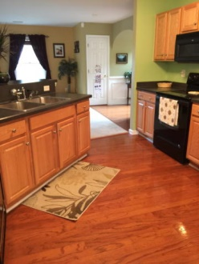
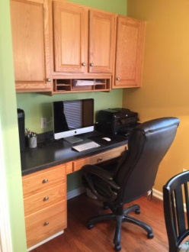
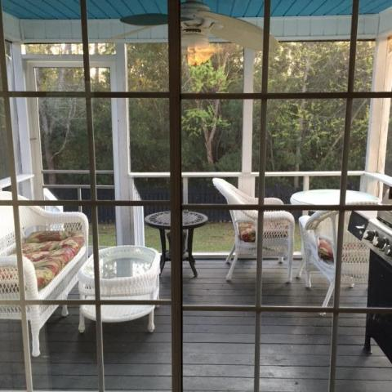
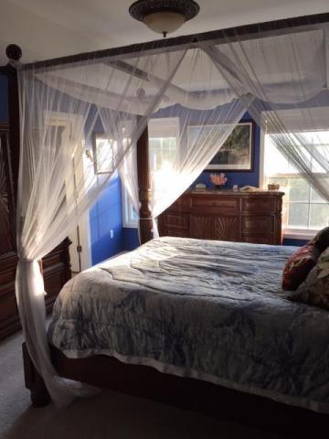

1468 Harbor Mist Ct
The Peninsula
Charleston, SC 29492
MLS# 15007892
$279,999
4 Bedrooms | 2½ Baths | 2,072 sf
Open House Lunch ~ Friday, Oct 3 from 11 - 1
Handyman Special… Bring your hard hats!
Price Reduced In The Peninsula!
The largest floor plan in The Peninsula with 2100 SF, four bedrooms, 2.5 baths and a lovely fenced in yard is being offered as we enter a busy spring market. Set on a private cul de sac on the marsh, it offers a peaceful retreat after a busy day. The screened in porch will soothe you as you relax while listening to the birds chirp and the tree frogs call each other. The wide open floor plan leaves plenty of room for family living or entertaining guests. Great amenities for outdoor fun like the large community walk-in pool and a fabulous playground. This house has great sized bedrooms with large closets. The kitchen has a built in desk area for homework or just catching up on your daily emails! A security system and two zoned heating and air system are two more additions that make this home a great deal! A public dock for your boat is nearby, and don't forget that the new K-8 school is expected to be opened in the Fall of 2016. Close to 526, Daniel Island and the Mount Pleasant Towne Centre for your shopping and dining needs, this home is an excellent value and won't last long priced at $135.00 a square foot.. If square footage is important please measure.
Susan & Greg Day
843-900-0477 | 732-757-2904
charlestonbyday@gmail.com
www.charlestonbyday.com
AgentOwned Realty Co. Premier Group, Inc. | 824 Johnnie Dodds Blvd | Mt Pleasant, SC 29464

