Slide 1
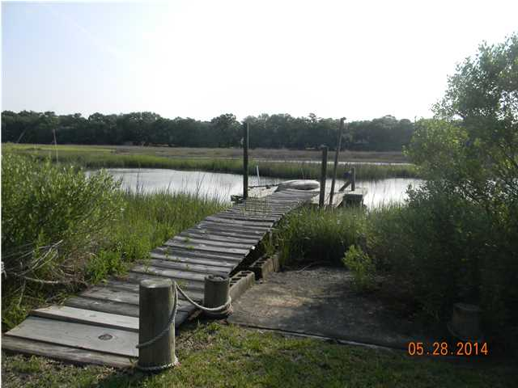
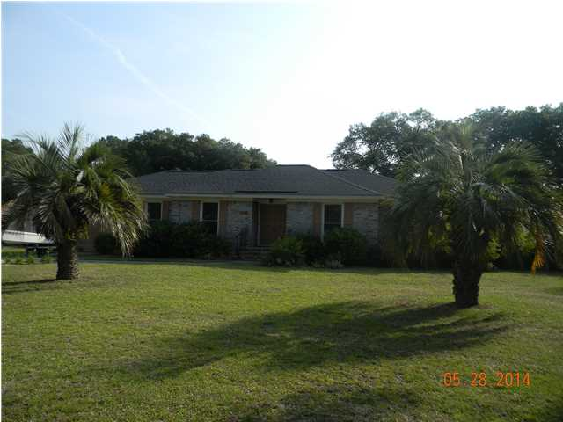
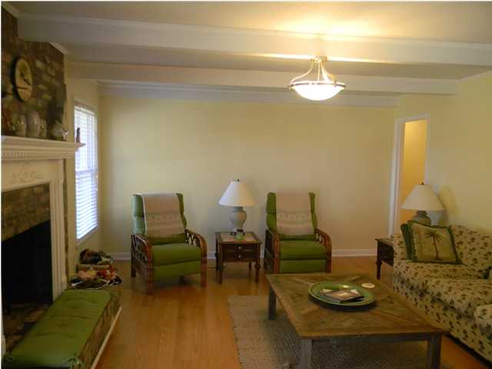
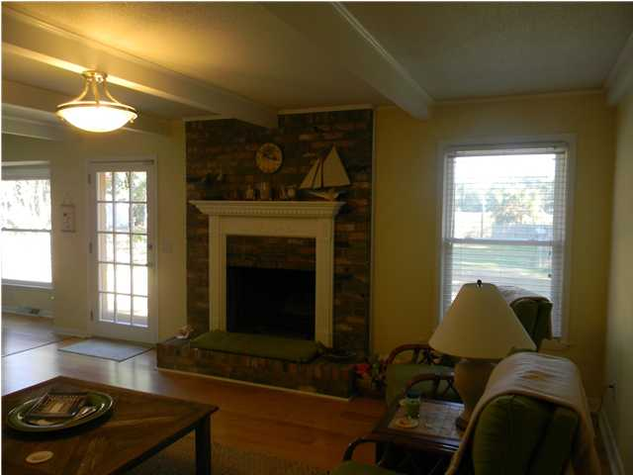
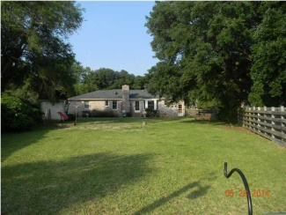
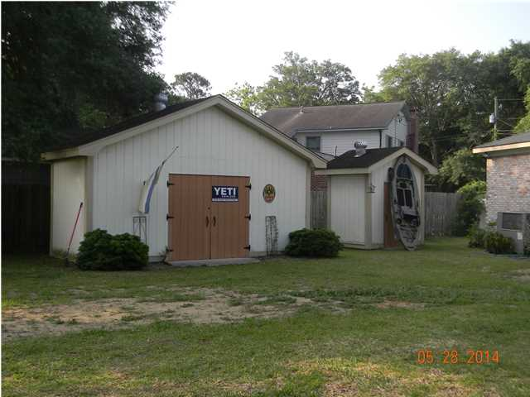
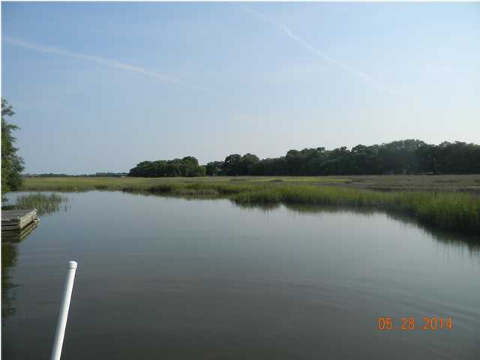

Reduced to Sell!
1468 Relyea Ave
Clarks Point, Charleston, SC
MLS# 1414364
$369,900
3 Bedrooms | 2 Baths | 1,627 sf
A must see! Brick home on tidal creek! Two floating docks with water and electricity and boat wench. Creek is short boat ride to James Island Creek you can see the Harbor View Road bridge from the dock huge back yard! Heating and air replaced 2012. Hardwood floors throughout! Barn has electricity and there is a shed for storage. Living room and formal dining room with wainscoating. Beautiful brick fireplace in family room. Big eat in kitchen with bay window. All of the bedrooms are good size. No homeowner's association fees! Priced to sell! Flood insurance is assumable with Allstate $1043. Owner is licensed SC real estate broker.
Kitty LaTorre, ABR
cblatorre@hotmail.com 843-830-1900 {M}
ERA Wilder Realty, 125 Wappoo Creek, Suite F, Charleston, SC 29412

