Slide 1
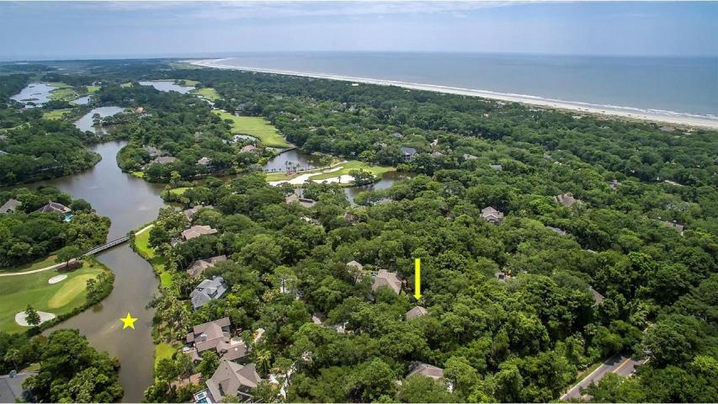
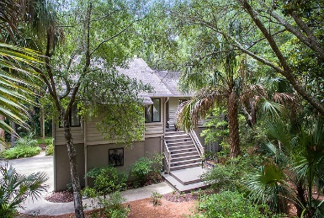
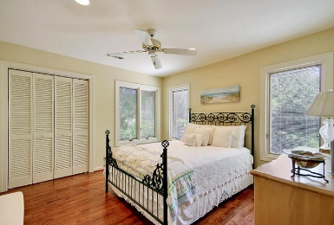
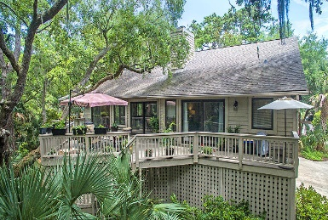
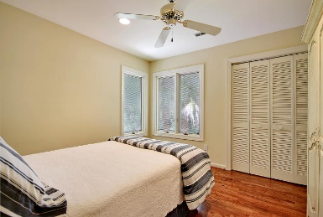
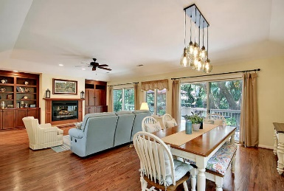
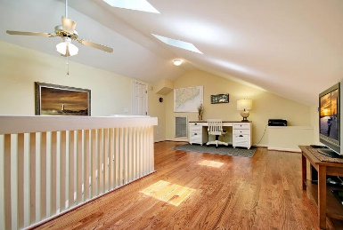
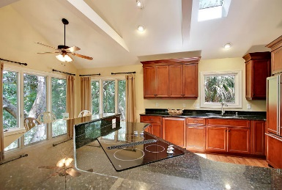
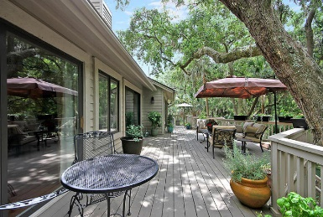
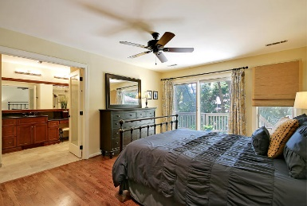
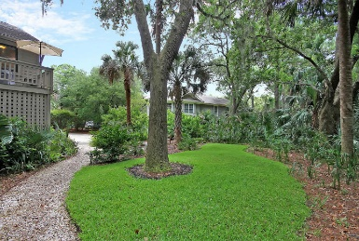
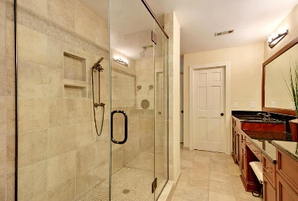
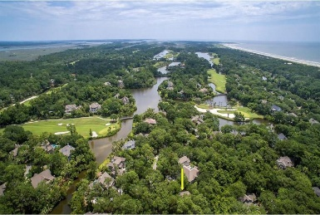
Great Downtown Investment Opportunity
Price Reduced!
146 Hooded Merganser Court
Kiawah Island, SC 29455 ~ MLS# 18018214 ~ $825,000
Nestled among the lush tropical landscape of Kiawah Island, this custom home is located past the second gate & nearby beautiful ponds, the golf course & the white sandy beaches that draw so many people to this destination. The private cul-de-sac boasts mature trees that create a canopy of shade over the home & expansive deck in the back of the home which offers an amazing outdoor living space. The renovated interior features gorgeous hardwood floors, skylights, a cozy fireplace in the great room & a luxurious master bath with a walk-in shower. There is a loft upstairs perfect for a home office or playroom. The home has great storage and a workshop area on the ground level. This home has been lovingly cared for, all that's left to do is move in & enjoy the island living lifestyle.
Additional features include:
Spacious, open floorplan
Great room includes a wall of windows and access to the deck and a gas fireplace with custom built-ins on either side
The stunning renovated kitchen includes granite countertops, new appliances, and custom wood cabinets
Bright and airy master bedroom has outdoor access to a private deck and a gorgeous master bathroom with custom cabinetry and tile, granite countertops, dual sinks, a vanity, a huge step-in shower, and a walk-in closet
Close to bike paths and the Golf Learning Center
Kiawah Island includes five golf courses, four swimming pools, and tennis courts
Book your showing today!
Book your viewing today!
Paige Rhodes 843-830-3281
paige@mattoneillteam.com
Ben Laaper 843-642-3546
ben@mattoneillteam.com

