Slide 1
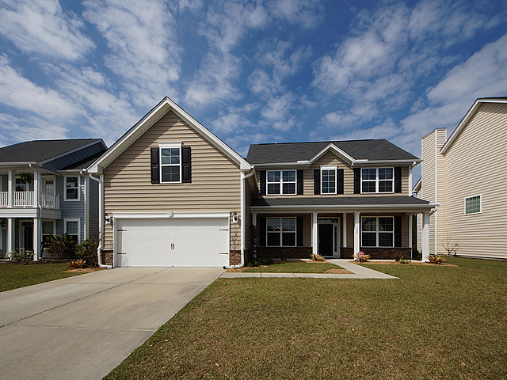
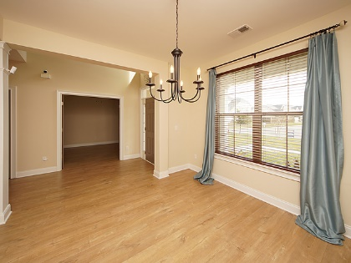
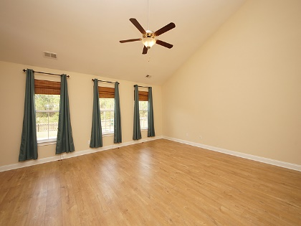
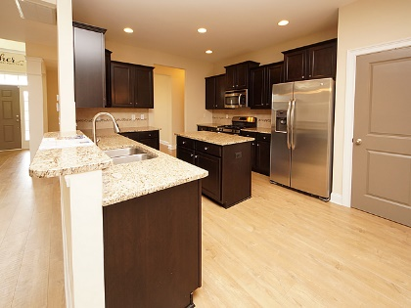
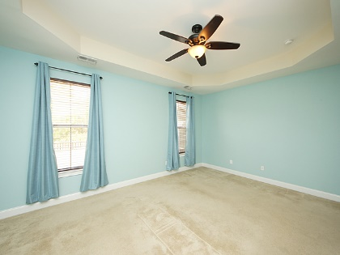
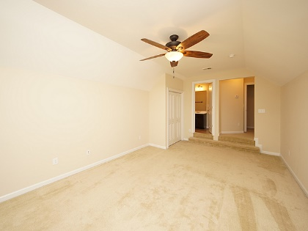
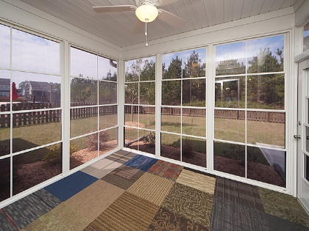
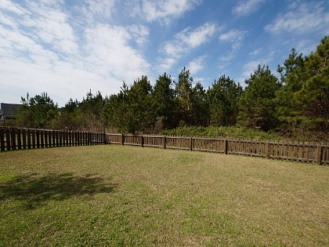


Just Reduced! Priced To Sell!
146 Royal Star Road
Cane Bay Plantation - Summerville, SC 29486
MLS# 17031610 - $309,990
This immaculate, well cared for 4 YEAR NEW home is ready for new owners. This open floorplan was designed with a modern flare to maximize all living spaces. There are 4 spacious bedrooms, 3.5 full baths, over 2700 square feet, well-appointed loft on 2nd floor, formal dining room, private office with French doors, MASTER SUITE is located on FIRST FLOOR, eat in kitchen and large open kitchen with adjoining family room. The first thing you will notice upon entering the home are the beautiful hand scraped wide planked laminate floors. The chef’s delight kitchen has been upgraded with raised panel cabinets, gas cooktop stove, stainless steel appliances, granite counter tops and tile backsplash.
The 3 additional bedrooms and loft are located on the 2nd floor. The huge FROG, 4th bedroom, has a full bath making it the perfect 2nd floor Dual Master. Additional features that help accentuate this beautiful home include: oversized private wooded back yard, 2 car garage with door opener, neighborhood walking paths, tankless water heater, newly finished ALL season porch, newly added back patio and custom sand box, trey ceilings, crown molding, custom mirrors, upgraded plumbing and lightening fixtures, drop zone in laundry room, fenced in back yard and remaining 10 year structural warranty convey to new owners. Call today to set up your private showing!
Bob Chambers, ABR
Office (843) 849-3005 · Mobile (843) 296-2546
bobchambers@infinity-realty.com
www.soldoncharleston.com
Infinity Realty | 1250 Fairmont Ave | Mt. Pleasant, SC 29464

