Slide 1
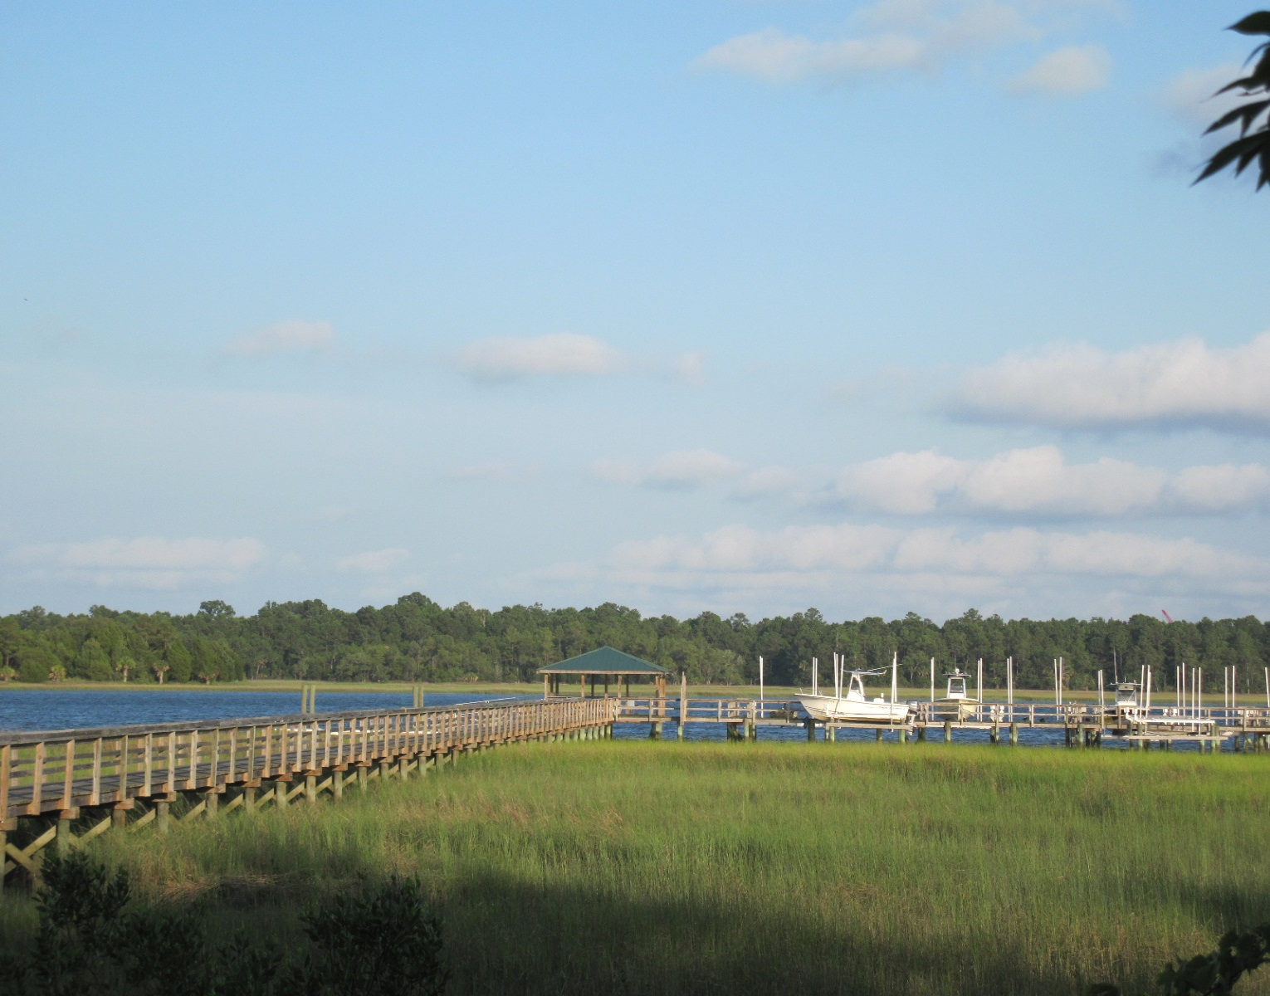
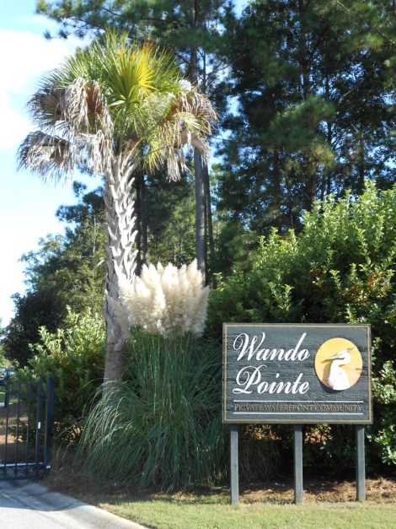
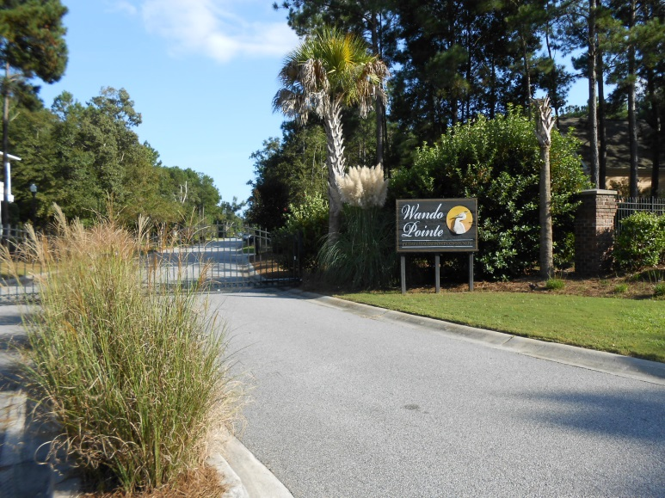
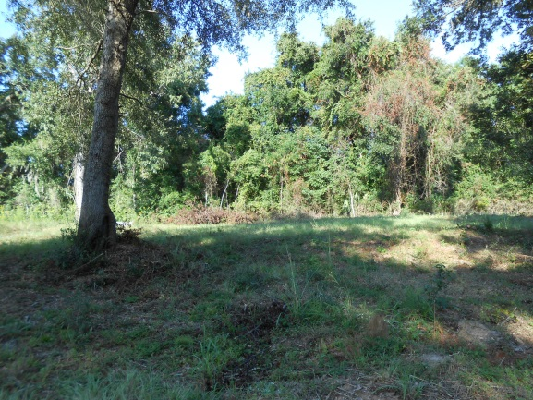
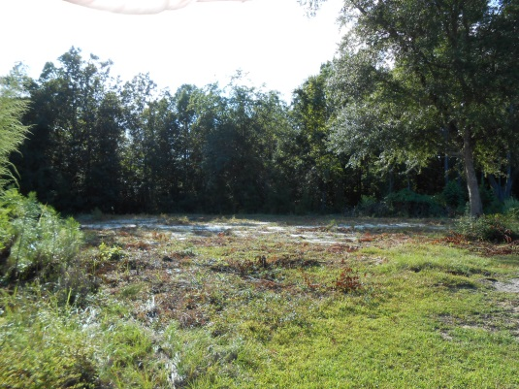
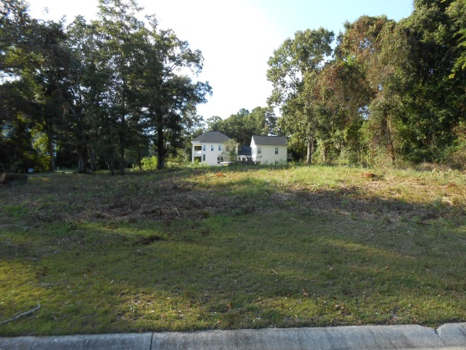


“Your Own Deeded Boat Slip and Lift…”
Wando Pointe Lot
with deeded private boat lift Charleston, SC 29492
One offered at $200K or less with fast closing! The other two are competitively priced in the lower $200Ks.
To Upper Wando River
To Charleston Harbor
& the Ocean
Your choice of three lots. Each is approximately 0.24 acres.
Your own personally deeded 12.000 pound boat lift/slip.
Your lift is to the right at the end of the Community Dock.
There is a community 35 ft floater dock to the left of the gazebo.
Gated small community just above the proposed Cainhoy Plantation, about a mile down river of the future replacement bridge at Hwy 41.
STEVE A. ROWE
Retired Military, Active Realtor®
(843) 303-7438
srowe@carolinaone.com
www.SteveRoweHomes.com

