Slide 1
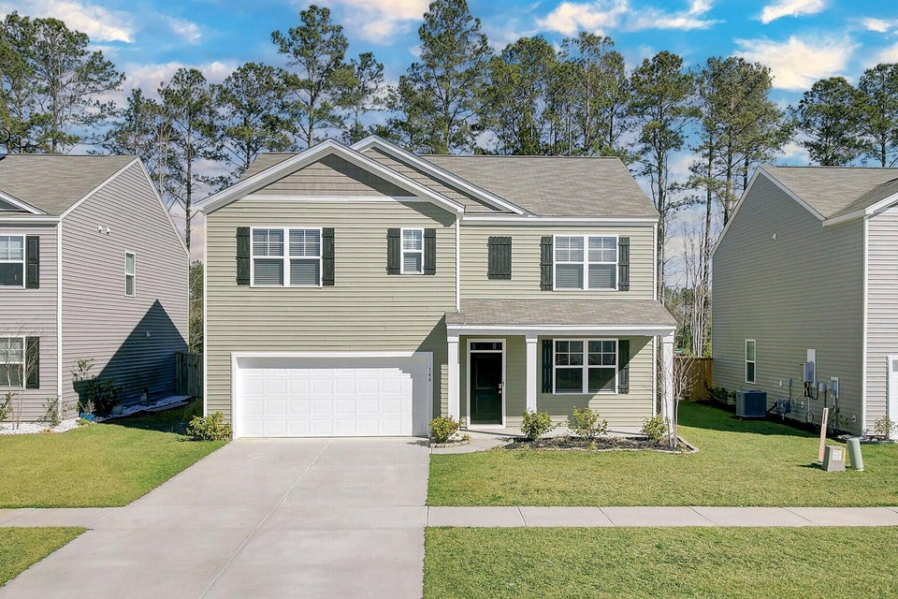
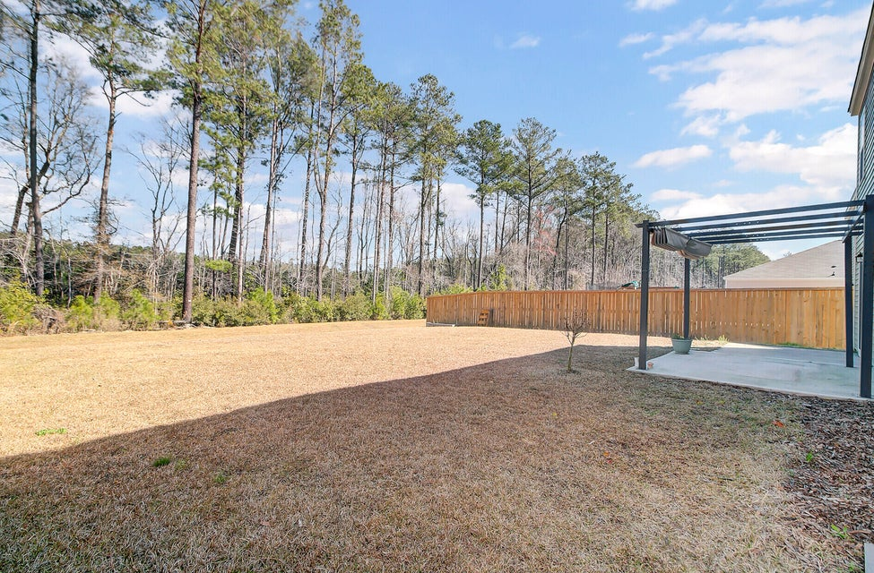
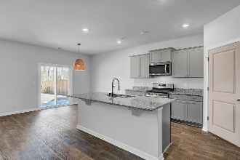
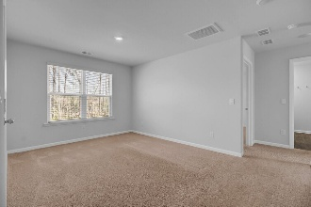
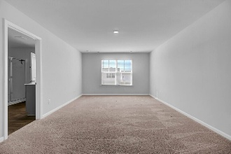
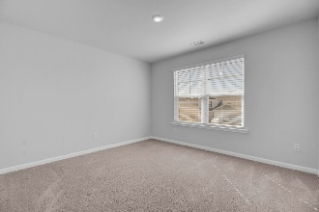
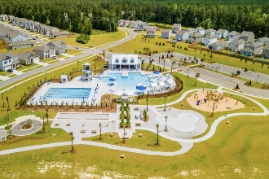


Price Reduction
146 Summit View Drive
Cane Bay Plantation | Summerville, SC 29486 | MLS# 25006113 | $409,900
Why settle for an ordinary home when you can have one that truly stands out? This Hayden floorplan in Pine Hills at Cane Bay is the perfect blend of space, style, and modern convenience. With five bedrooms, three bathrooms, and thoughtful design throughout, this home is ready to fit your lifestyle. Step inside and be greeted by an open-concept living space that feels both inviting and functional. The kitchen is the heart of the home, featuring a massive granite island that's perfect for meal prep, casual dining, or gathering with friends. A gas range makes cooking a dream, and the seamless flow into the dining and living areas ensures you're always part of the action. A downstairs flex room offers the perfect space for a home office, playroom, or second sitting area, while a private guest suite on the main level is ideal for visitors.
Upstairs, the spacious primary suite includes a walk-in closet and a double vanity bathroom, offering a peaceful retreat at the end of the day. Three additional bedrooms, a shared bath, and a bonus loft space provide room for everyone to spread out.
Beyond your front door, Pine Hills at Cane Bay delivers resort-style amenities that make every day feel like a getaway. Enjoy two pools, a clubhouse, fire pit, fishing pier, dog park, campsite, playground, and bocce ballall within the master-planned Cane Bay Plantation. With convenient access to the new Black Tom Road entrance, getting where you need to go has never been easier.
This is more than just a house; it's a home designed for the way you live. Schedule your showing today and see for yourself!
Hillary Jones
843-709-4666
realcharlestonagent@gmail.com
www.realcharlestonagent.com
Carolina Elite Real Estate | 706 N Cedar St | Summerville, SC 29483

