Slide 1
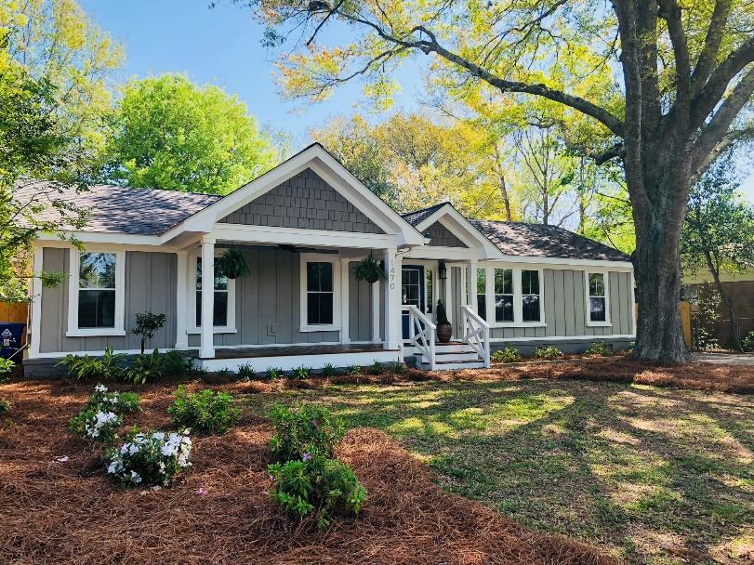
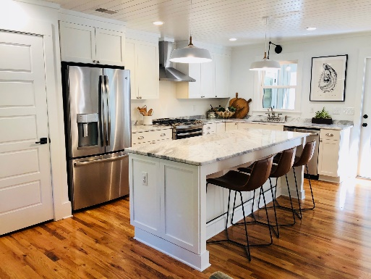
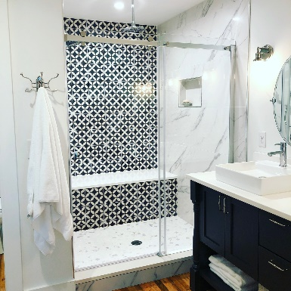
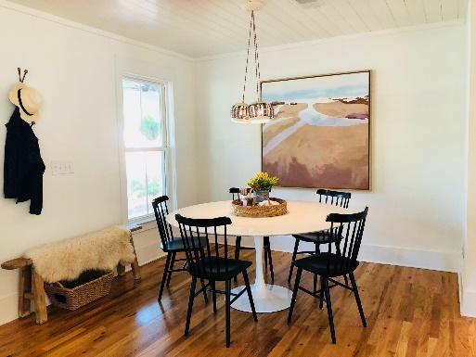


4 bed, 3.5 bath
Private Boatlift
Broker Open House!
Thursday April 11, 2018
10:00AM - 12:00PM
1470 Seminole Street
Mount Pleasant SC 29464
Totally renovated ranch in desirable Old Mount Pleasant.
Find quintessential Mount Pleasant charm in this 1950's ranch home that has been completely renovated and upgraded to include 4 bedrooms, 4 full bathrooms, 2,115 square feet of total living space and a totally open floor plan. You will love the best modern features like thankless hot water heater, vaulted ceiling in the huge master bedroom addition, high end light fixtures, fabulous tile selections and so much more.
Offered for $829,000
Crissy Rowell
Mobile - (843) 377-5177
crissy.rowell@carolinaone.com
www.crissyrowell.com
Carolina One Real Estate | 195 W Coleman Blvd | Mt Pleasant, SC 29464

