Slide 1
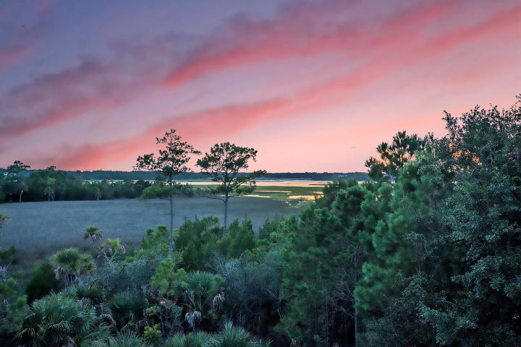
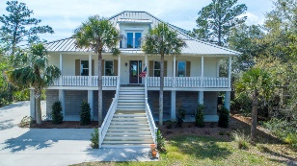
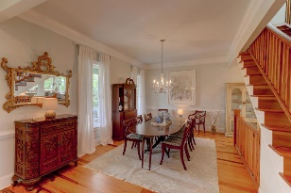
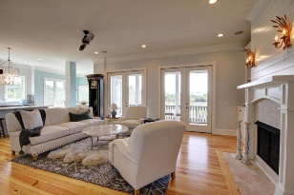
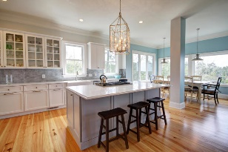
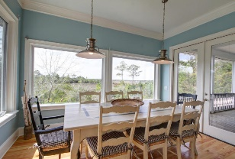
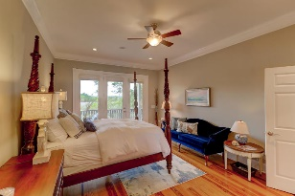
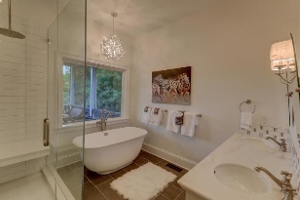
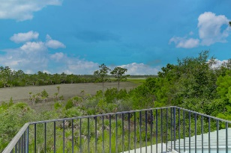
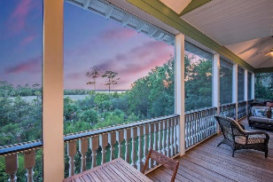
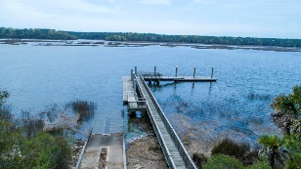

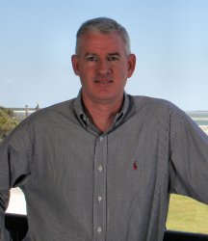
1471 Cat Island Parkway
Paradise Island :: Awendaw, SC 29429
MLS# 18022617 :: $750,000
Amazing Location!
Amazing Price!
First Time On The Market!
Stunning low country home with unobstructed views of the Wando River. This custom built home has recently under gone a renovation with new kitchen including custom cabinetry, top line appliances including 6 burner gas cook top, double ovens, new dishwasher, microwave and refrigerator. The exterior and interior has new paint. Open floor plan great for entertaining with easy flow from dining room to great room and kitchen only separated by a floating staircase. Separate eat in area with more river views. The great room extends to the large screened in rear porch which again is great for entertaining or just catching an incredible sunset.
Master Suite remodeled and new fireplace with shiplap and new stone details. Master bedroom is on main living level with an attached office/nursery area and a shower with rain head, gorgeous stand alone tub and new flooring and lighting. Large walk in closet and separate water closet complete this space. Upstairs are three guest bedrooms all with their own baths, two of the bedrooms have private sunning decks with spectacular views. House has beautiful heart pine floors throughout, central vacuum and even hurricane shutters on most windows and doors. Large two car garage with lots of storage and nicely manicured lawn with irrigation . There is a private boat landing with ramp directly on Wando River and boat storage for residents. Just for Short drive to nearby beaches and even shorter to new shopping areas including minutes from Costco.
Clay Cunningham
O (843) 886-8110
M (843) 345-4647
clay@carolinaone.com
www.claysre.com
Carolina One Real Estate
1503 Palm Blvd Ste
Isle of Palms, SC 29451

