Slide 1

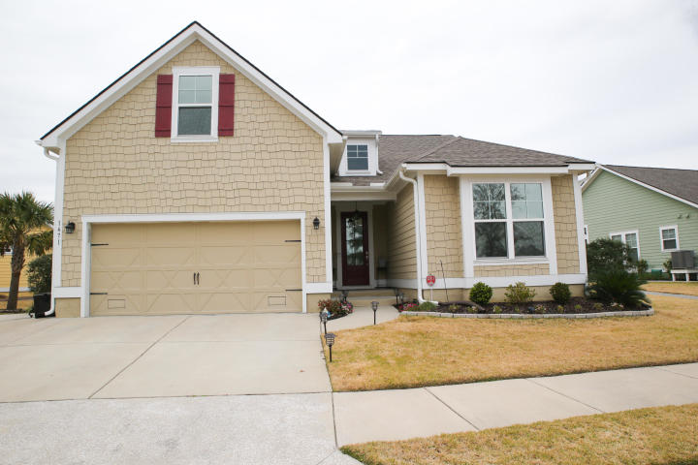
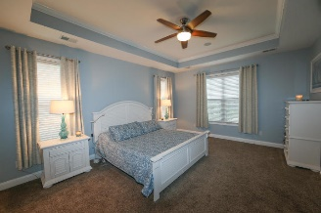
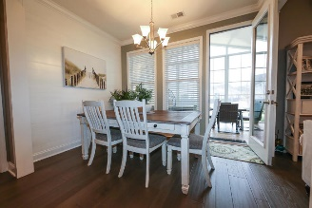
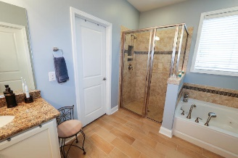
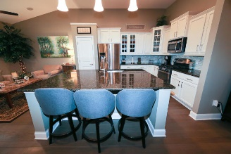
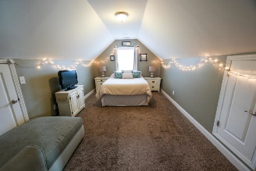
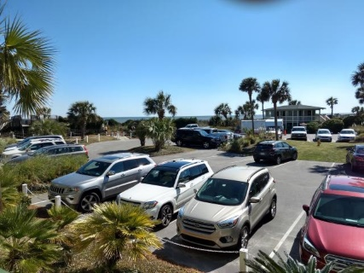
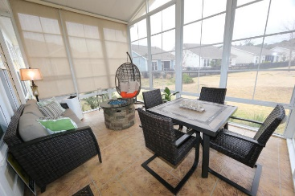
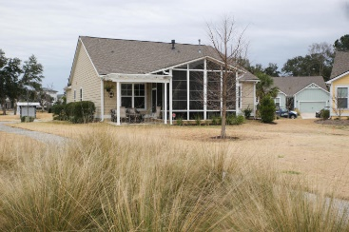
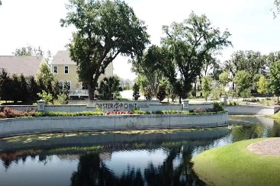
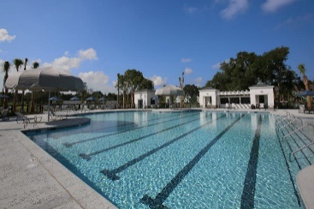


Agent Open House Wednesday, April 10th ~ 11 to 1
1471 Longspur Drive
Oyster Point - Mount Pleasant, SC 29466
MLS# 19005789 - $544,990
Pristine 1.5 story Bluffton Cottage with LOW HOA Fees and RE Taxes & NO FLOOD INSURANCE needed. Premium lot has Pond views from the front and back of home. Open floor plan with fireplace is an owners dream. A 12' x 16' 4-season room was added with a stamped concrete floor & EZ Breeze windows to enjoy the pond views. Also added was a 10' x 11' cement patio with Pergola with pond views. This move-in ready home boasts upgraded hardwoods, upgraded kitchen cabinets, brilliant granite counter-tops, and stainless steel appliances. Sonos sys. & Speakers to convey. The spacious first Fl. Master bedroom features tray ceilings & walk-in closet with built-in shelving. Home is only 4 miles to the IOP Beach and 6 miles to the downtown, OP has resort-style amenities, making this a must see home.
Steve Troyano
(843) 371-4790 | stevetroyano@kw.com
stevetroyano.kw.com
Keller Williams Realty Chas. Islands | 1304 Palm Blvd | Isle Of Palms, SC 29451

