Slide 1
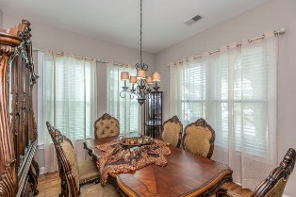
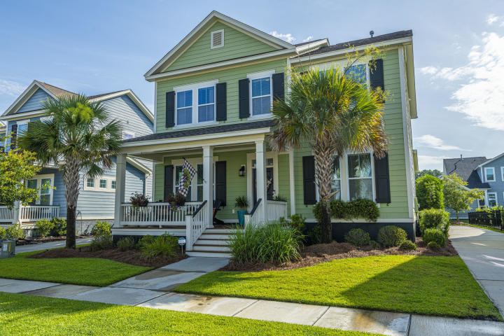
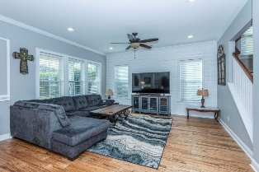
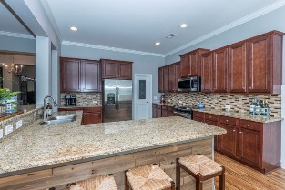
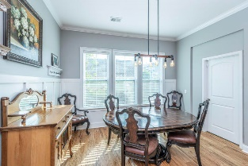
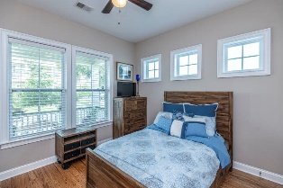
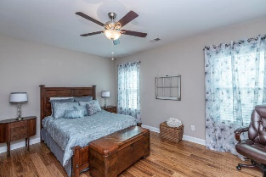
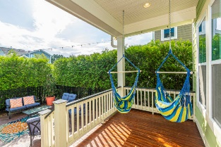
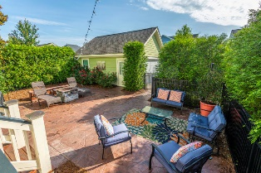
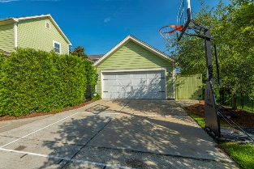


1472 Croaton Crossing
Carolina Park ~ Mount Pleasant, SC 29466
MLS# 20018224 ~ $549,500
Just Reduced in Carolina Park!
Beautiful 4 bedroom, 3 bath home with lots of Charleston character in highly desirable Carolina Park. This home has several custom upgrades including hardwood floors throughout the home, ceramic tile bathrooms, shiplap in the family room, sliding barn doors to the executive office, crown moulding, and a mudroom that leads to a back porch, stamped patio, and private fenced yard. The large open kitchen features granite countertops and looks over a spacious living room. Upstairs, the master bedroom with ensuite bath and his-and-her closets is complemented by two bedrooms, full bath, and an open loft. Downstairs, there is a private mother-in-law suite with an additional full bathroom. New washer and dryer convey with the home.
A $1500 lender credit is available and will be applied towards the buyer's closing costs if the buyer chooses the seller's preferred lender. This credit is in addition to any other negotiated seller concessions.
Virtual Tour: https://my.matterport.com/show/?m=6m3jmMmMAeL
Kristin Schatmeyer
Cell - (843) 697-7370
kristin.schatmeyer@carolinaone.com
www.KristinSchatmeyer.com
Carolina One Real Estate
2713 Highway 17 North
Mt. Pleasant, SC 29466

