Slide 1
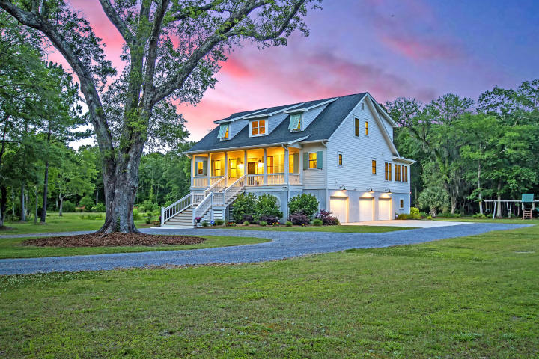



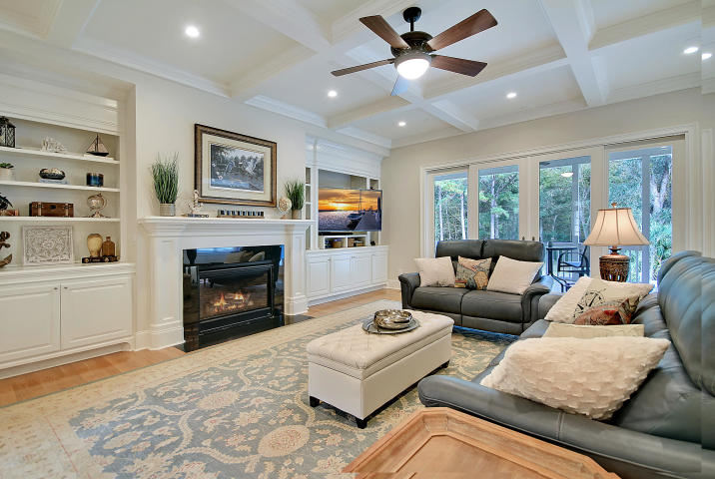
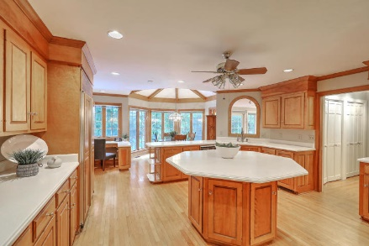
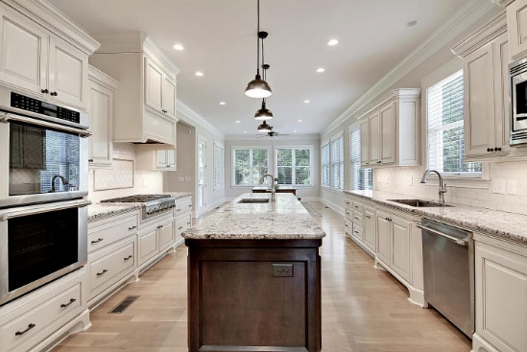



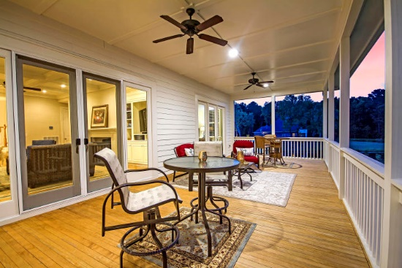

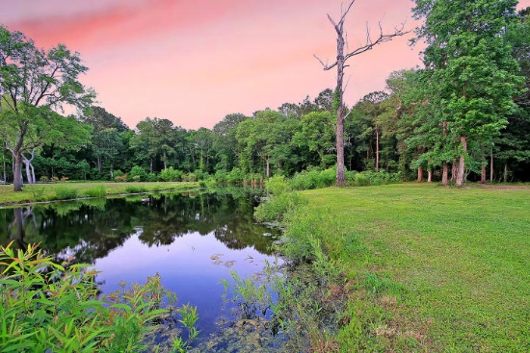
Parkshore Marshfront
Just Reduced!
1472 Old Rosebud Trail
Pepper Plantation ~ Mount Pleasant ~ MLS# 19012983 ~ $1,215,000
Located in the peaceful, gated, equestrian community of Pepper Plantation, this custom home sits on a three acre pond lot & shows like a model. When you're here, instead of hearing traffic all day, nature noises are the only backdrop with horses neighing, honking geese & leaves rustling on mature trees. Be prepared to fully enjoy the low country landscape from the full front porch, the expansive back deck & the patio down below. This sun drenched, open floor plan is riddled with high end finishes, has amazing storage throughout & features a self-contained, ground floor mother-in-law suite with a kitchen, bedroom, full bath & living room. A massive chef's eat-in kitchen, fireplace in the living room & luxurious owner's retreat are just a few elements that make this home so inviting!
APPRAISAL IN HAND FOR $1,375,000
Additional features include:
Just 2.5 miles from Wando High School and the new Lowes. Only 2 miles from the new Costco and Mount Pleasant Hospital. A straight-shot ride down Hwy 17 to the Ravenel Bridge.
Horses and chickens are both permitted in Pepper Plantation
Plenty of room in the backyard for a pool
Three car garage with additional storage space contained under the front porch, accessible from door in back of garage.
Wando River access and boat ramp is just outside the gates to Pepper Plantation, at the end of Chandler Road.
Flood zone "X" (minimal flood risk, no flood insurance required)
Book your showing today!
Christopher Smith christopher@mattoneillteam.com 843-267-0735

