Slide 1

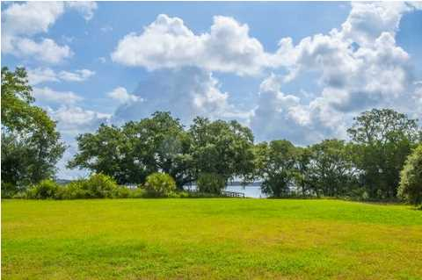
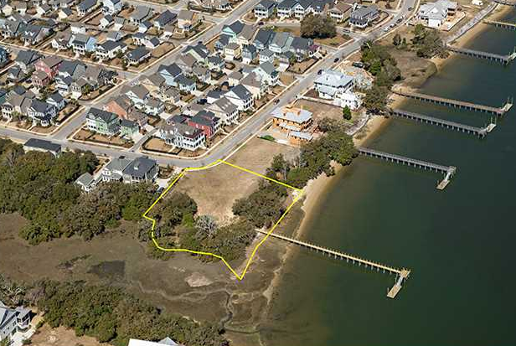
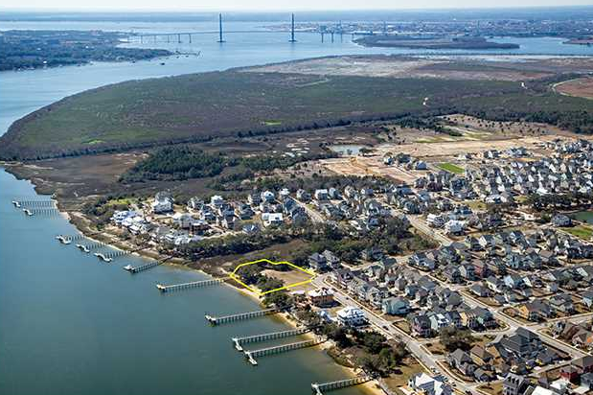
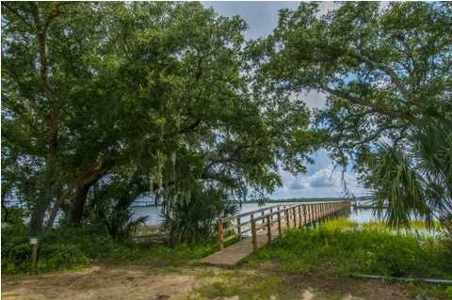
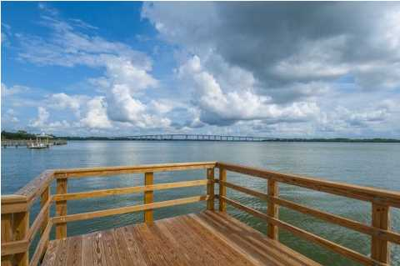
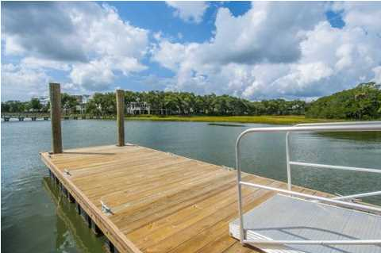
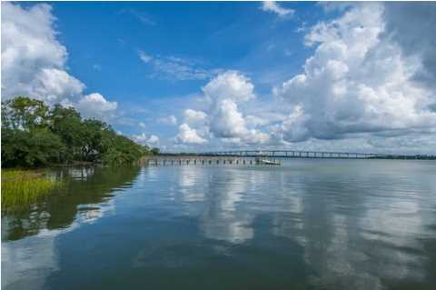
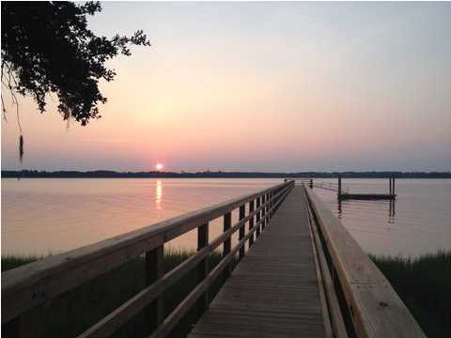

Deep Water Lot with Dock
1472 Wando View St ~ Smythe Park @ Daniel Island
A true Deep Water lot on the Wando River with Private Dock already in place! Build your dream home on one of Daniel Island's largest lots, just over .80 acres. This corner lot gives you plenty of privacy along with breath taking beauty as you watch the sun rise over the Wando each morning. Located in prestigious Smythe Park Neighborhood, you are close to the Daniel Island school (K-8), the Library and the 11 acre Smythe Lake with canoe/paddle board launch along with plenty of walking and biking paths. There is also a Pool, Pavilion and Play Parks close by. Daniel Island offers a coastal life style along with many shops, restaurants, and community events all year long. Buyer pays a onetime neighborhood enhancement fee of .5% of sales price to Daniel Island Community Fund at closing. Daniel Island resale addendum will be required on offer to purchase.
MLS# 1423776
$1,500,000
.81 Acres
Lisa O’Keefe
ABR, GRN, SFR
843-442-7968 C
lisa@theroettgerteam.com
The Roettger Team
Carolina One Real Estate | 195 W Coleman Blvd | Mt Pleasant, SC 29464

