Slide 1
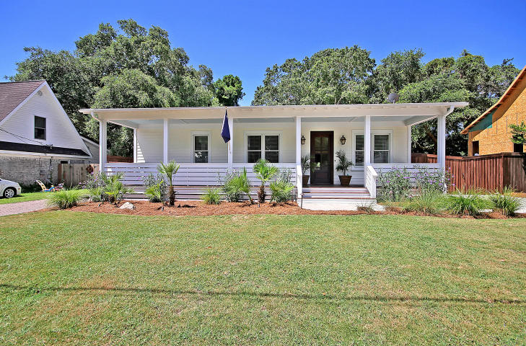
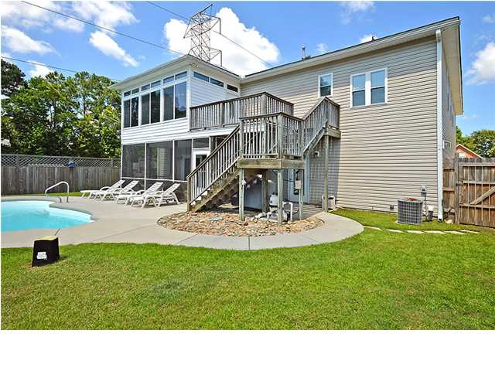
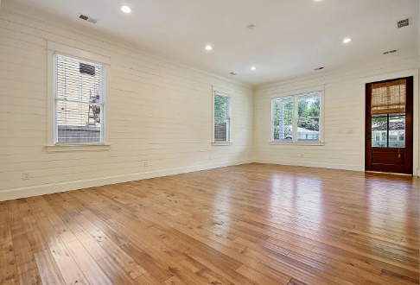
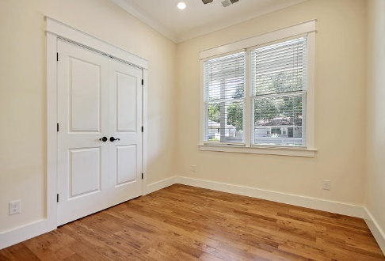
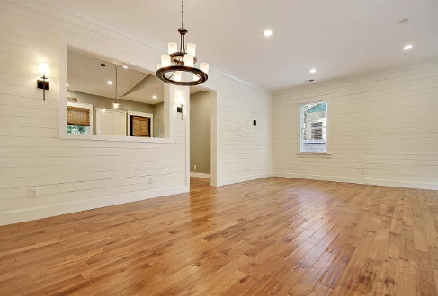
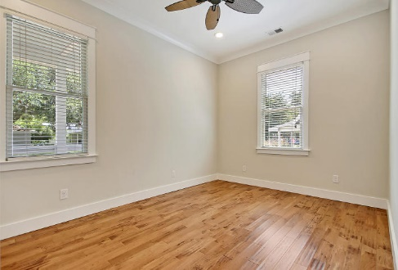
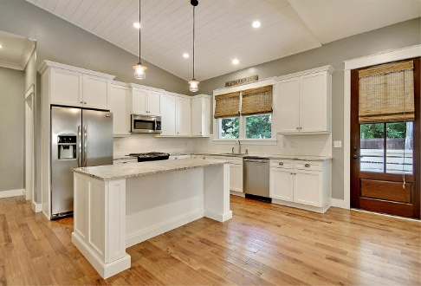
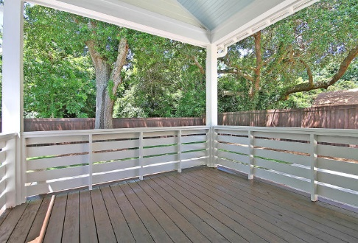
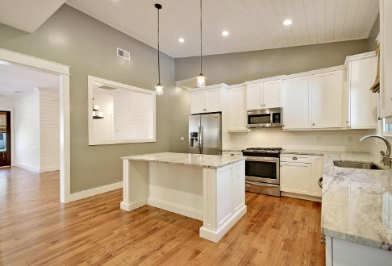
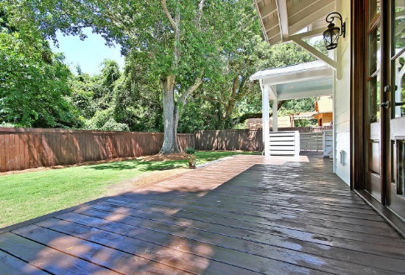
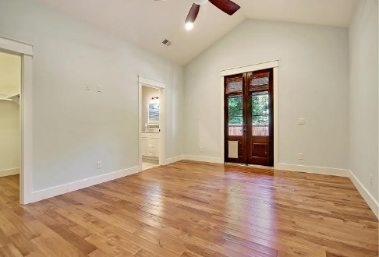
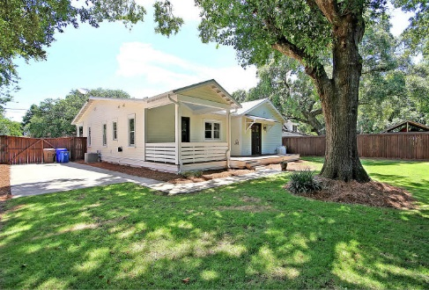

Price Reduced!
Price Reduced
1473 Mataoka Street
Osceola Heights ~ Mount Pleasant ~ MLS# 18019573 ~ $784,900
So many amazing details in this gorgeous home! Walk through the door and take in the stunning hand scraped hardwood floors, sparkling white shiplap walls, custom moldings, and breezy paint colors. The kitchen has been beautifully updated with white cabinetry, a large island with tons of storage, and neutral granite countertops. The bathrooms were also updated with light crisp colors, beautiful stone counters, and tile showers. The large low country porch is where you will want to spend your days relaxing and sipping cold glasses of sweet tea on hot summer evenings. Or, if you enjoy privacy, you will love the spacious fenced back yard complete with a huge deck....great for entertaining!
Additional features include:
Location, location, location!!
Quiet Old Village neighborhood.
Four spacious bedrooms with beautiful hardwood flooring.
Large back deck with enclosure.
Huge concrete driveway.
New sod in front yard.
Beautiful landscaping.
Metal roof.
Book your showing today!
Hamilton Horne Hamilton@MattOneillTeam.com (843)708-0584

