Slide 1
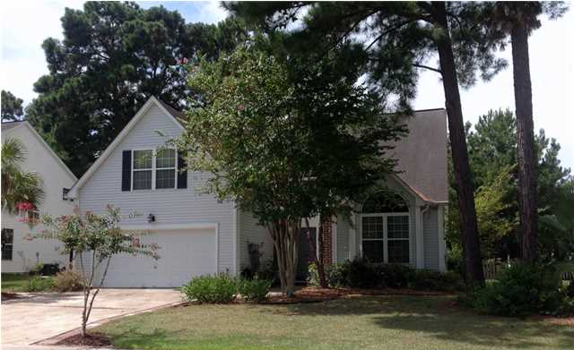
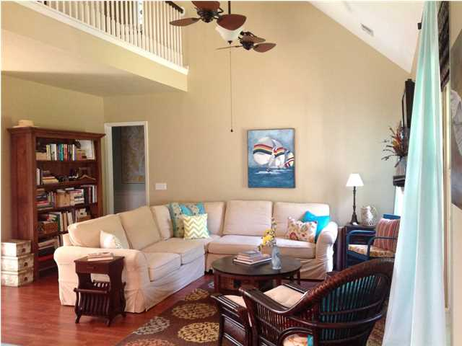
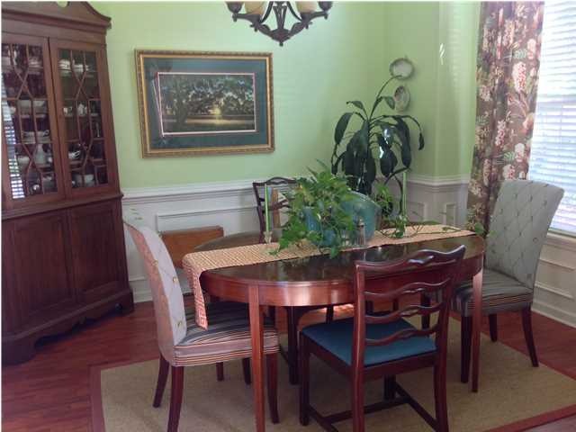
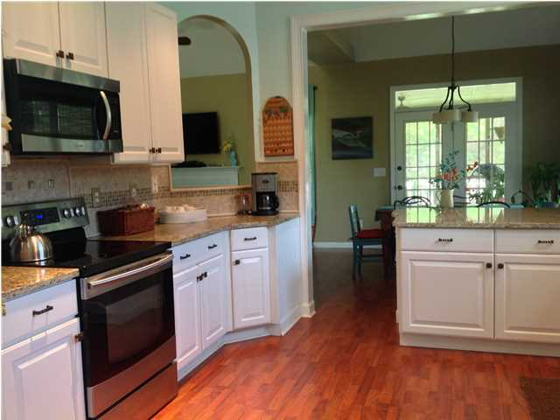
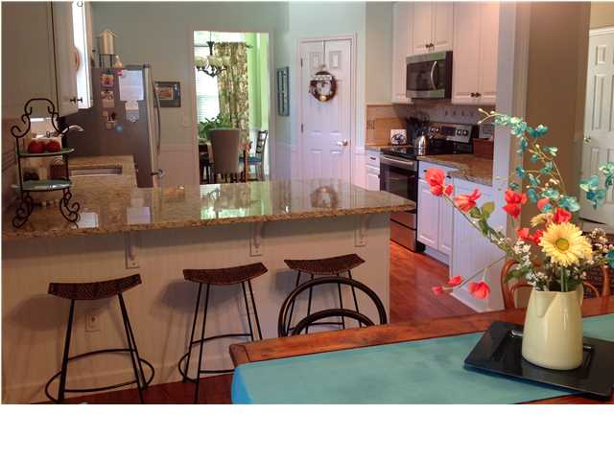
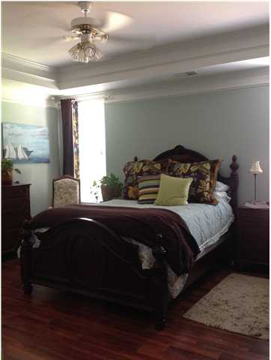
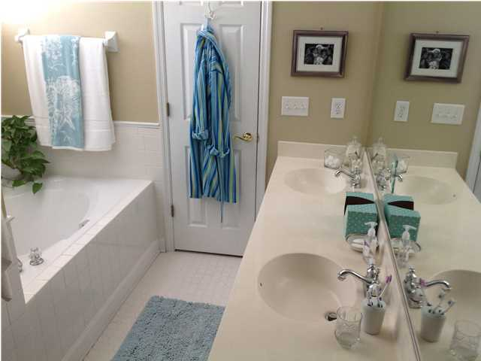
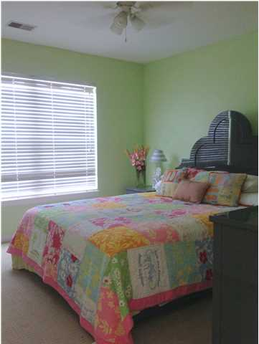
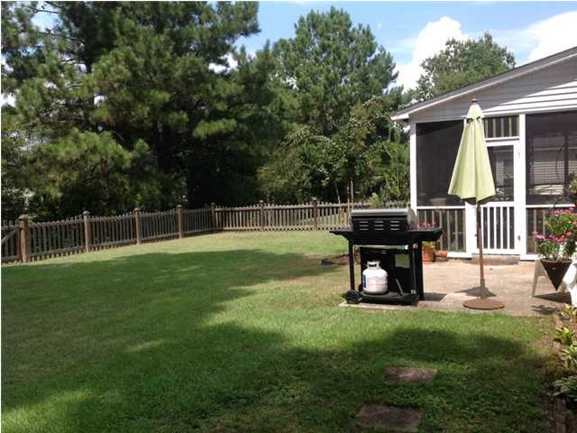
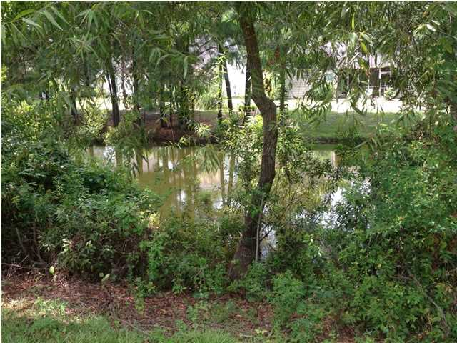



1475 Cypress Pointe Dr Dunes West Mt Pleasant, SC MLS# 1423717 $365,000
Open House ~ Sunday Sept. 14th, 12-4
Big 4 Bedroom Home Within a Mile of I-26!
This beautiful two-story has it all so see it quick before it's gone. Located in the Cypress Pointe section of Dunes West Subdivision, just outside the gates. The home has been renovated within the last three years and is move in ready with 4 bedrooms, master suite on main level, and 2.5 baths. Home has an open floor plan with laminate wood flooring for most of main level, crown moldings, wainscoting, wall frame moldings, cathedral ceilings, French doors, and more. Kitchen has granite countertops, stainless appliances, custom tiled back splash, island, large pantry and recessed lighting. Stainless refrigerator will convey. The family room features fireplace with granite, cathedral ceiling, wood flooring and is open to kitchen for easy entertaining. Flat screen television over fireplace will convey. Master suite on main level has a tray ceiling, crown molding, wood flooring and walk-in closet. The master bath has a garden tub, separate shower, dual vanity and tile flooring. Main level also has a powder room and a laundry room. Upgraded carpeting upstairs where you have 3 other bedrooms and a full bath. The finished room over the garage is being counted as the fourth bedroom but could be used as an upstairs den, playroom, or whatever you need. There is also a large screened porch off the kitchen, a patio for grilling and big fenced backyard overlooking a pond. Dunes West is a sought after community with amenities including pool, water slide, fitness center, boat ramp and storage, biking and walking trails, sidewalks, with golf and club memberships available. Desirable schools to include Laurel Hill, Pinckney, Cario and Wando High School.
Jennifer Nipper, Realtor®
(843) 478-1800 | jen@AgentOwned.com
www.AgentOwned.com
The AgentOwned Realty Co | 824 Johnnie Dodds Blvd | Mt. Pleasant, SC 29464
Real Estate • Mortgage • Insurance

