Slide 1
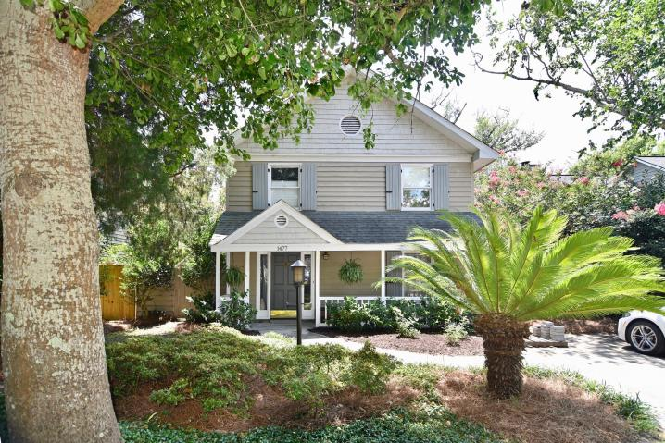
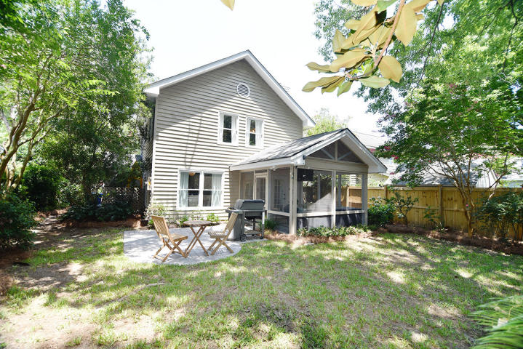

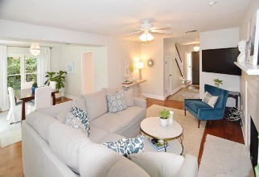
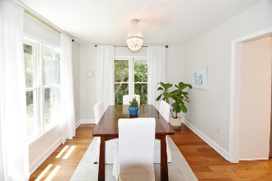
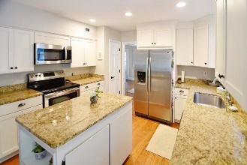
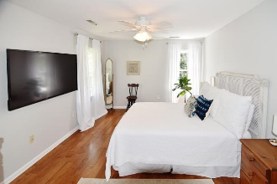
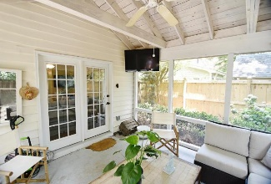
Price Just Reduced! Open House Thursday 11:30-1:00 Refreshments Will Be Provided 1477 Kinloch Lane ~ Old Mt Pleasant ~ MLS# 18018494 ~ $545,000
Located on a quiet, tree-lined street in the heart of Old Mt Pleasant, this exceptionally maintained home is close to everything! Just a short walk to shopping, restaurants and award winning Mt Pleasant Academy & Moultire Middle Schools, quick bike ride to the beach, and 10 minute drive to Downtown Charleston. Enjoy the many updates that include engineered hickory flooring throughout, new carrara marble mantle above the fireplace, and updated kitchen and bathrooms.
The backyard includes a privacy fence, mature landscaping, new patio and oversized screened porch which is perfect for relaxing or entertaining. Upstairs, the spacious master suite includes a large walk in closet. The owners just installed a new HVAC in April of 2018, and no Flood Insurance is Required!
Trey Morrison
trey@landsouthofcharleston.com
Mobile 843-697-6849
Land South of Charleston, LLC | 180 E Bay St Ste 300 | Charleston, SC 29401

