Slide 1
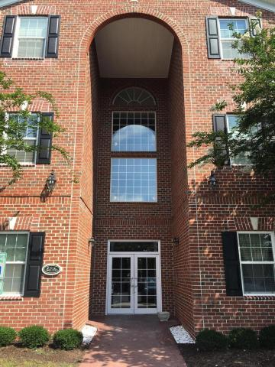
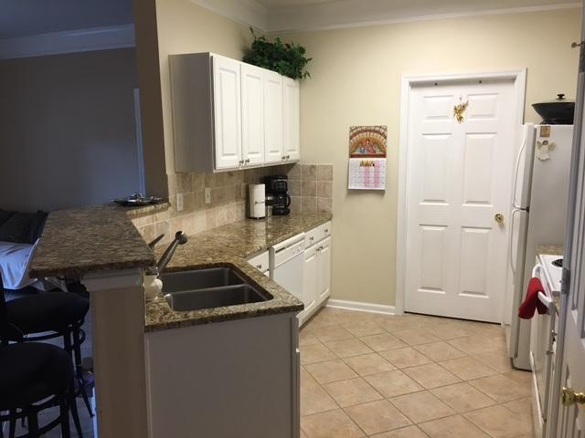
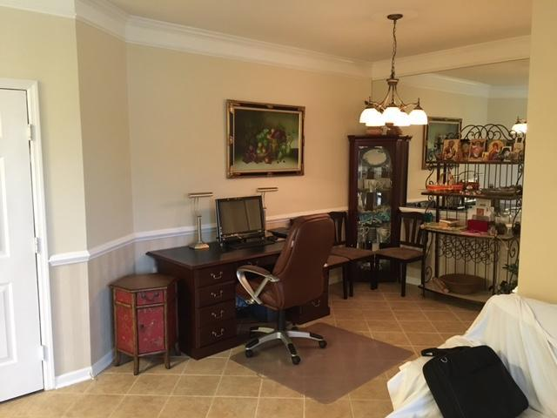
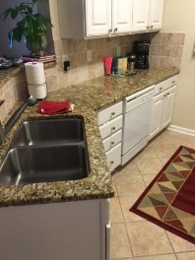
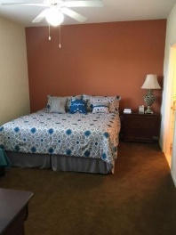
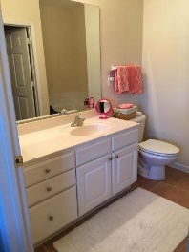
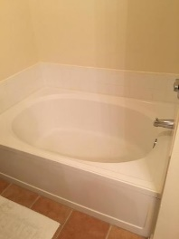
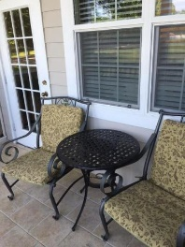
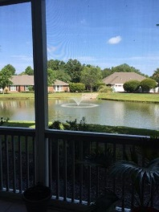
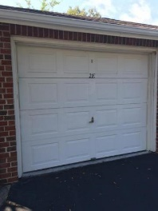
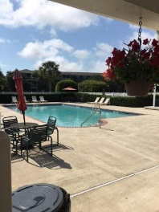
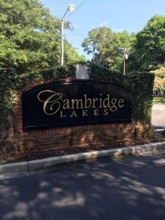


REDUCED PRICE…
BRING ALL OFFERS!
1477 Cambridge Lakes Dr #106
Cambridge Lakes
Mount Pleasant
MLS# 16014982
$229,900
2 Bedrooms | 2 Baths | 1,093sf
FIRST FLOOR CONDO WITH DEEDED GARAGE!
Excellent Condition! Two Bedrooms, Two full bathrooms with tile flooring and granite counters! Only carpet is in the two bedrooms. Perfectly located just minutes from the beach, downtown Charleston, shopping and restaurants! Only 1 minute from I-526. Neighborhood swimming pool and clubhouse. Each building requires security code to enter.
Erik Fender
C 843-830-7346
O 843-856-8800
erik.fender@cbcarolinas.com
Coldwell Banker Residential Brokerage
1127 Queensborough Blvd. 103
Mt Pleasant, SC 29464

