Slide 1
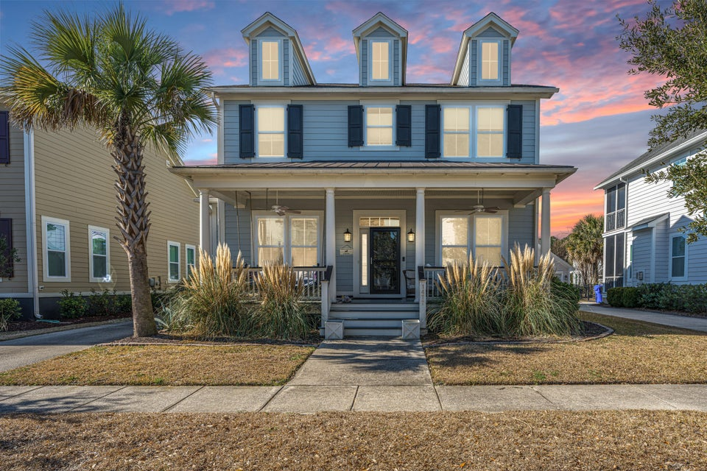
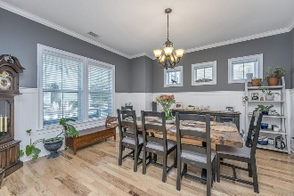
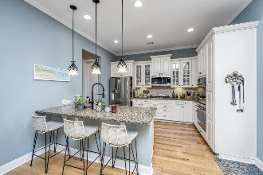
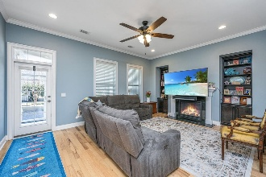
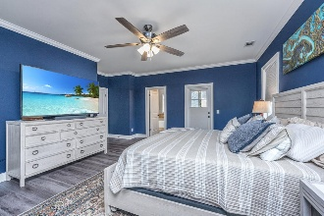
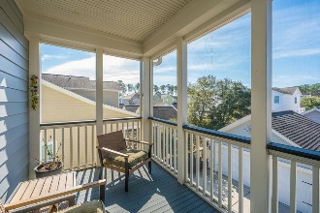

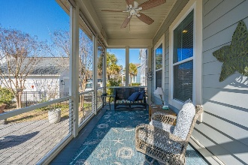
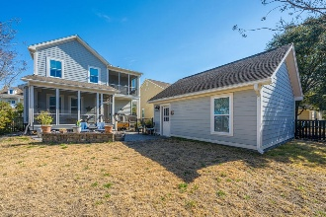
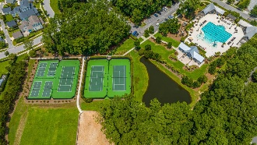


1477 Croaton Crossing Carolina Park | Mount Pleasant, SC 29466 MLS# 26004487 | $929,000
OPEN HOUSE SATURDAY 1-3
PRICE ADJUSTMENT!
Nestled in the heart of Carolina Park, one of Mount Pleasant's most sought-after communities, 1477 Croaton Crossing offers an exceptional blend of timeless style and modern comfort. This beautifully updated 3-bedroom, 2.5-bath home spans 2,548 square feet and is thoughtfully designed for both elegant entertaining and relaxed Lowcountry living. Sunlight fills the open living spaces, creating a warm and inviting atmosphere throughout. The seamless flow leads to a charming screened-in porch—an ideal retreat for morning coffee, quiet evenings, or gathering with friends while enjoying the peaceful surroundings. Upstairs, the spacious primary suite provides a private sanctuary, complemented by two additional bedrooms featuring new luxury vinyl plank flooring. Significant 2021 updates—including a new HVAC system, fresh interior and exterior paint, and all new window treatments - offer both beauty and peace of mind. Located in vibrant Carolina Park, residents enjoy resort-style amenities including a pool, tennis courts, scenic walking trails, and neighborhood parks. Just minutes from top-rated schools, boutique shopping, dining, and the beaches, this home offers the perfect balance of convenience and coastal lifestyle. This is more than a home - it's a place to truly live and enjoy the best of Mount Pleasant.
Scan for a virtual walkthrough!
Suzi Baldrick Mobile 843-442-3149
suzi.baldrick@carolinaone.com
Carolina One Real Estate
1503 Palm Blvd
Isle of Palms, SC 29451-2280

