Slide 1
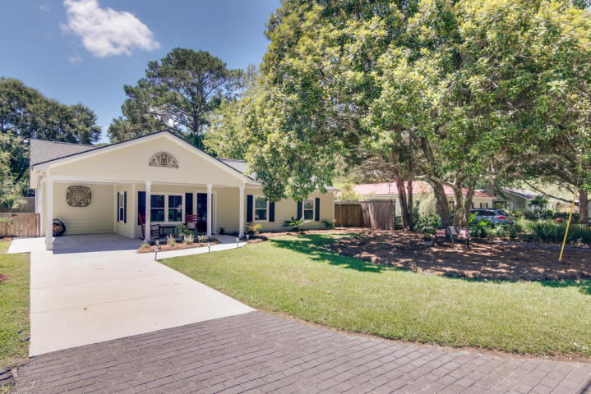
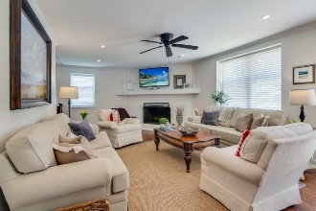
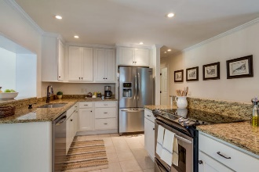
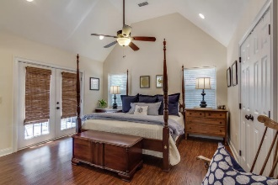
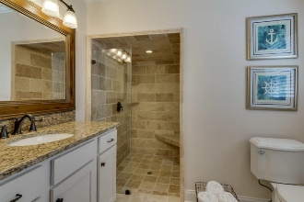
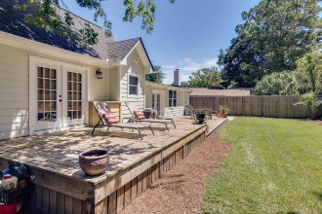
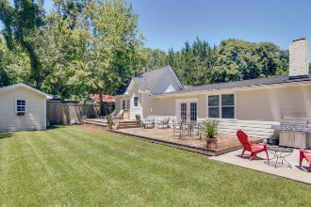

Lowered Price on Old Mt Pleasant Renovated Home
Open House Saturday 12-3 Refreshments Provided
1479 Goblet Avenue
Old Mt Pleasant :: Mount Pleasant, SC 29464 :: MLS# 16021977 :: $634,900
BEAUTIFUL, UPDATED, and RENOVATED from the studs out in 2012/2013, which includes all new plumbing, electrical, HVAC, Architectural ROOF, Energy Efficient Windows, TANKLESS WATER HEATER, EXTERIOR Hardi Siding, and Flooring throughout. The OPEN KITCHEN features updated cabinetry, GRANITE kitchen counters and STAINLESS APPLIANCES. There are ample storage closets, including a pantry, with updated wood shelving. This lovely home has 4 bedrooms, 2 custom baths, a large family room, a living/dining area, HUGE MASTER SUITE with VAULTED CEILINGS, double closets, and French door access to the HUGE MULTI-LEVEL DECK for your entertaining needs. Nicely Landscaped yard has 8’ privacy fence in the back, a CUSTOM BUILT SHED, lots of storage, and located in the highly sought after OLD MT PLEASANT!
Scott Baskin
843-324-4139 M | 843-972-2400 O scott.r.baskin@gmail.com | www.scottbaskin.com
RE/MAX Advanced Realty
311 Johnnie Dodds Blvd
Mt Pleasant, SC 29464

