Slide 1
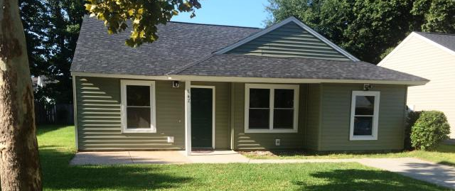
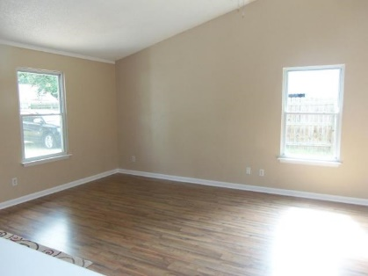
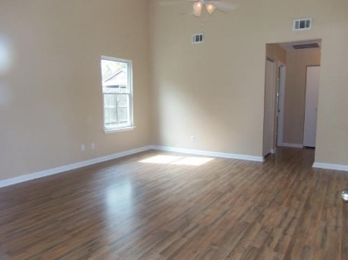
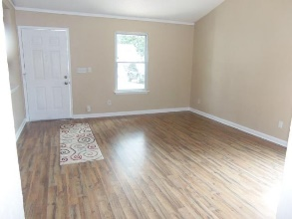

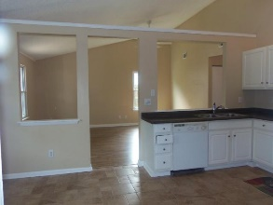
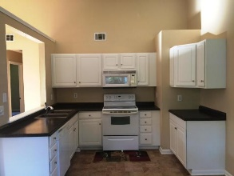
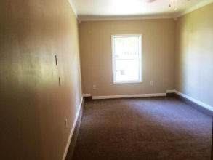
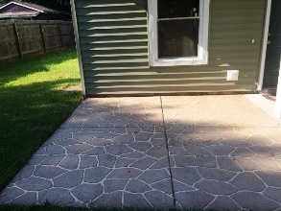


147 Manchester Rd Sangaree Summerville, SC 29483 MLS# 15021821 ~ $115,000
Move-in Ready
One of the best neat and clean homes in Sangaree!
This tastefully renovated 3br,1.5ba ranch style home has open floor, subsection (Victoria Place) has been updated with new paint, carpet, sandstone tile, vinyl siding, roof-architectural shingles, woodgrain laminate flooring, countertops, new windows, partial wooden privacy fence with spacious front and back yard. Vaulted ceiling in family room, kitchen & dining area. Updated larger closet space in bedrooms. 3rd bedroom is converted garage with a half bath. HVAC has new blower and has been serviced. Nearby schools, library, shopping, restaurants, walking and biking trails and play park. Great price, convenient location! Earnest money $500., Approved loan verification with offer.
Cheri Hamner
M - 843-364-4325
O - 843-261-7115
cheri.hamner@agentownedrealty.com

