Slide 1
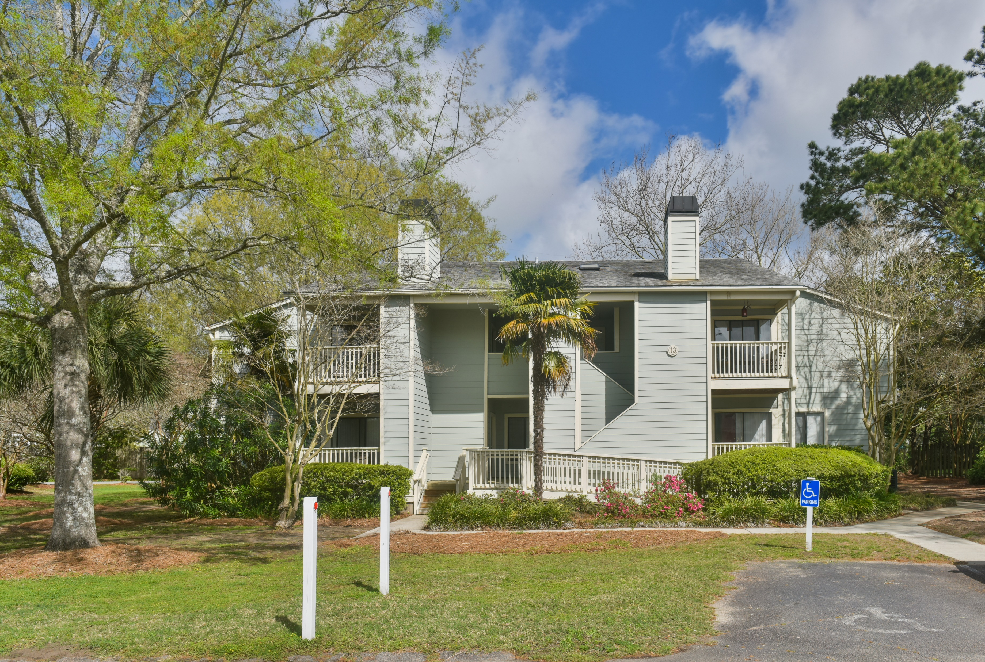
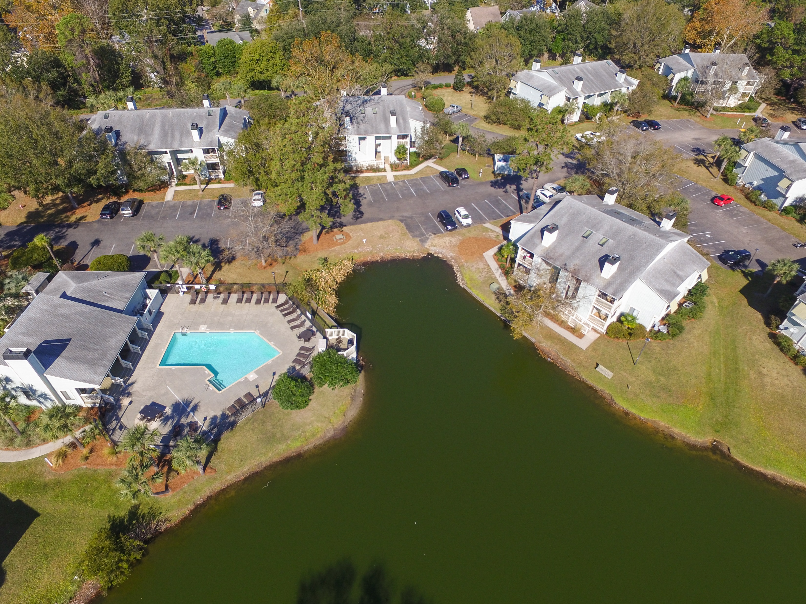
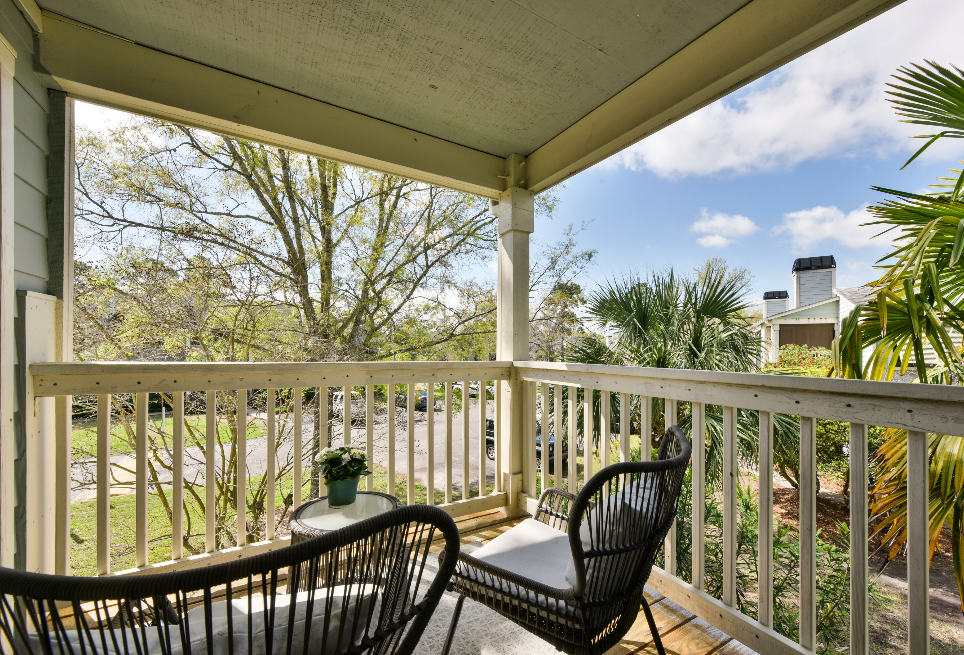
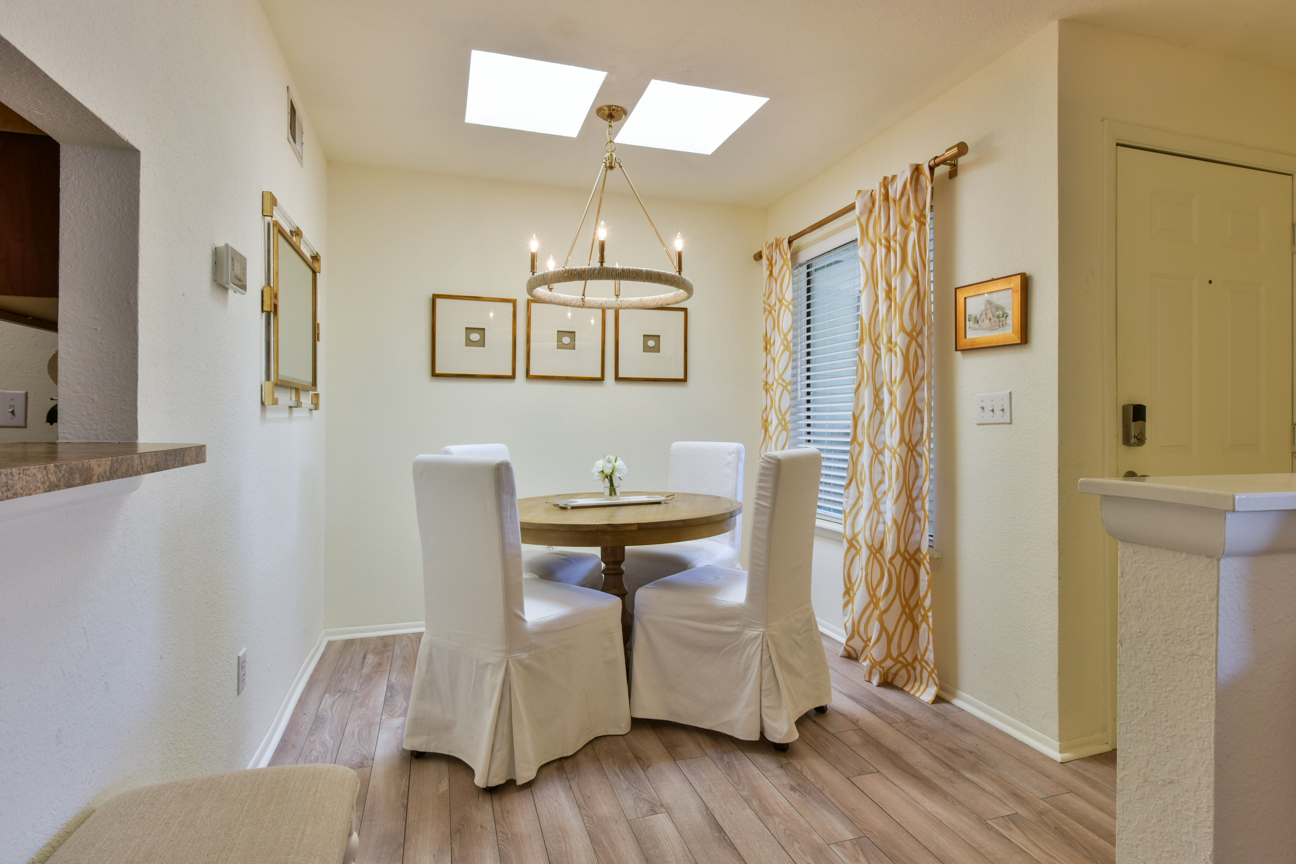
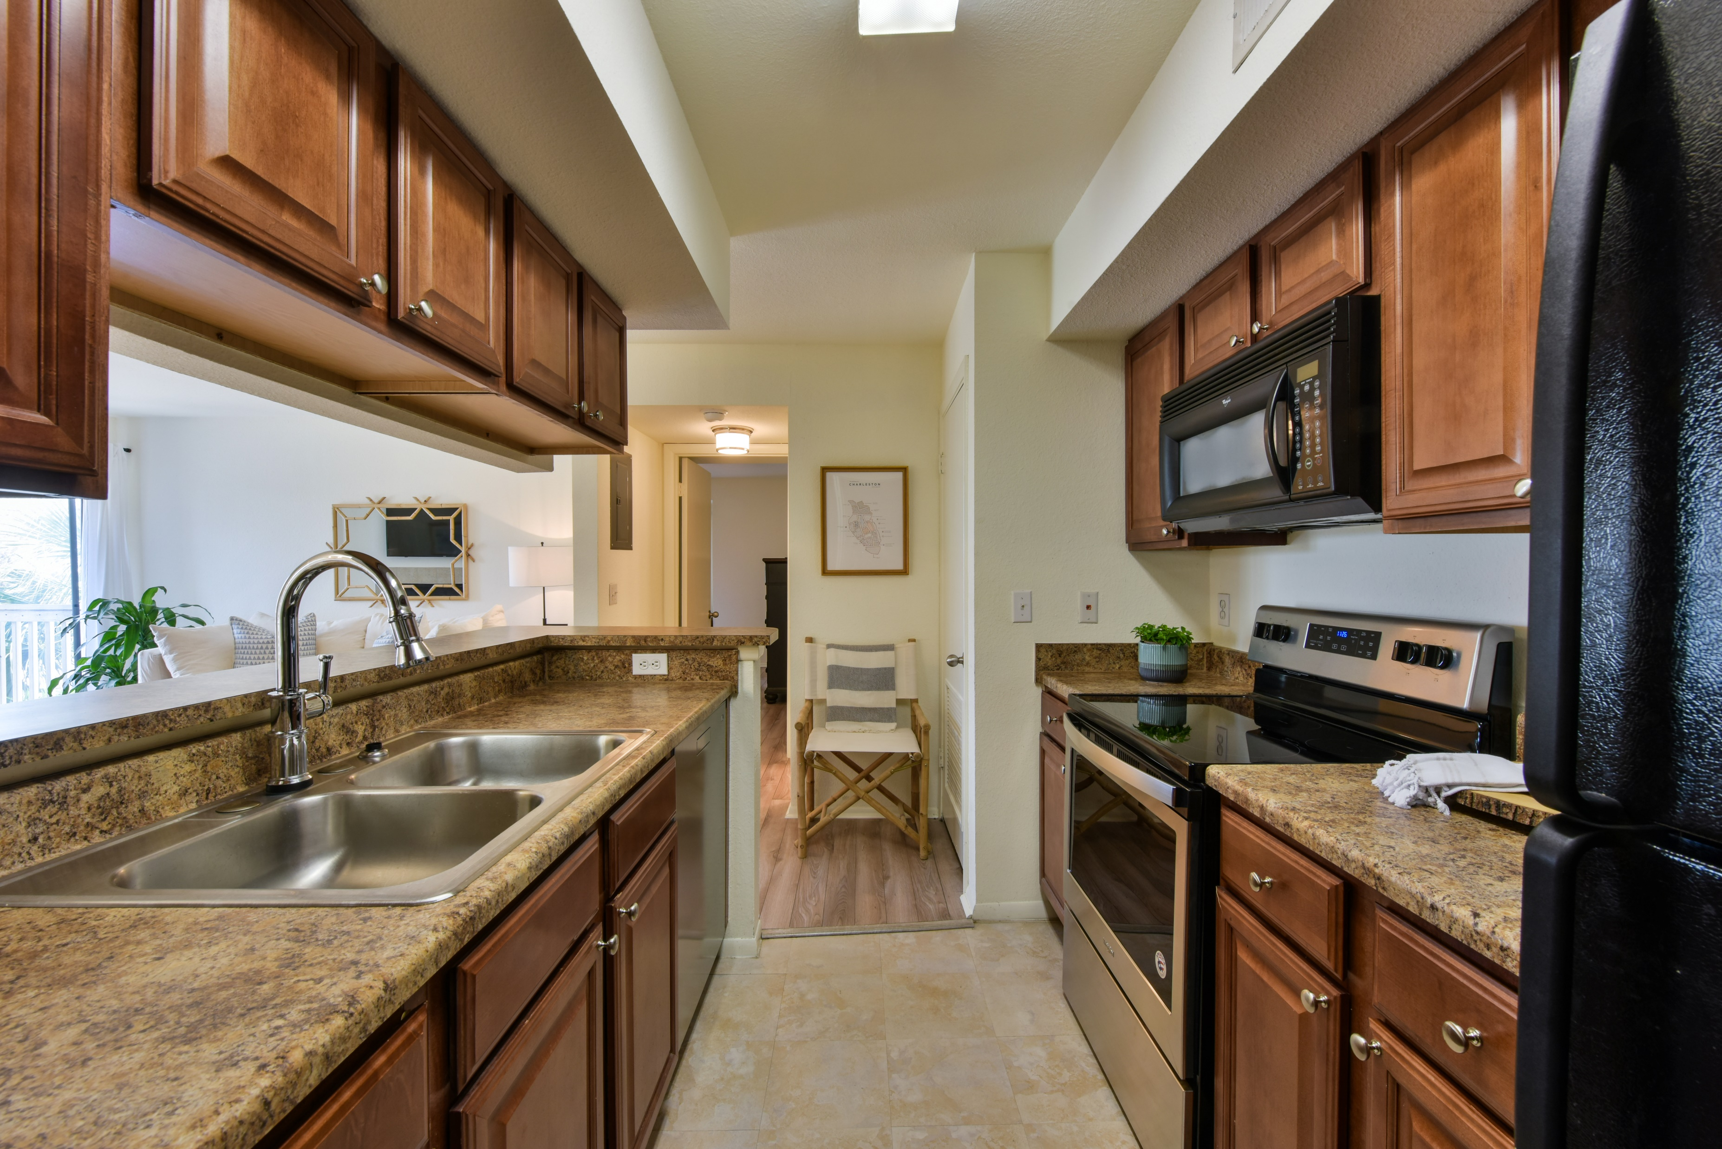
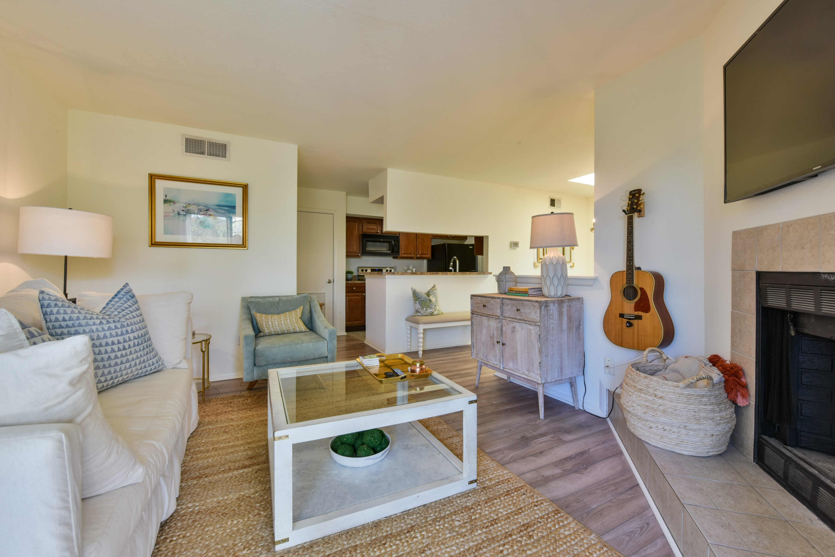
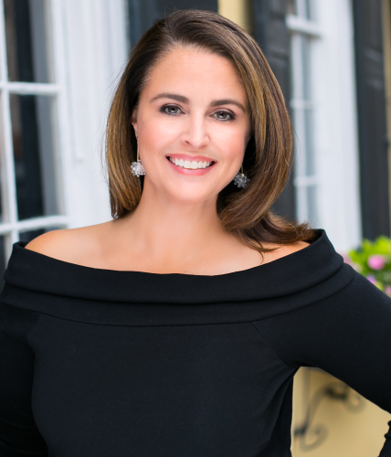

Virtual Open House Sunday 1-3
1481 Center Street 1303
Bay Club Sea Lofts ~ Mount Pleasant, SC 29464 ~ MLS# 20008570 ~ $205,000
Precious 1 bedroom Bay Club Sea Loft! Fabulous location and amenities! Walk to restaurants and grocery store, bike to Sullivan's Island and the Old Village. Amenities include pool, clubhouse with fitness center, tennis court, dog park, boat storage and more!
Feel free to call in or send your clients by clicking this link: https://zoom.us/j/2096635473
Please note they'll have to download the free Zoom app.
I will be available real time to answer questions and do video tours.
Robyn Hall
843-906-5200
robyn.hall@carolinaone.com
Carolina One Real Estate | 2713 Highway 17 North | Mt. Pleasant, SC 29466

