Slide 1
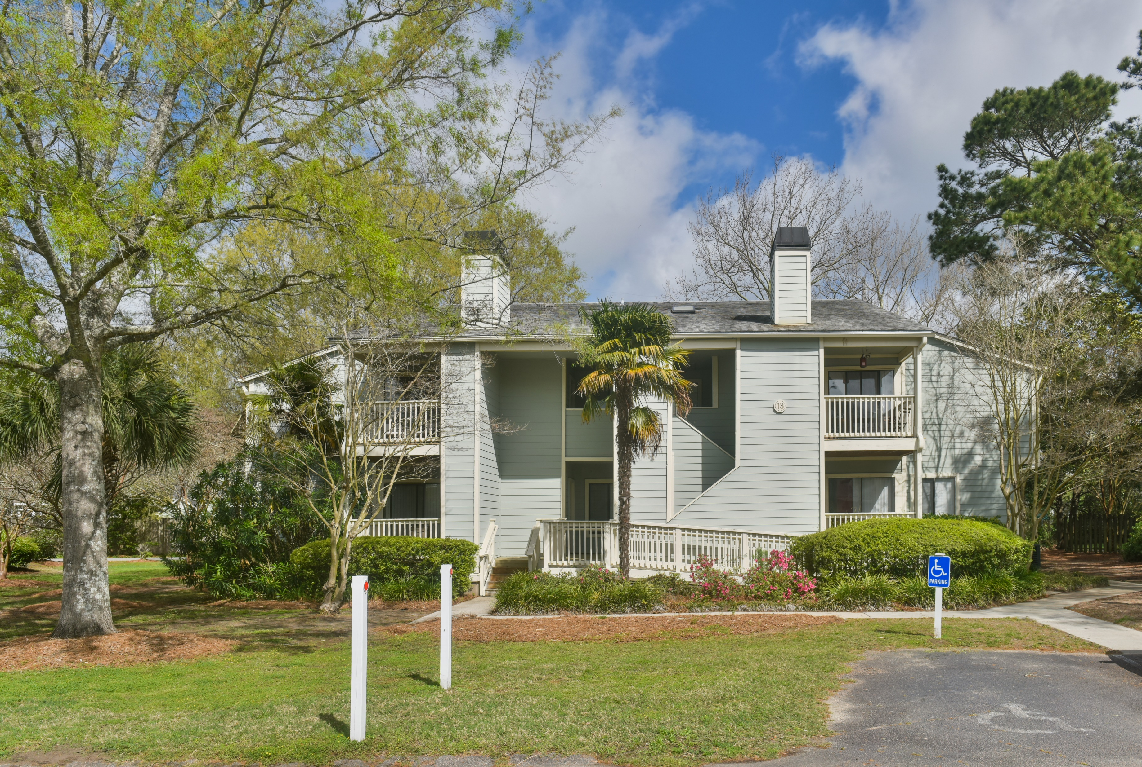
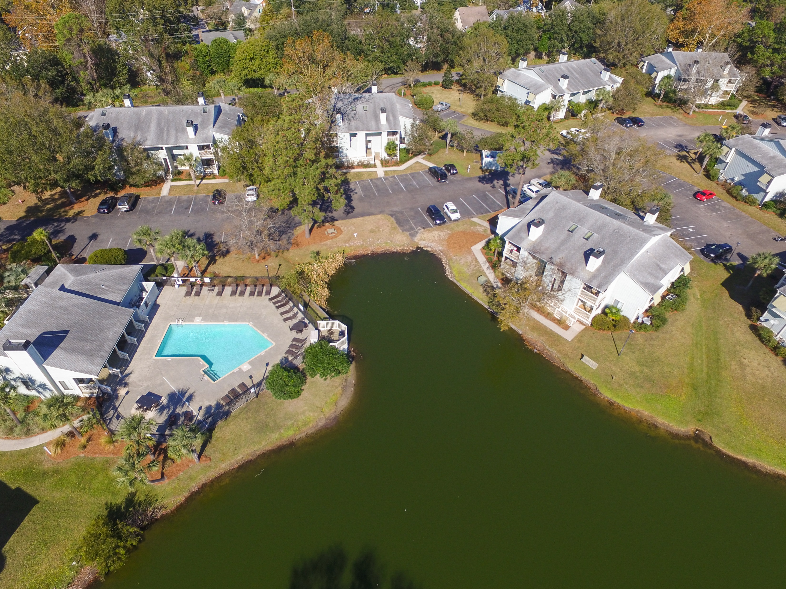
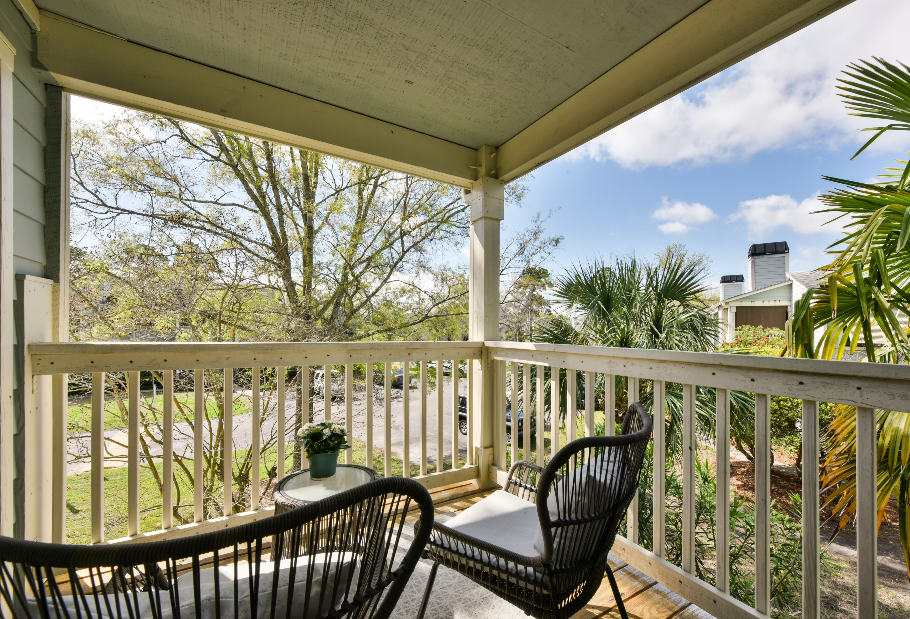
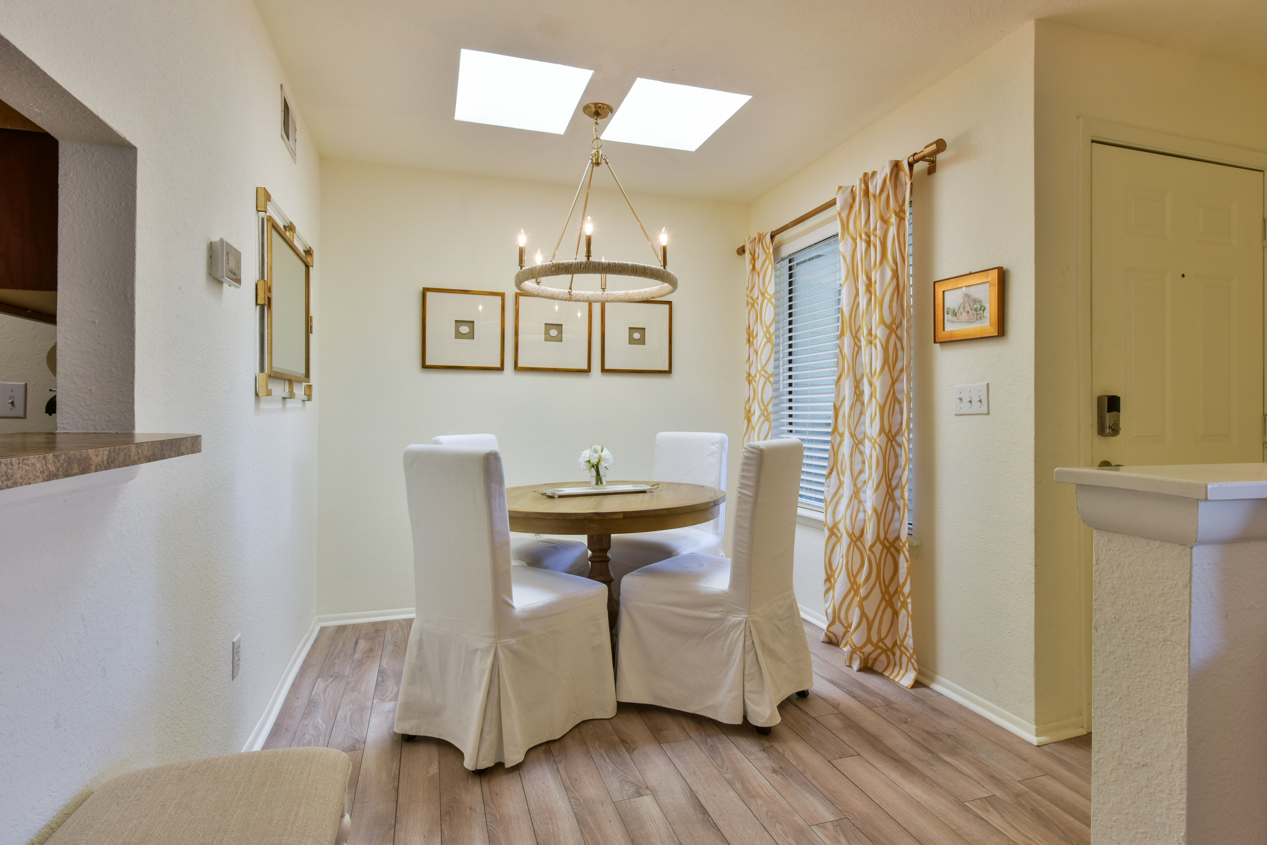
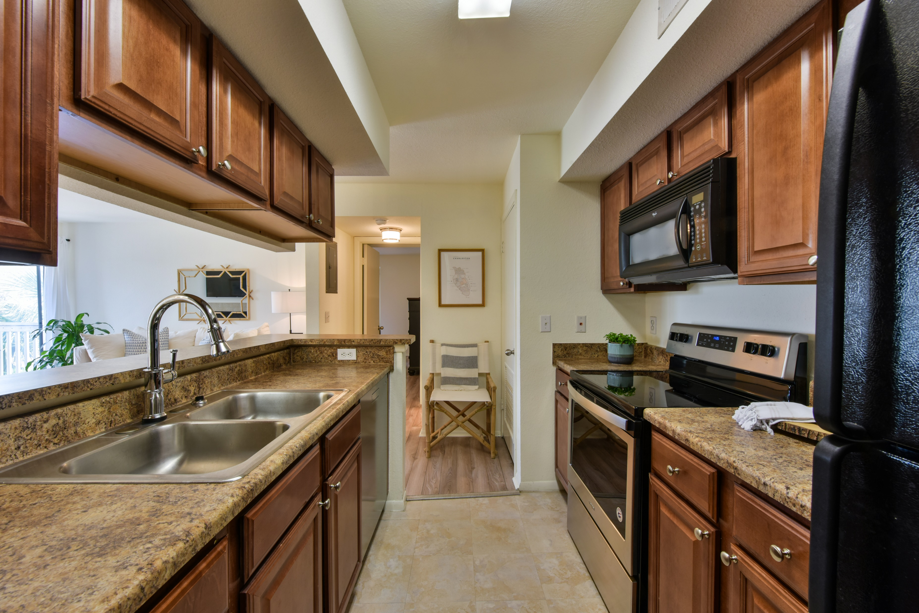
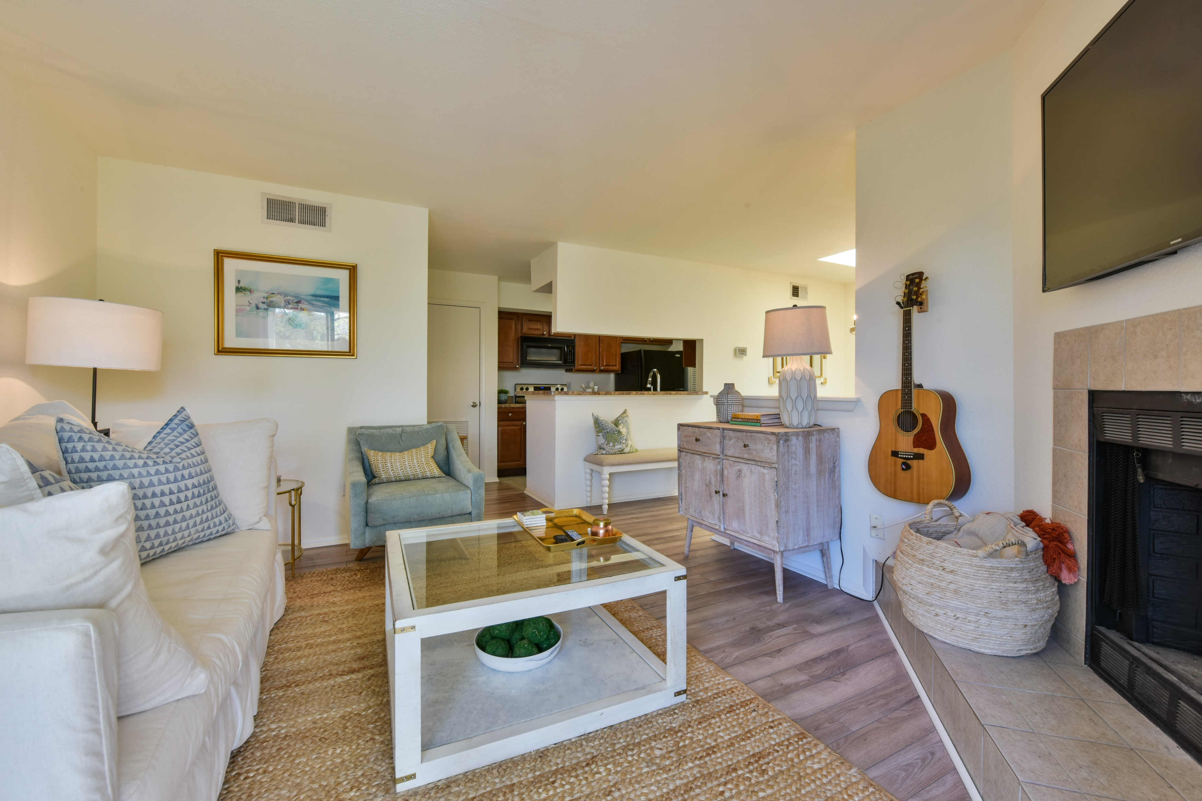
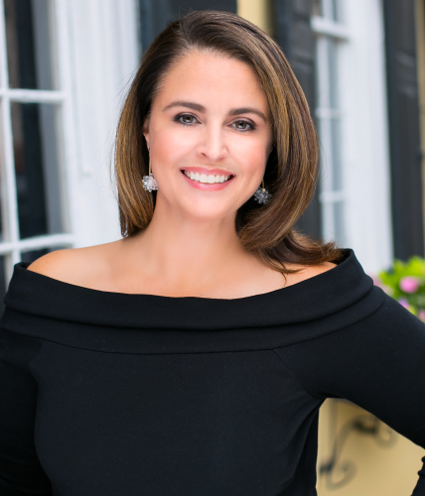

1481 Center Street 1303
Bay Club Sea Lofts ~ Mount Pleasant, SC 29464
MLS# 20008570 ~ $205,000
Precious 1 bedroom Bay Club Sea Loft! Fabulous location and amenities! Walk to restaurants and grocery store, bike to Sullivan's Island and the Old Village. Amenities include pool, clubhouse with fitness center, tennis court, dog park, boat storage and more!
Robyn Hall
843-906-5200
robyn.hall@carolinaone.com
Carolina One Real Estate | 2713 Highway 17 North | Mt. Pleasant, SC 29466

