Slide 1
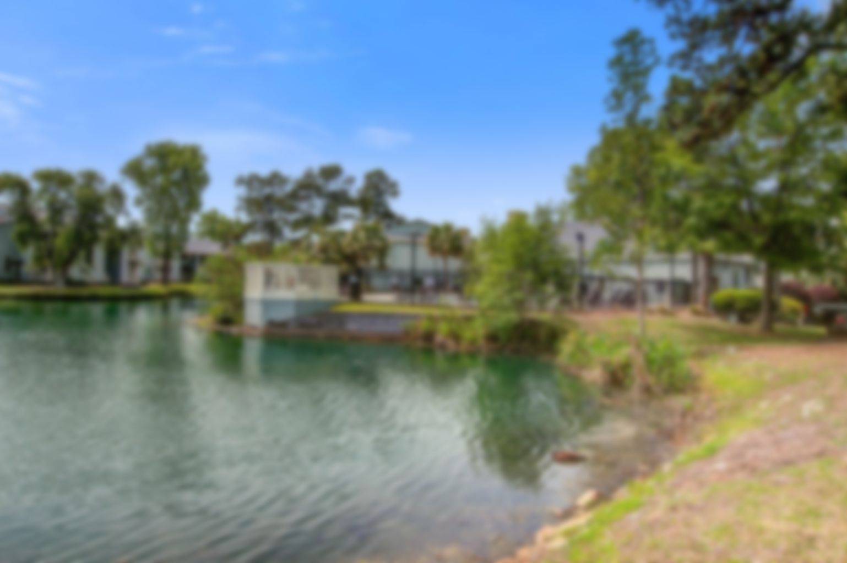
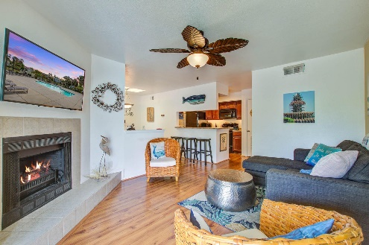
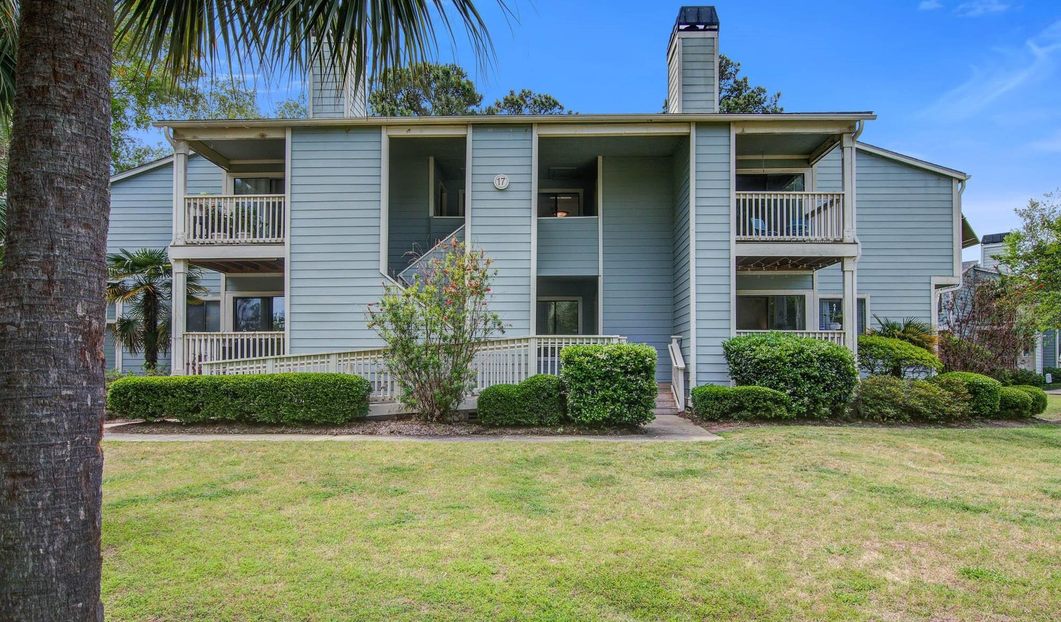
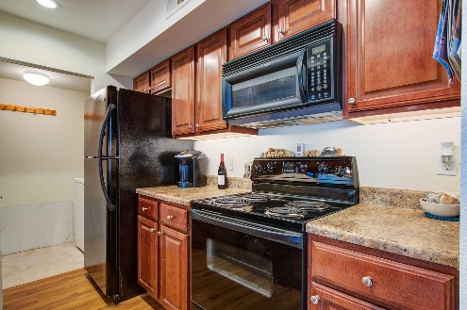
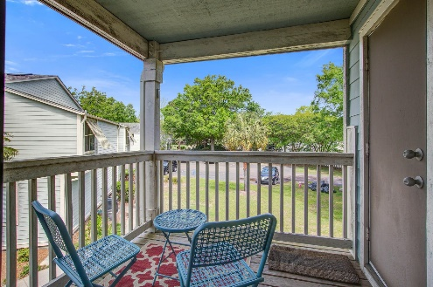
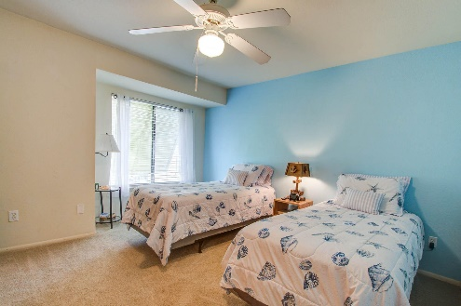
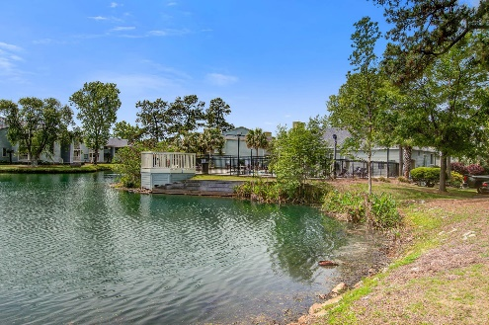
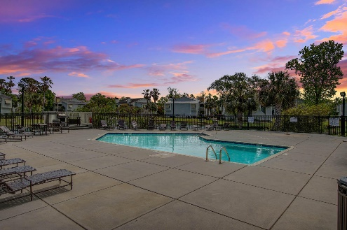

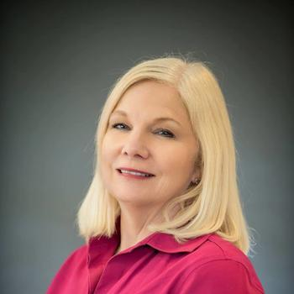
Bay Club Sea Lofts Just A Bike Ride To Sullivans Island!
1481 Center Street Ext #1704
Mt Pleasant, SC 29464 | MLS# 23008258 | $329,000
Opportunity to own a Beach Haven! Charming home for simple living! It's a short bike ride to Sullivans Island, close to the Ravenel Bridge, Shem Creek many restaurants and shops. Bay Club Sea Lofts offer a private pool, tennis court, pickle ball, a dog park, boat storage, exercise room and a club house available to rent. This one bedroom one bath condo is on the 2nd/TOP floor, no one above it. It has a wood burning fireplace, dining area sky light and a balcony. If you are looking to be near the beach and not far out of town- look no further than this charming neighborhood. To live in or invest in this is one of the most private and secluded locations. Building has brand new roof! Minimum one year lease allowed in this community. Some Furnishings are negotiable. Easy to See!
Jan Miller Cell (843) 345-9719 | Jan.Miller@nvrealtygroup.com
NV Realty Group | 91 Broad St, Ste A | Charleston, SC 29401
janmiller.nvrealtygroup.com

