Slide 1
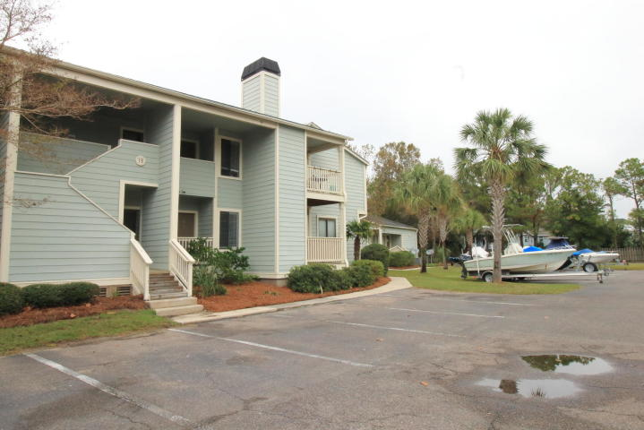
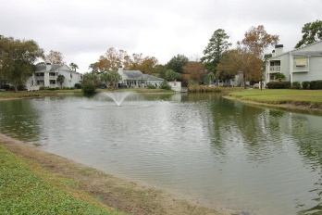
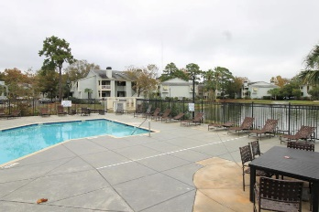
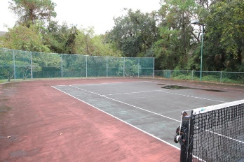
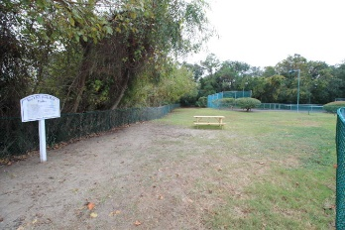
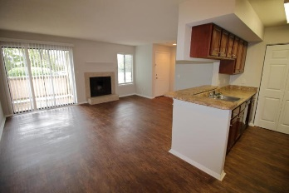
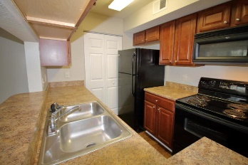
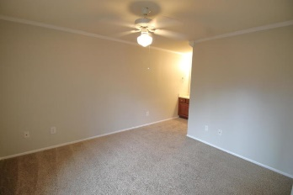
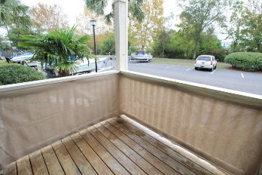
$350 Rental Referral Fee!
1481 Center St #1902
Bay Club Homes ~ Mt Pleasant
MLS# 18028302 ~ $1,395
Charming condominium close to shopping and the beaches. Updated interior, new paint through out and new flooring. Separate laundry room with washer/dryer. Bay club Sea Lofts also has a boat storage in addition to tennis , pool, exercise room, and dog park! If schools or square footage are important please verify. Owner must approval all pets and pet fees.
Miler Properties, Inc.
625 Old Trolley Road
Summerville, SC 29485
(843) 821-1111
www.milerproperties.com

