Slide 1
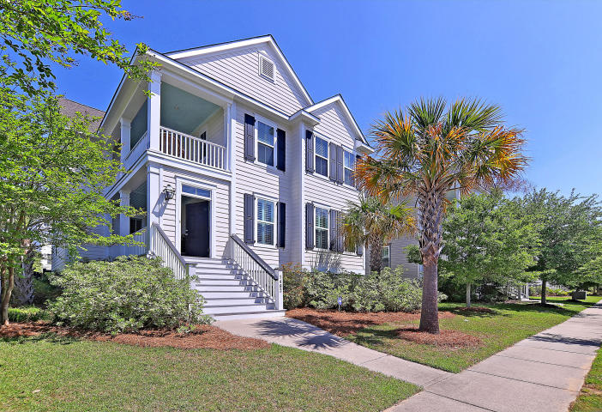
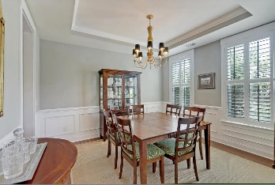
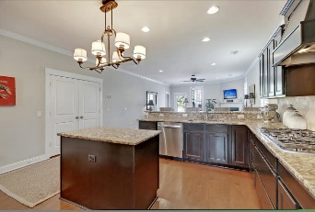
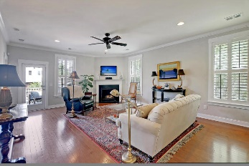
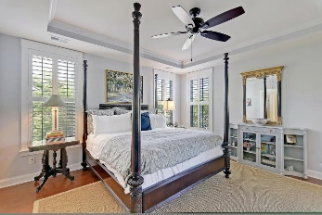
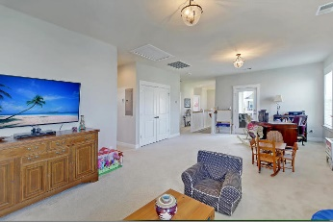
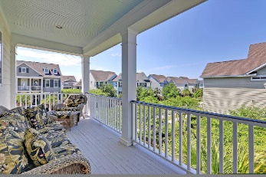
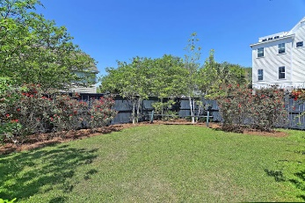
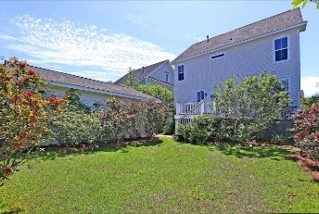
$500 Agent Bonus
1482 Wando Landing Street
Daniel Island
Charleston
MLS# 20010302
$724,500
Welcome home to this meticulously maintained home in Daniel Island, in a fantastic location! Within a one minute walk to the popular pirate ship play ground and Smythe Park! Open floor plan with dual porches. Gourmet kitchen with small island, granite countertops, gas range and backsplash, perfect for entertaining! The open living area comes complete with crown molding, gas fireplace, and plantation shutters. Formal dining room with upgraded chandelier, and half bath complete the floorplan. Downstairs master bedroom with bath ensuite has garden tub, tiled stand up shower, and walk in closet. Upstairs you will find a huge living area, great for playing or entertaining. 3 more bedrooms, 2 baths, and laundry area. Too many amenities to list! Contact for more information!
Make sure you check out the 3d tour! https://my.matterport.com/show/?m=yLmtaVYNWzV
Sean Harrington
(843) 226-9652 | sean@milerproperties.com

