Slide 1

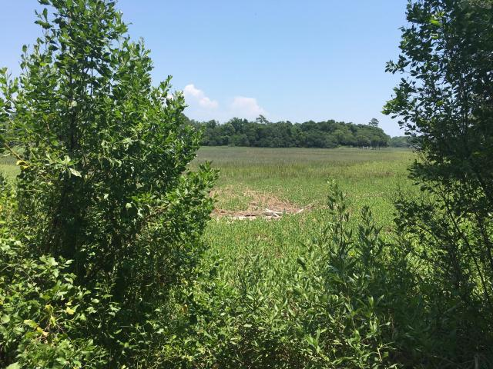

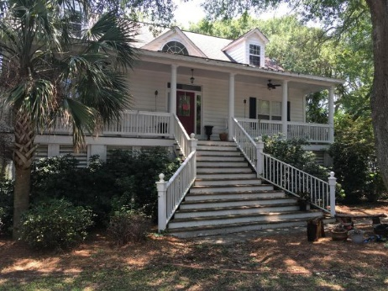
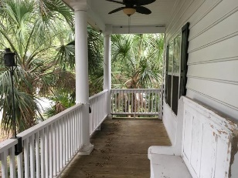
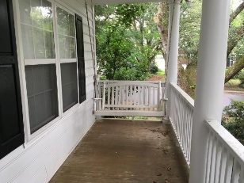
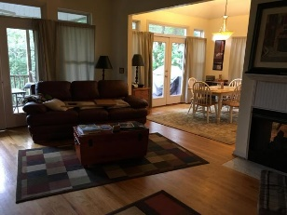
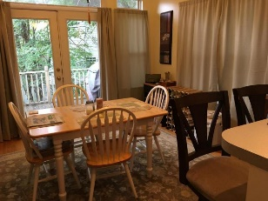
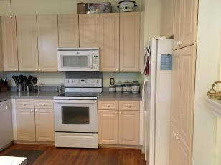
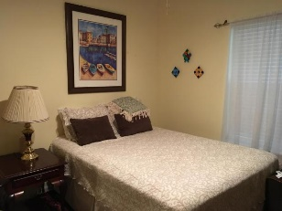
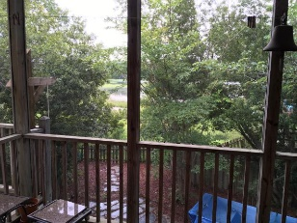
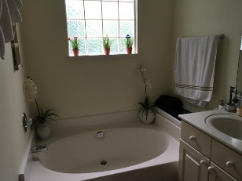
ON THE MARSH
PRICE REDUCED!
1483 Harborsun
Wexford Sound ~ Charleston
MLS# 16014772 ~ $404,950
A wide and comfortable front porch welcomes you to this beautiful lowcountry home. A large living room with expansive views over the marsh, opens up to a dining area, and large kitchen. Two good size guests rooms, and a guest bathroom are adjacent to the hall. The master bedroom is large, and also has views over the marsh. Three decks on the back of the house, one from the master bedroom, one from the dining room, and a screened in porch from the living room for those cool evenings. Underneath the house is a large enclosed garage, with plenty of storage for your cars, boat, surf boards and other toys, as well as your gardening equipment. Outside is a large fenced, well maintained yard, with access to the marsh. Owner is a licensed Real Estate Agent.
Lorraine Hatton
(843) 345-4932
lorrainehatton@hotmail.com
Brand Name Real Estate
4 Carriage Lane Suite 106
Charleston, SC 29407

