Slide 1
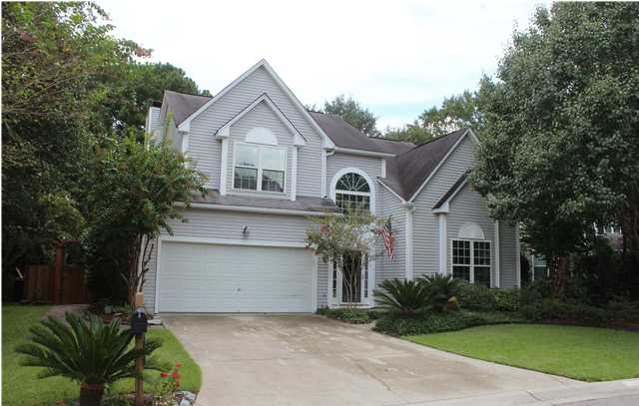
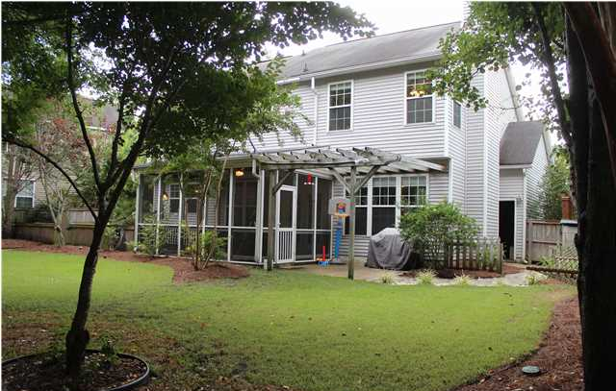
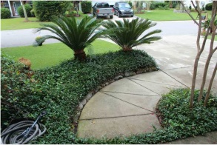
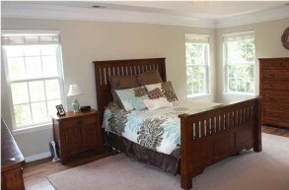
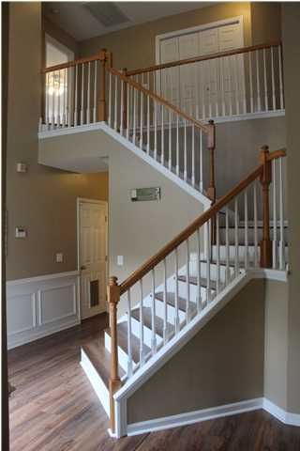
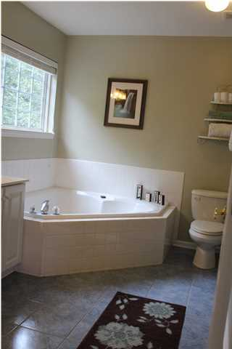
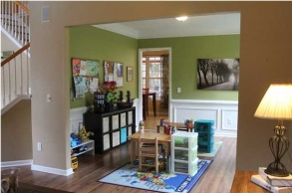
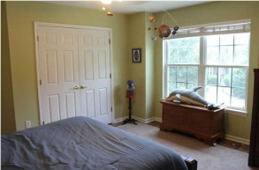
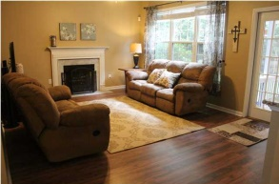
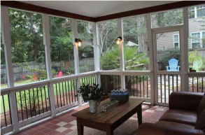
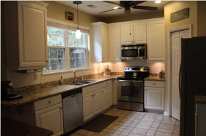
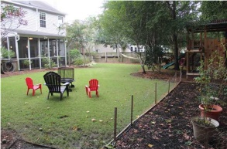


Pristine Dunes West Home
1484 Cypress Pointe Dr
Cypress Pointe @ Dunes West
Mount Pleasant
MLS# 1424122 - $374,500
This home is the one you have been waiting on, but don't wait too long...2012 received a lift with granite countertops throughout, new hardware and sink in downstairs bath, 2500.00 worth of professionally installed blinds throughout the home, RainSoft water system installed, zoysia sod, stone walkway , hardwood laminate throughout, just this year- 7600.00 Trane 15 Seer Air a/c, playset in the private backyard conveys. Truly, a gem of a home.
Robin Crump
(843) 813-5688
Robincrumprealestate@gmail.com
Brand Name Real Estate | 207 East Bay Street Ste 311 | Charleston, SC 29401

